Slide 1

BRITISH CARDIOVASCULAR INTERVENTION SOCIETY
AHP ANNUAL CONFERENCE 2026
Drug Coated Balloons
“Leave Nothing Behind”
Kenny Christian
Band 7 Nurse Practice Educator
Liverpool Heart and Chest Hospital
13–14 July 2026
Birmingham Conference & Events Centre

Slide 2

BRITISH CARDIOVASCULAR INTERVENTION SOCIETY
Declaration of Interests
I have no conflicts of interest to declare.
Join the conversation using #BCISAHP
Notes:
Required by the meeting. Keep ONE of the two statements and delete the other.

Slide 3
DRUG COATED BALLOONS
Objectives
AHP ANNUAL CONFERENCE 2026
Notes:
Use between sections of your talk. Duplicate this slide as needed.

Slide 4

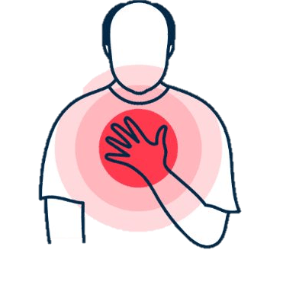
Objectives
BRITISH CARDIOVASCULAR INTERVENTION SOCIETY
What are DCBs?
Lesion Prep &
DCB Deployment
Advantages &
Disadvantages
Cases
Join the conversation using #BCISAHP

Slide 5
The Problem with Permanent Metal
Why DCBs are used?
AHP ANNUAL CONFERENCE 2026
Notes:
Use between sections of your talk. Duplicate this slide as needed.

Slide 6
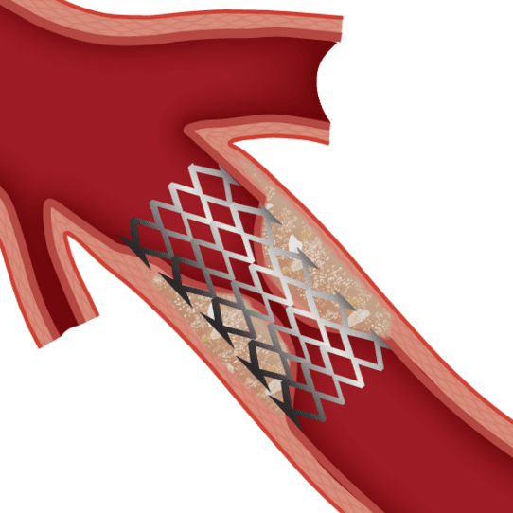
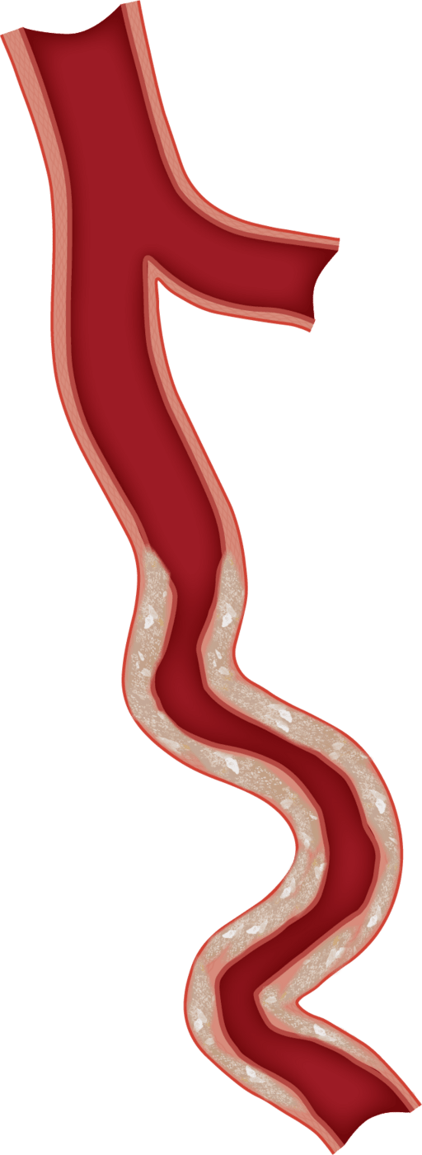
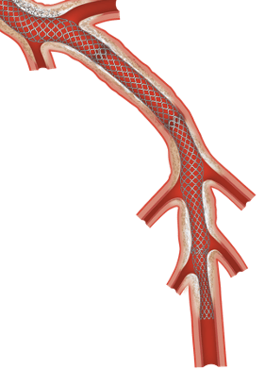
Why DCBs?
BRITISH CARDIOVASCULAR INTERVENTION SOCIETY
Drug Eluting Stents remain the gold standard for PCI
But they come with trade offs:
2% annual rate of
stent failure
Limitations in tortuous & small vessels
Increased bleeding risk
Limiting future surgical options
DCBs emerged as part of “Leave Nothing Behind” strategy
Commercially available since 2006
Madhavan MV et al. J Am Coll Cardiol. 2020;75(6):590-604.
Notes:
First reported successful use in ISR: 2006 (paclitaxel-coated balloon)
Brief and punchy. Give the audience the why before the what. Emphasise this is not about replacing stents — it's about having the right tool for the right patient.

Slide 7
INTRODUCTION
DCBs - A Cage Free Solution
AHP ANNUAL CONFERENCE 2026
Notes:
Use between sections of your talk. Duplicate this slide as needed.

Slide 8
What are Drug Coated Balloons?
BRITISH CARDIOVASCULAR INTERVENTION SOCIETY
The Balloon (Delivery vehicle):
Standard semi-compliant balloon acts as delivery vehicle
Drug Coated Balloons
The Excipient (Carrier):
Coating that binds the drug to the balloon, transfers it to the arterial tissue upon inflation.
The Drug (The package):
Highly lipophilic (fat-soluble) medication that absorbs rapidly into the vessel wall.
Join the conversation using #BCISAHP
Notes:
Drug transfers and stays in the tissue for months, inhibiting cell proliferation.

Slide 9
What dose the data say?
Evidence on DCBs
AHP ANNUAL CONFERENCE 2026
Notes:
Use between sections of your talk. Duplicate this slide as needed.

Slide 10
Evidence on DCBs
BRITISH CARDIOVASCULAR INTERVENTION SOCIETY
TRIAL | LESION TYPE | KEY FINDING
BASKET-SMALL 2 | SVD (<2.75MM) | DCB = DES AT 3 year for MACE
PICCOLETO II | SVD | No difference in clinical outcome at 12 months
PEPCAD II | ISR (Bare Mettle Stents) | DCB superior to uncoated balloons
ISAR – DESIRE 3 | ISR (Drug Eluting Stents) | DCB comparable to DES for DES-ISR
REC- CAGEFREE I | De Novo | DCB did not meet non-inferiority vs DES
BASKET-SMALL 3 (ongoing) | SVD | Data awaits
Join the conversation using #BCISAHP

Slide 11
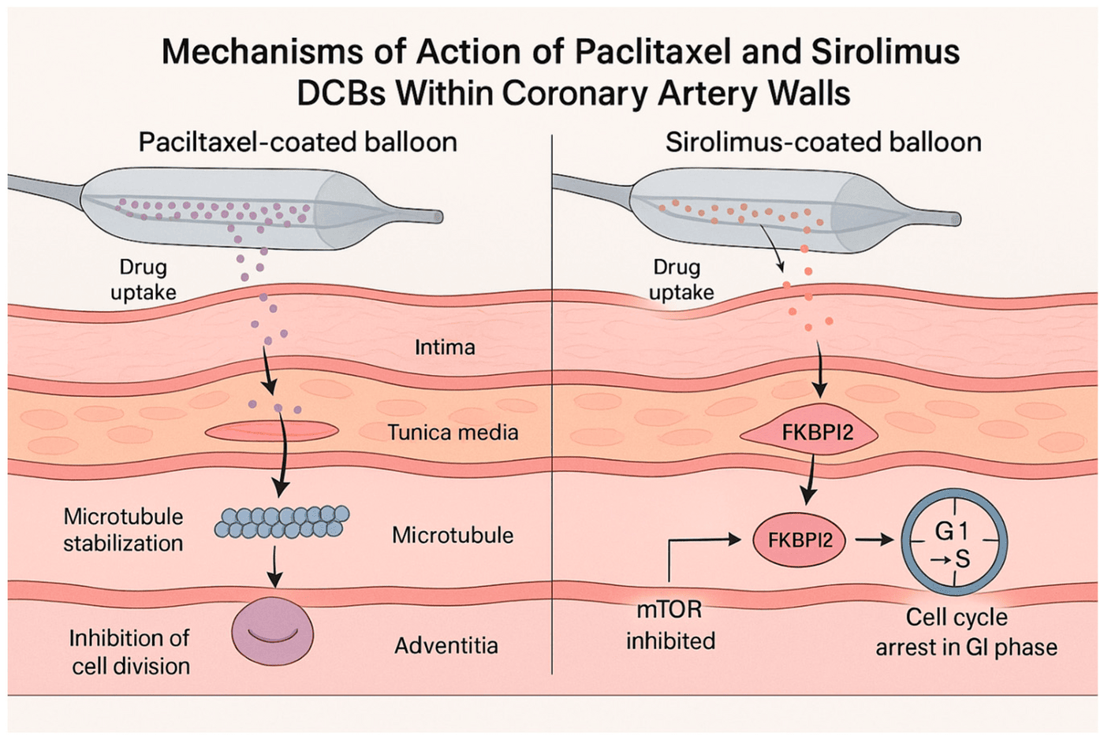
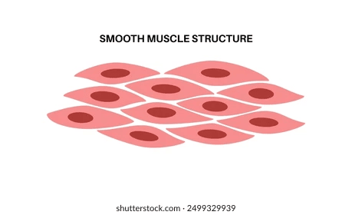
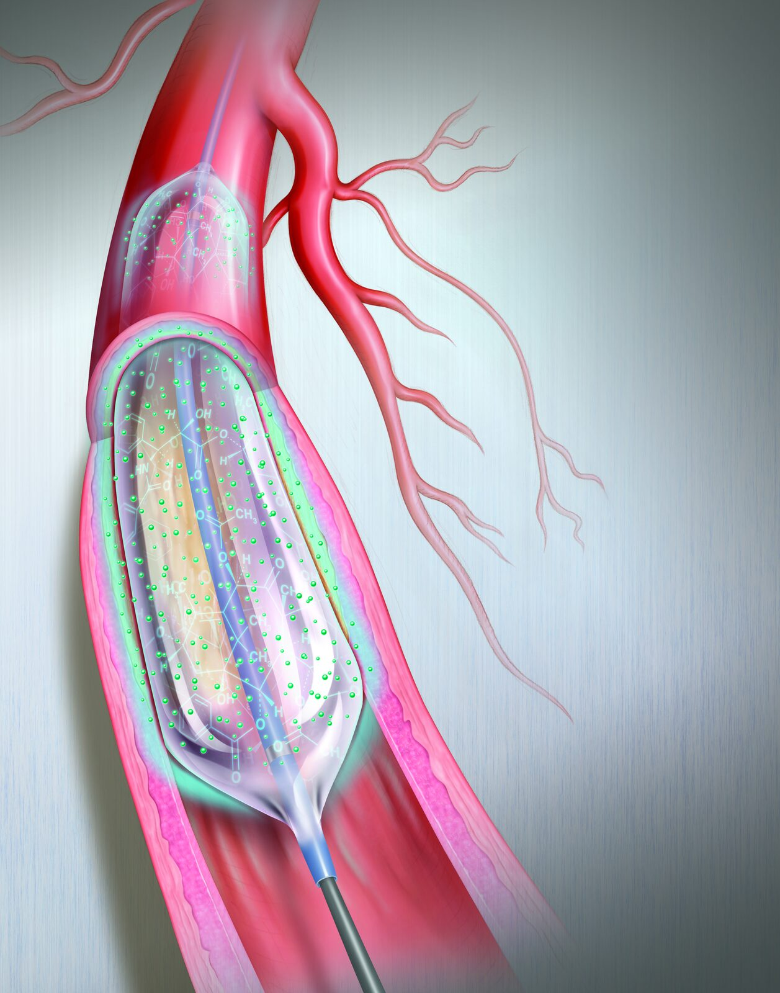
Types of DCBs & MOA
BRITISH CARDIOVASCULAR INTERVENTION SOCIETY
Coated Drug
Mechanism of Action
Depth of
penetration
Paclitaxel
(Historically most common)
Cytotoxic – binding & freezing microtubules, halting cell division
300
micrometers
Sirolimus
(Newer generation)
Cytostatic – blocks protein complex (mTOR) & stops cells from multiplying
250
micrometers
Drug must transfer to the vessel wall – adequate lesion prep is must.
Notes:
Paclitaxel Highly lipophilic, rapid uptake, prolonged retention
Sirolimus (Limus family) Requires advanced excipient for transfer; emerging evidence
Mechanism of Action: Paclitaxel binds to structural proteins called microtubules, freezing them and halting cell division. Sirolimus blocks a specific protein complex (mTOR) to stop cells from entering the DNA synthesis phase

Slide 12
How to use DCB.
Lesion Preparation & DCB Deployment
AHP ANNUAL CONFERENCE 2026
Notes:
Use between sections of your talk. Duplicate this slide as needed.

Slide 13
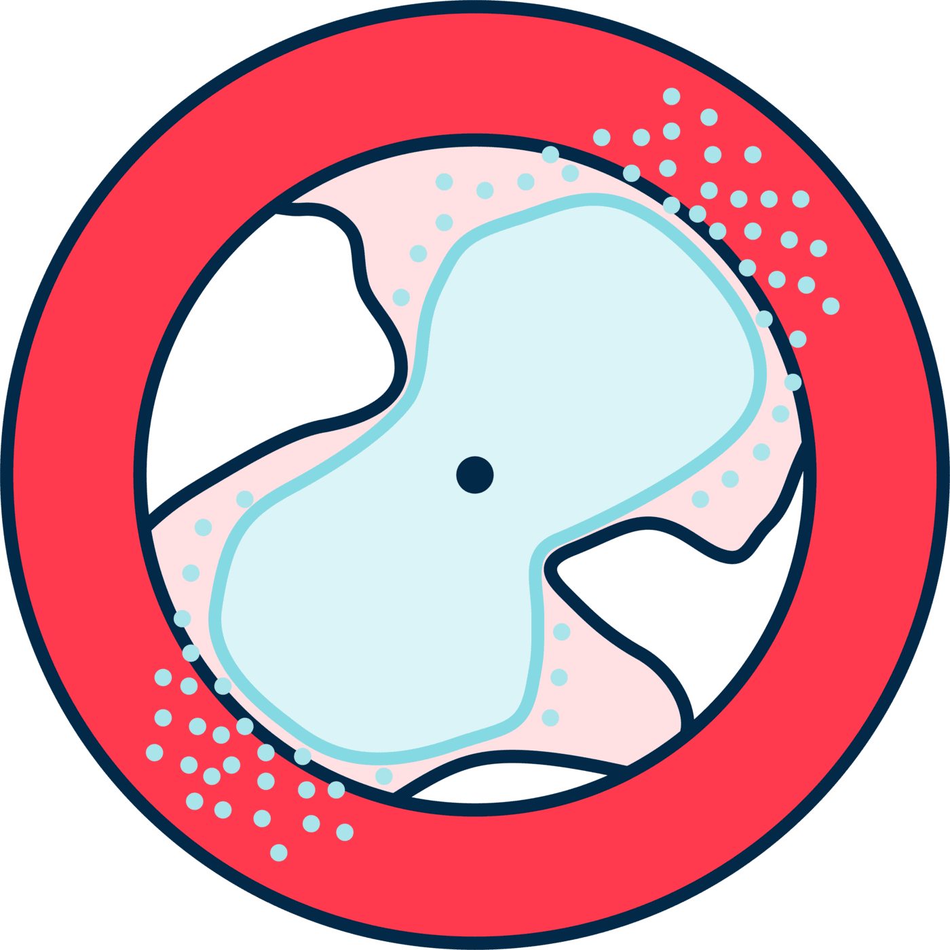
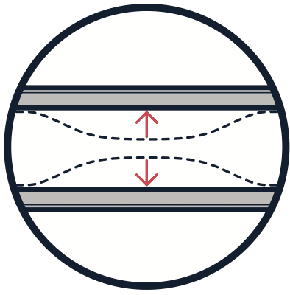
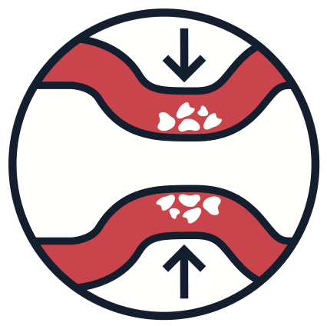
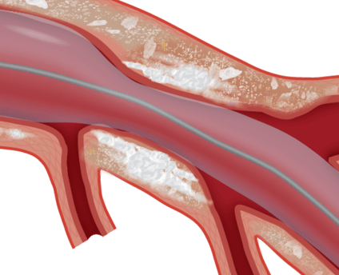
Lesion Preparation
BRITISH CARDIOVASCULAR INTERVENTION SOCIETY
For the drug to work on smooth muscle cells, the plaque must be modified to allow it to get there.
Maximise
acute luminal gain
Minimise
elastic recoil
Facilitate
effective drug absorption
DCBs cannot fix a poorly prepared lesion — unlike a stent which scaffolds the vessel

Slide 14
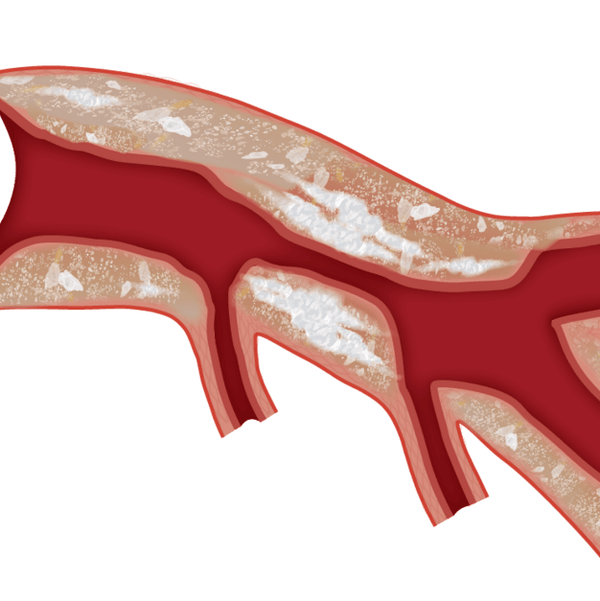
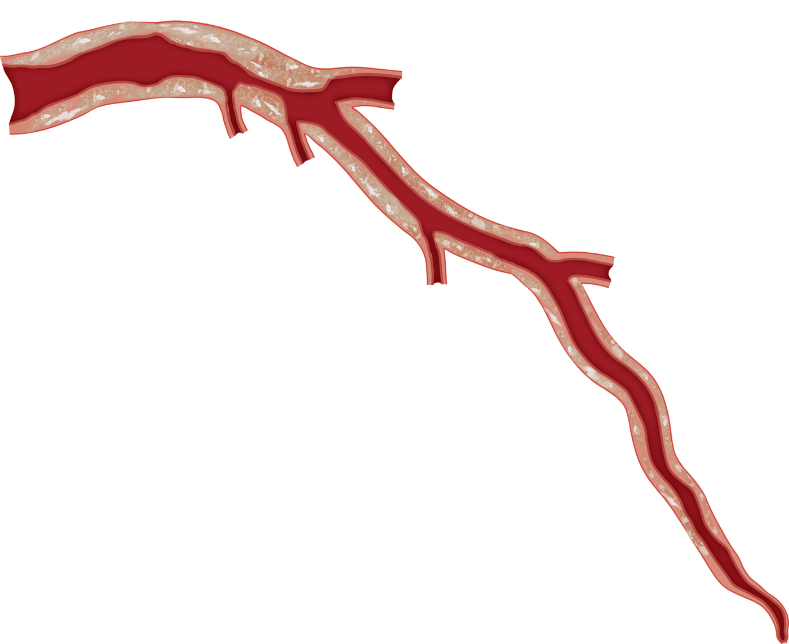
Lesion Preparation
BRITISH CARDIOVASCULAR INTERVENTION SOCIETY
IN-STENT RESTENOSIS
CALCIFIC DISEASE
Fibrotic DISEASE
In-Stent Restenosis
Calcific Lesions
Fibrotic Plaque
Consider IVUS
(Reason for ISR and accurate sizing)
NC Balloons
(Often at high pressure)
Cutting/ Scoring Balloons
(To score/ cut neointimal tissue)
Consider IVUS
(Plaque morphology and accurate sizing)
Rotational Atherectomy
Intra-vascular Lithotripsy
OPN NC Balloons
Consider IVUS
(Plaque morphology and accurate sizing)
Scoring or Cutting Balloons:
Controlled incisions in fibrotic plaque
Improves compliance
Reduces Recoil
Better drug absorption

Slide 15
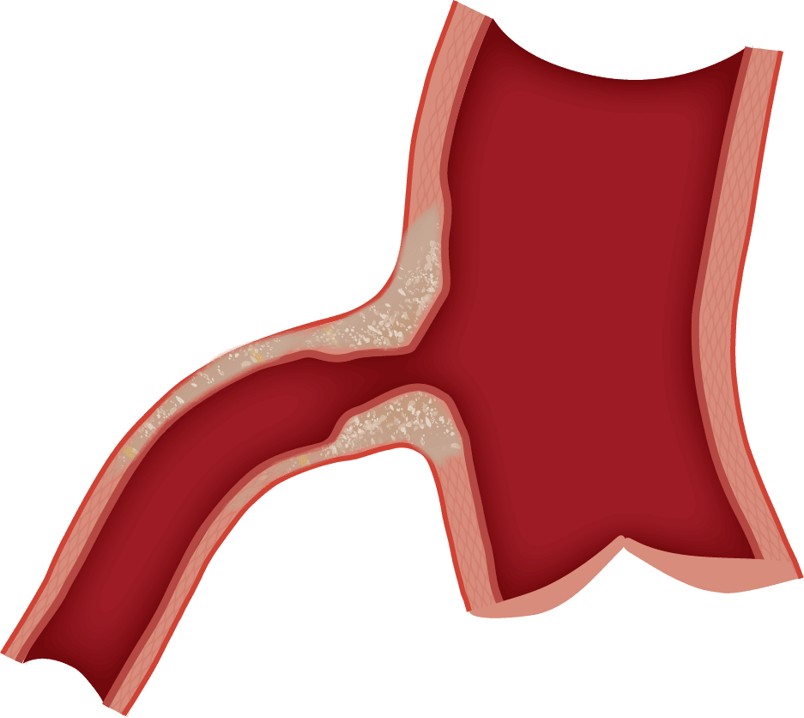
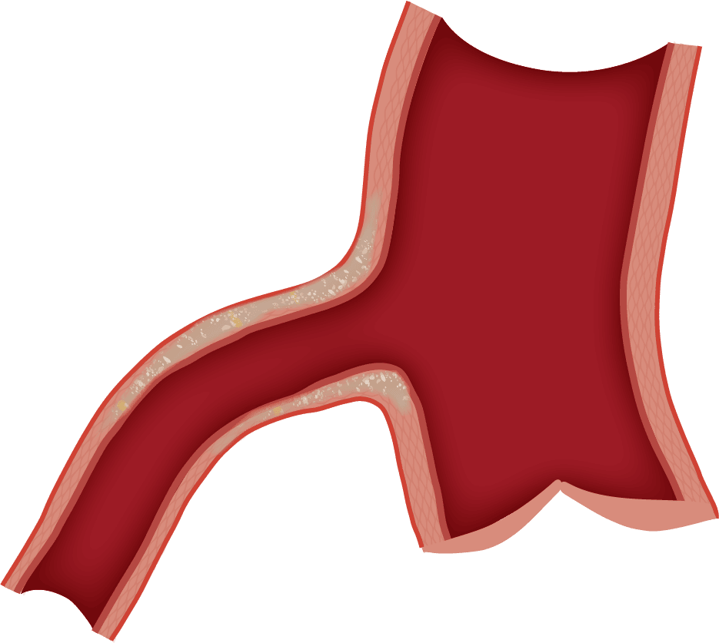
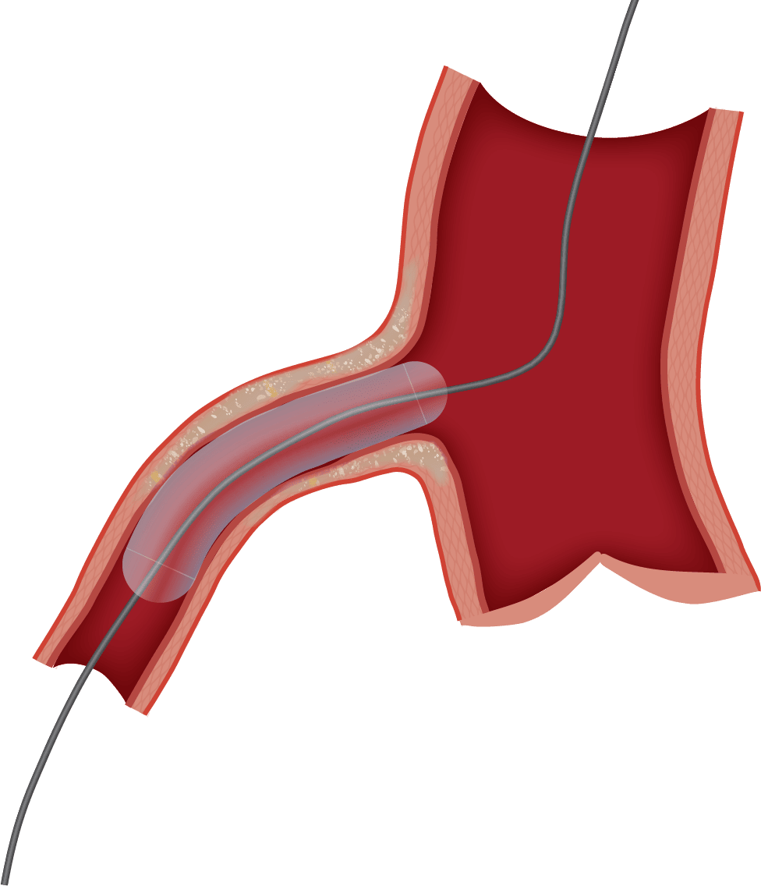
Deployment of DCB
BRITISH CARDIOVASCULAR INTERVENTION SOCIETY
Once lesion is prepped, following criteria must be achieved:
Residual stenosis must be ≤ 30%
(If more – recoil may happen)
TIMI 3 or more Blood Flow
(prolonged inflation with DCB may cause more issues)
Non-flow Limiting Dissection
(Bailout stenting may be required)
Deploying the DCB:
Sizing based on angiogram and intra-coronary imaging
(1:1 vessel to balloon ratio)
One attempt delivery of DCB
(drug loss on re-crossing)
Inflation at nominal pressure for 30 to 60 seconds
(SC Balloons – may cause dissection if not careful)
Join the conversation using #BCISAHP
Notes:
Select correctly sized DCB (1:1 vessel to balloon ratio)
Deliver DCB smoothly to target site — one attempt preferred (drug loss on re-crossing)
Inflate at nominal pressure for 30–60 seconds (full inflation essential)
Remove DCB
Assess final result: angiography ± OCT/IVUS
Bailout stenting if: residual stenosis >30%, flow-limiting dissection, haemodynamic compromise

Slide 16
Team approach
What could AHPs do?
AHP ANNUAL CONFERENCE 2026
Notes:
Use between sections of your talk. Duplicate this slide as needed.

Slide 17



What could AHPs do?
BRITISH CARDIOVASCULAR INTERVENTION SOCIETY
Pre-procedure:
Know your stock
Lesion prep tools
Imaging modality of choice
Support lesion prep & Imaging
ACTs
Careful handling & prep
Best angiographic projections
One shot delivery
Clear communication on inflation time
Timer for 30 to 60 seconds
Intra-procedure:
Things to consider:
Bailout stenting – Dissections
No-reflow and hypotension
Patient comfort
DAPT
Join the conversation using #BCISAHP
Notes:
Title: What Does This Mean For Us in the Cath Lab?
Content:
📋 Pre-procedure:
Confirm DCB device availability and correct sizing
Check lesion prep tools are ready (NC balloon, scoring balloon, Rotablator if needed)
Review imaging modality plan (OCT/IVUS availability)
Patient consent understanding — ensure patient knows "no stent" plan
🏥 Intra-procedure:
Deliver DCB smoothly — minimise handling time outside the body
Set timer for inflation (30–60 sec) — communicate clearly with operator
Document device lot number, size, inflation pressure, and duration
Anticipate bailout stenting — have stent on standby
📝 Post-procedure:
Accurate documentation of DCB use in procedure notes
DAPT counselling — explain shorter duration and importance of compliance
Highlight any bailout stenting and update DAPT plan accordingly
Ensure discharge letter reflects DCB-only strategy
🎤 Speaker Note: This is the most impactful slide for your audience. AHPs want to know: what does this mean for me? Make it practical and team-focused. Your experience as a clinical educator gives you credibility here — share real examples if time allows.

Slide 18
A balanced view at
Advantages vs Disadvantages of DCBs
AHP ANNUAL CONFERENCE 2026
Notes:
Use between sections of your talk. Duplicate this slide as needed.

Slide 19


Advantages of DCBs
BRITISH CARDIOVASCULAR INTERVENTION SOCIETY
The Case For:
Why DCBs are an attractive option?
No permanent implant:
Preserves anatomy & vasomotion, no late stent thrombosis or ISR
Ideal for complex anatomy:
ISR, small vessels, bifurcations
Reduces Bleeding Risk:
Shorter DAPT for HBR pts
Future options:
CABG, Bailout stenting
Join the conversation using #BCISAHP
Notes:
Title: The Case For: Why DCBs Are an Attractive Option
Content:
🚫 No permanent implant — preserves vessel anatomy and vasomotion
🩸 Shorter DAPT duration — major benefit for HBR patients (potentially 1–3 months vs 6–12 months for DES)
🔄 CABG option preserved — no metal to navigate surgically
❌ No late stent thrombosis risk — eliminates a feared DES complication
🔬 Positive vascular remodelling — early re-endothelialisation, plaque regression possible
🏥 Ideal for complex anatomy — small vessels, bifurcations, ISR
💊 Avoids drug polymer long-term — less chronic inflammation than DES
🧑‍⚕️ Single antiplatelet therapy may be feasible in very high bleeding risk (emerging data)

Slide 20

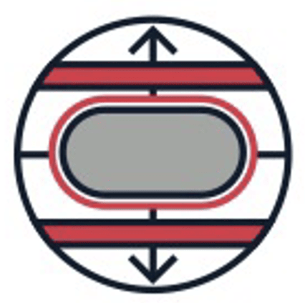

Disadvantages of DCBs
BRITISH CARDIOVASCULAR INTERVENTION SOCIETY
The Case Against:
Being honest about the limitations
No scaffolding:
Acute recoil & dissections may need DES
Lesion prep is critical:
Poor prep = poor outcomes
Transient drug delivery:
One chance to deliver drug,
Re-inflation risks coating loss
More data required:
Limited long-term data on Sirolimus,
ongoing large vessel De Novo lesion studies
Join the conversation using #BCISAHP
Notes:
Title: The Case Against: Being Honest About the Limitations
Content:
⚠️ Evidence gaps — most RCT data is from ISR and SVD; large vessel de novo evidence is weak
⚠️ No scaffolding — cannot manage acute recoil or dissection; bailout stenting required in ~5–15% of cases
⚠️ Lesion preparation is critical — operator-dependent; poor prep = poor outcome
⚠️ Drug delivery is transient — one shot at drug transfer; re-inflation risks coating loss
⚠️ Not equivalent across devices — results from one DCB cannot be extrapolated to another
⚠️ Sirolimus DCBs — limited long-term data compared to paclitaxel
⚠️ REC-CAGEFREE I — DCB failed non-inferiority vs DES in de novo low-risk lesions
⚠️ Cost — DCBs can be more expensive than conventional balloons, similar to DES

Slide 21
BRITISH CARDIOVASCULAR INTERVENTION SOCIETY
Case 1
Simple is (not always) suffice
Join the conversation using #BCISAHP
Notes:
Required by the meeting. Keep ONE of the two statements and delete the other.

Slide 22
Patient Background
BRITISH CARDIOVASCULAR INTERVENTION SOCIETY
72-year-old man
Small NSTEMI
Lateral TWI
Hypokinesia inf-lateral wall
Myelodysplastic syndrome, transfusion dependent, CKD 3, HTN, hyperchol, non-diabetic
Retired fire safety worker
Independent, walks
Cares for wife
Realises he’s got medical issues
Reduce risk of further events
Symptom and QoL improvement
Enable care for his wife
Join the conversation using #BCISAHP
Notes:
Required by the meeting. Keep ONE of the two statements and delete the other.

Slide 23
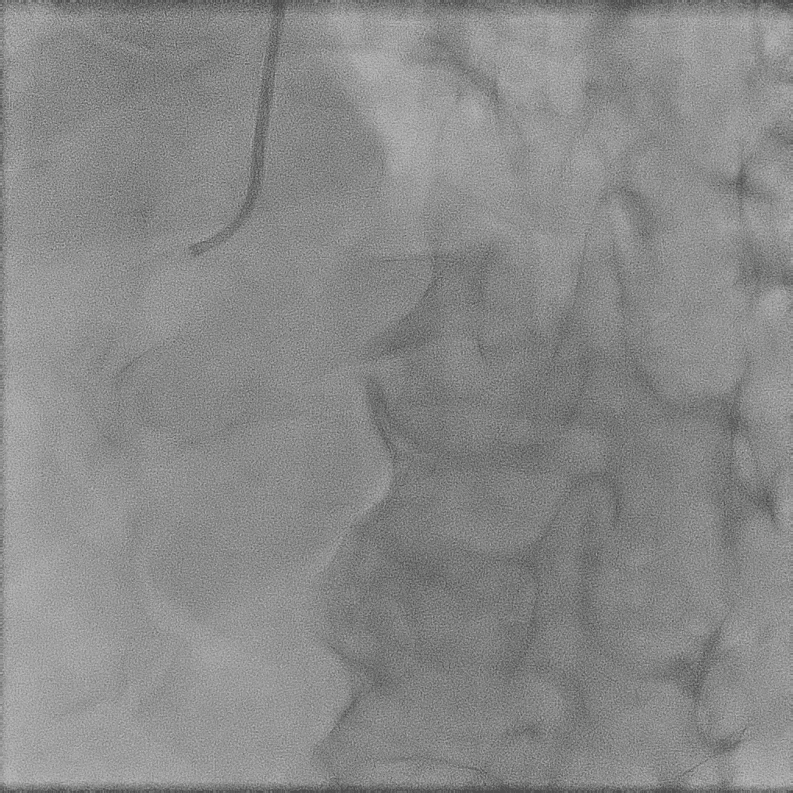
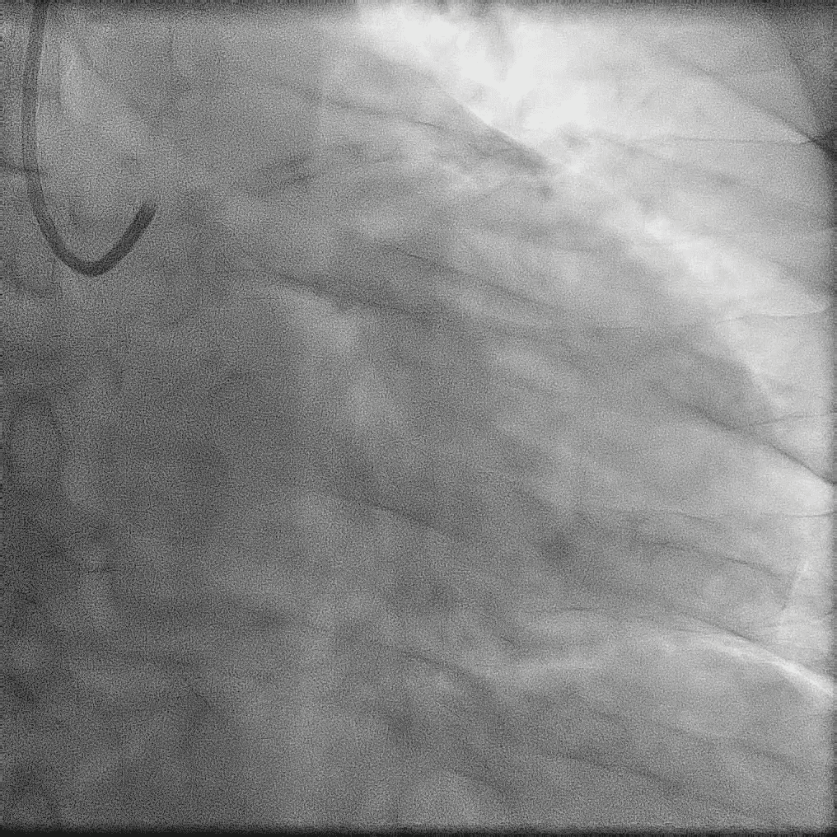
Baseline angiogram
BRITISH CARDIOVASCULAR INTERVENTION SOCIETY
Heavy calcification
Calcific Nodule
Join the conversation using #BCISAHP
Notes:
Required by the meeting. Keep ONE of the two statements and delete the other.

Slide 24
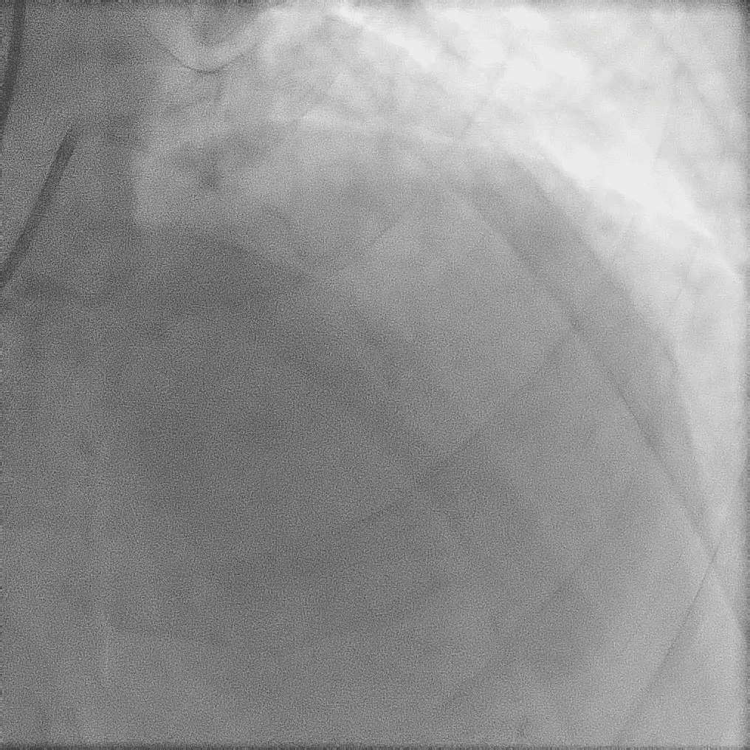
Baseline angiogram
BRITISH CARDIOVASCULAR INTERVENTION SOCIETY
Calcific Nodule
Join the conversation using #BCISAHP
Notes:
Required by the meeting. Keep ONE of the two statements and delete the other.

Slide 25
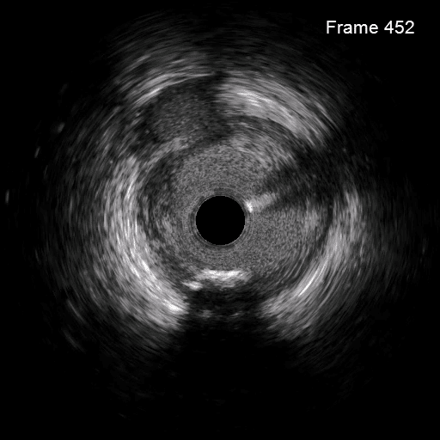
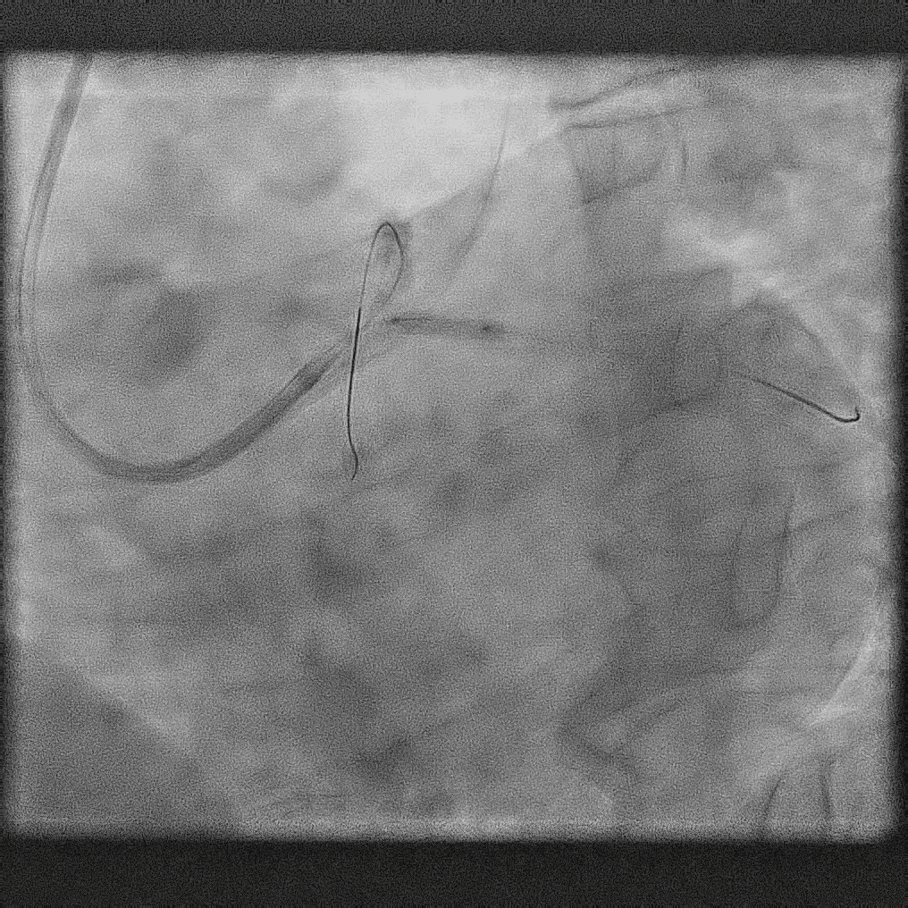
IVUS, Lesion Prep, & DCB
BRITISH CARDIOVASCULAR INTERVENTION SOCIETY
DCB
Join the conversation using #BCISAHP
Notes:
Required by the meeting. Keep ONE of the two statements and delete the other.

Slide 26
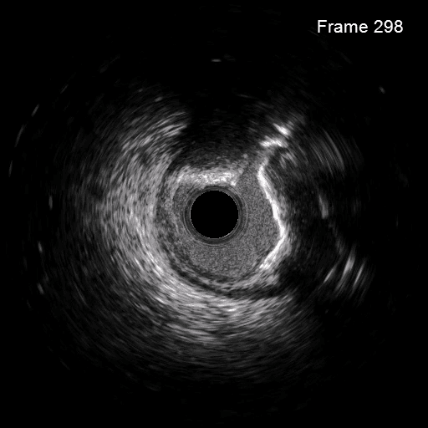
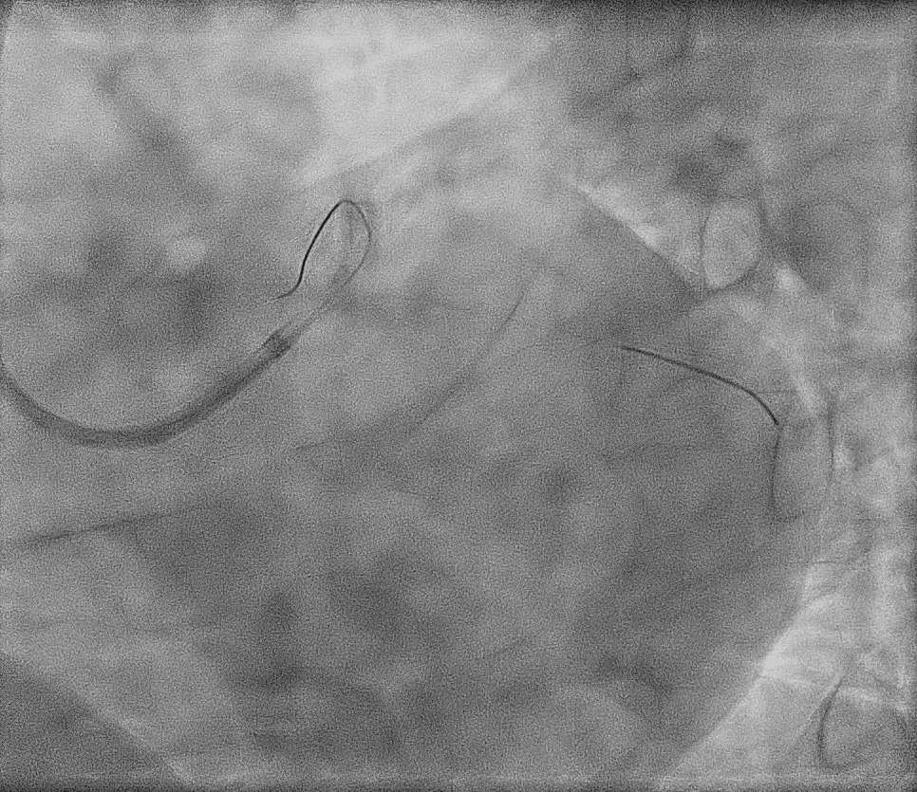
Modified + DCB

Slide 27
Final Angiogram
BRITISH CARDIOVASCULAR INTERVENTION SOCIETY
Good result
< 30% recoil
No dissections
No Hemodynamic compromise
Patient was discharged
Join the conversation using #BCISAHP
Notes:
Required by the meeting. Keep ONE of the two statements and delete the other.

Slide 28
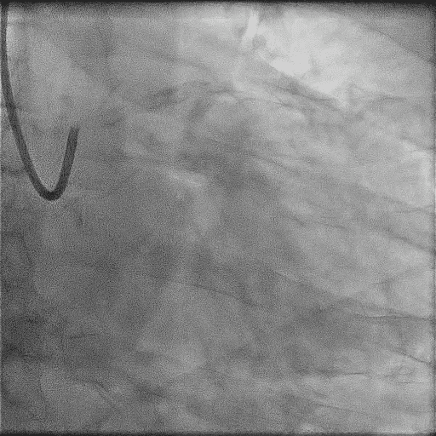
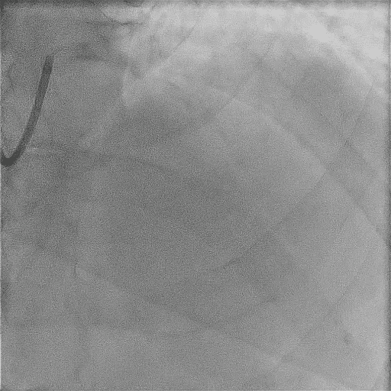
3 Months Later…
BRITISH CARDIOVASCULAR INTERVENTION SOCIETY
Calcific Nodule returns
Join the conversation using #BCISAHP
Notes:
Required by the meeting. Keep ONE of the two statements and delete the other.

Slide 29
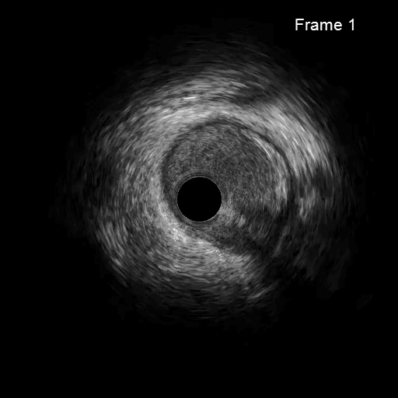
3 Months Later…
BRITISH CARDIOVASCULAR INTERVENTION SOCIETY
Join the conversation using #BCISAHP
Notes:
Required by the meeting. Keep ONE of the two statements and delete the other.

Slide 30
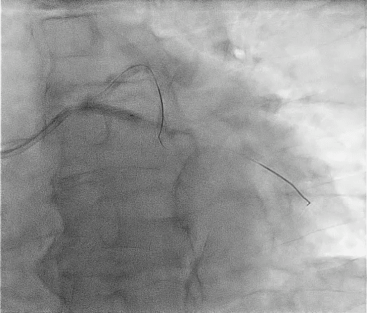
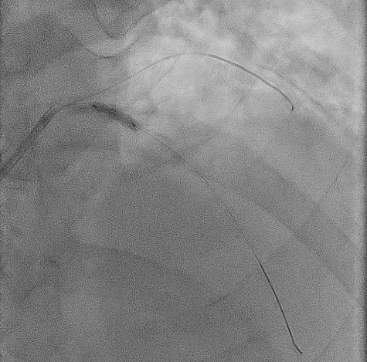
Calcium Mod with IVL in both branches
BRITISH CARDIOVASCULAR INTERVENTION SOCIETY
IVL Balloons
Join the conversation using #BCISAHP
Notes:
Required by the meeting. Keep ONE of the two statements and delete the other.

Slide 31
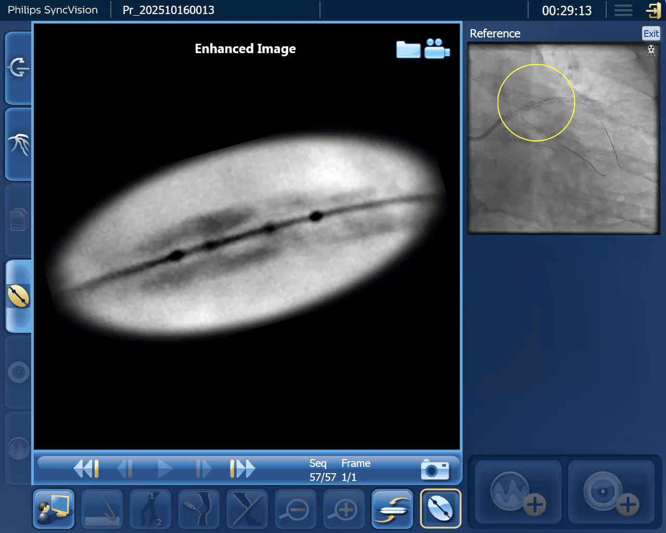
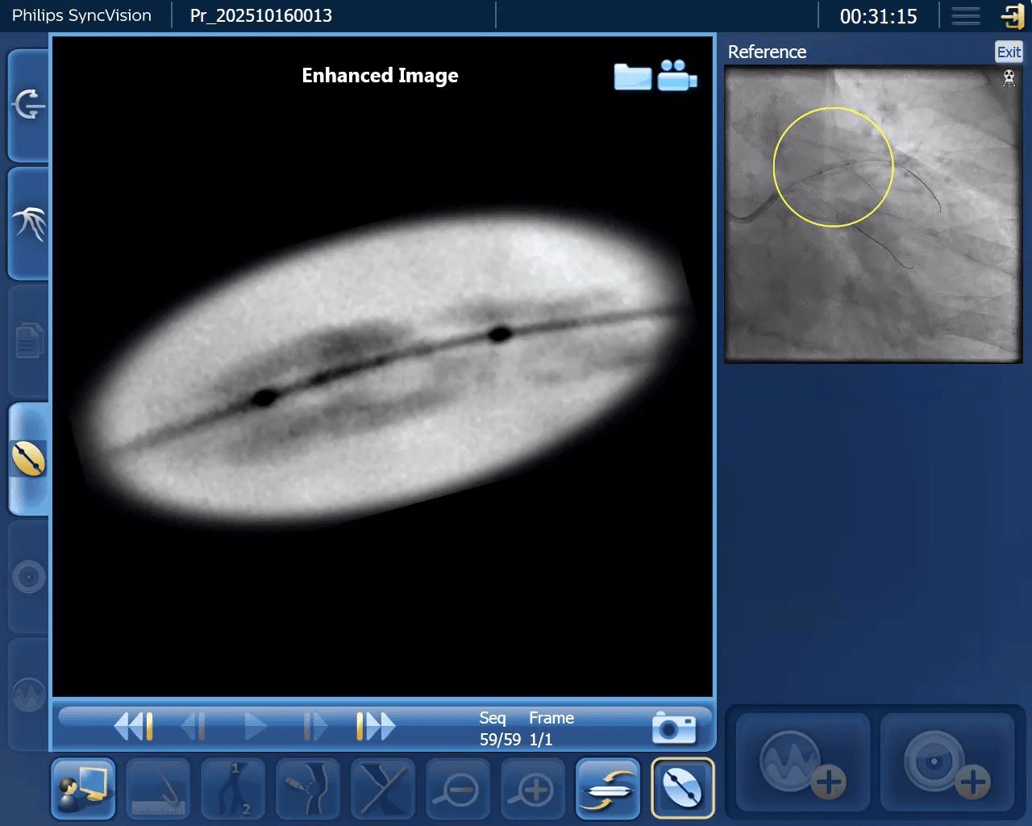








Calcium Mod with IVL in both branches
BRITISH CARDIOVASCULAR INTERVENTION SOCIETY
Emitters on the calcium
Join the conversation using #BCISAHP
Notes:
Required by the meeting. Keep ONE of the two statements and delete the other.

Slide 32
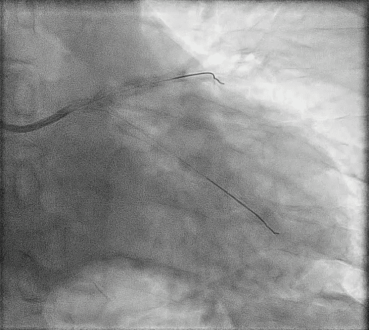
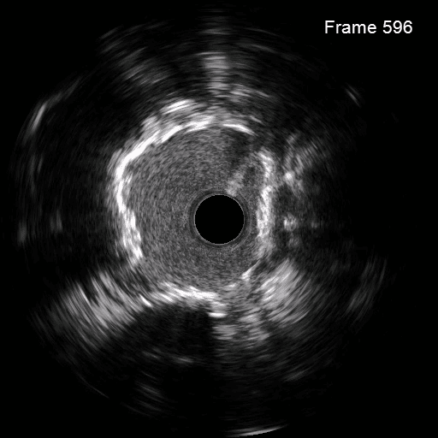
Good prep, DES, and final result
BRITISH CARDIOVASCULAR INTERVENTION SOCIETY
Join the conversation using #BCISAHP
Notes:
Required by the meeting. Keep ONE of the two statements and delete the other.

Slide 33
BRITISH CARDIOVASCULAR INTERVENTION SOCIETY
Case 2
Bifurcation PCI with DCBs
Join the conversation using #BCISAHP
Notes:
Required by the meeting. Keep ONE of the two statements and delete the other.

Slide 34
Patient Background
BRITISH CARDIOVASCULAR INTERVENTION SOCIETY
Troponin 130
ECG lateral T wave inversion
Dyslipidemia
Non-smoker, Normotensive
Normal LV
54-years-old male
Acute coronary syndrome
First presentation
Reduce risk of further events
Symptom and QoL improvement
Join the conversation using #BCISAHP
Notes:
Required by the meeting. Keep ONE of the two statements and delete the other.

Slide 35
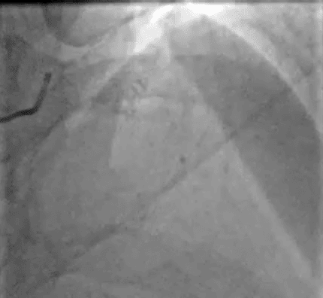
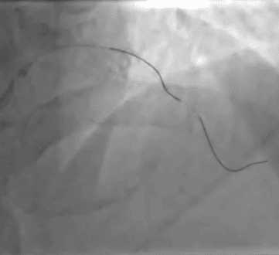
Sever LAD lesion – difficult to wire
BRITISH CARDIOVASCULAR INTERVENTION SOCIETY
Lesion at the bifurcation
Join the conversation using #BCISAHP
Notes:
With no obvious SB lesion

Slide 36
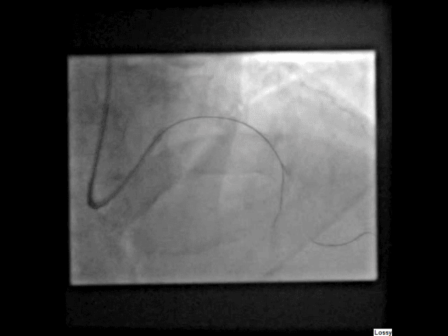
Dual Lumen MC with Gaia NXT 2
BRITISH CARDIOVASCULAR INTERVENTION SOCIETY
Join the conversation using #BCISAHP
Notes:
Multiple wires used to attempt to cross stenosis
Success only achieved with dual lumen catheter and Gaia 2 wire

Slide 37
Case 1 - Simple Bifurcation 1,1,0
Complex Medina 1,1,0 Bifurcation Lesion
Notes:
This is a restenosis that’s challenging to wire. But it’s a challenging because of the angulation and the lesion morphology.
This image is not live, it’s post analysis but shows it’s a tricky one to treat

Slide 38
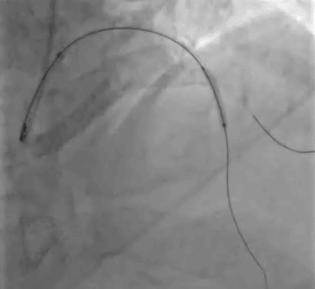
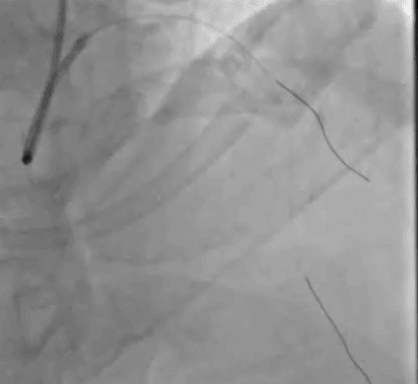
SC Balloon 2.5x15 in LAD
BRITISH CARDIOVASCULAR INTERVENTION SOCIETY
Join the conversation using #BCISAHP
Notes:
Having de-escalated the gaia wire to a workhorse runthrough the stenosis is dilated with a 2.5mm balloon

Slide 39
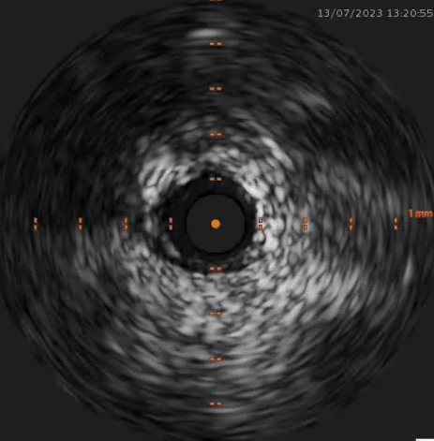
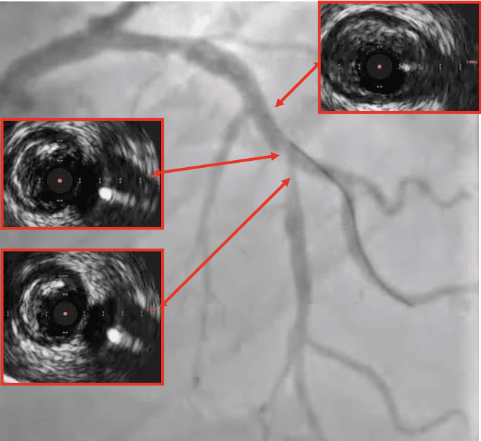
IVUS for lesion morphology & diameter
BRITISH CARDIOVASCULAR INTERVENTION SOCIETY
Dense fibrotic plaque
Join the conversation using #BCISAHP
Notes:
IVUS is then used to define the morphology and landing zones
It shows very dense fibrotic plaque in the LAD – there would be a risk of occluding the diagonal by placing a stent in the LAD

Slide 40
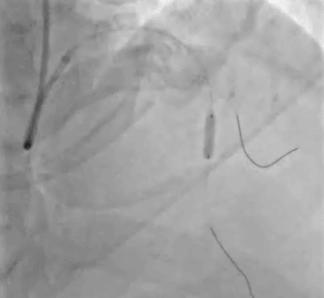
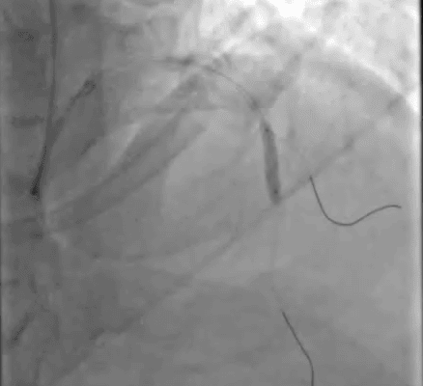
3.0x10 Scoring & 3.5x20 NC balloon
BRITISH CARDIOVASCULAR INTERVENTION SOCIETY
Join the conversation using #BCISAHP
Notes:
We’re not going to go straight for stenting but do some more lesion preparation. By doing sufficient preparation we may not need to stent at all.
The angiosculpt balloon pushes back the fibrotic plaque and permits higher pressure application through the scoring wire around the balloon

Slide 41
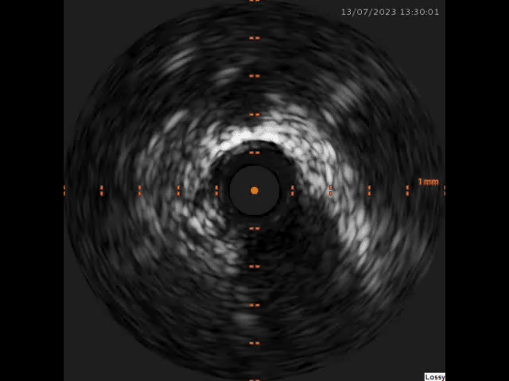
Case 1 - Simple Bifurcation 1,1,0
Evidence of 120⁰ Medial Dissection
Notes:
Angiographic & IVUS post lesion preparation looks optimal but IVUS shows a medial dissection but this is stable and can be left without stent

Slide 42
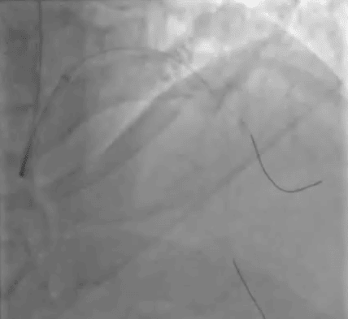
IVUS and angiogram <30% stenosis
BRITISH CARDIOVASCULAR INTERVENTION SOCIETY
Join the conversation using #BCISAHP
Notes:
The angiogram confirms it’s well prepared. We can see the side branch looks clean but we still need to do more work with the balloon around the bifurcation proximally.

Slide 43
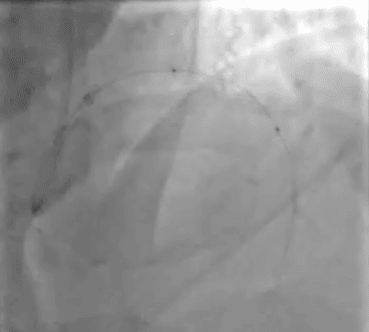
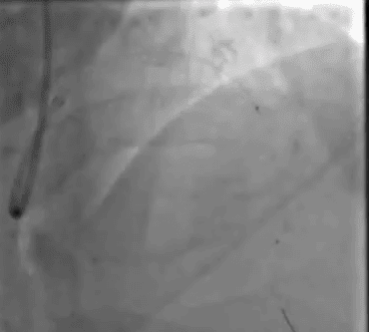
3.0x30 & 3.5x20 DCBs
BRITISH CARDIOVASCULAR INTERVENTION SOCIETY
Join the conversation using #BCISAHP
Notes:
No contrast hold up. So safe to leave without stent Because there’s less than 30% recoil there’s no need to stent this and we can treat with a DCB

Slide 44
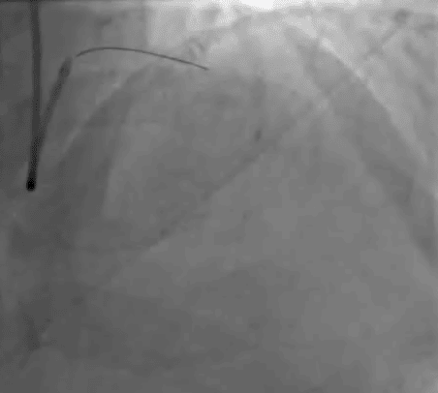
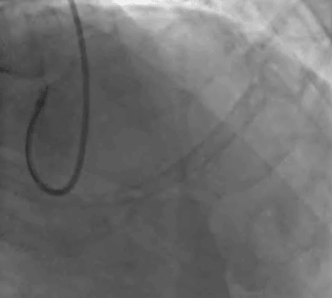
Final views
BRITISH CARDIOVASCULAR INTERVENTION SOCIETY
Join the conversation using #BCISAHP
Notes:
Finish with 2 x DCB and this is the final result.

Slide 45
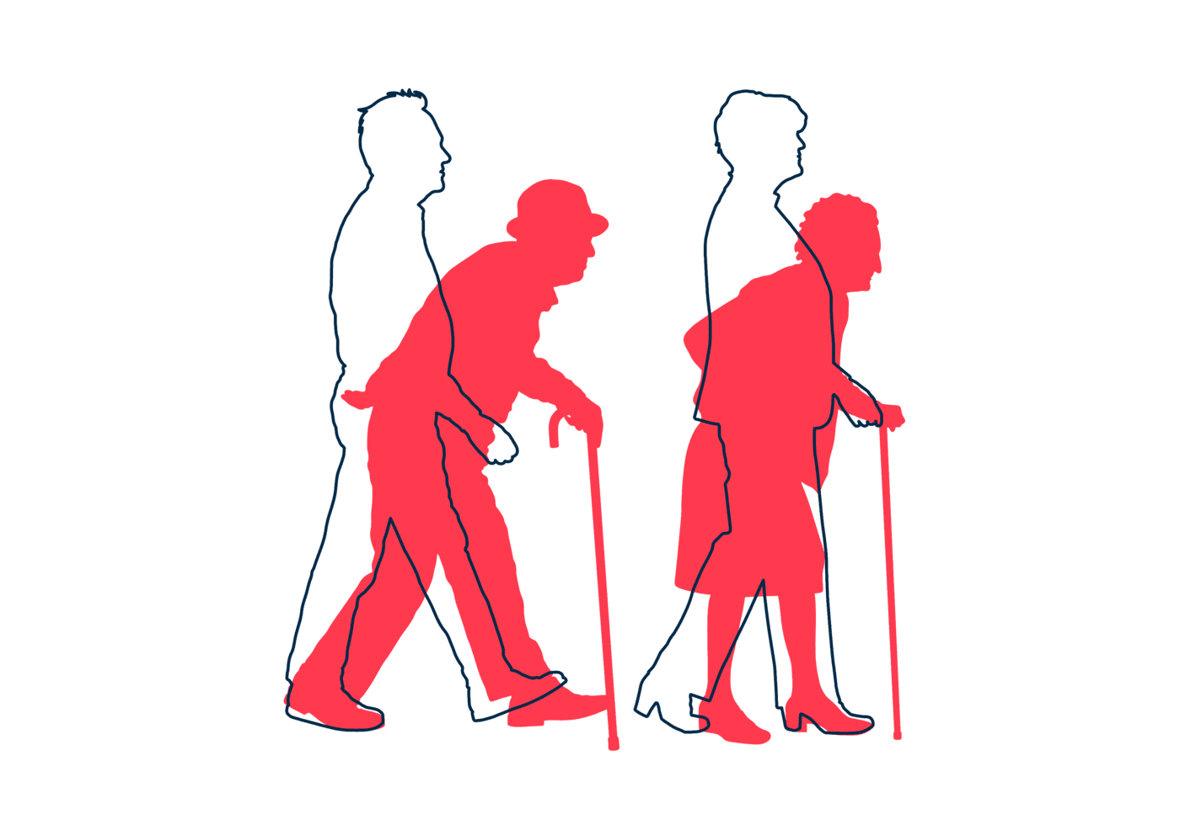
One year later…
BRITISH CARDIOVASCULAR INTERVENTION SOCIETY
Patient is asymptomatic
Join the conversation using #BCISAHP
Notes:
Required by the meeting. Keep ONE of the two statements and delete the other.

Slide 46
What did we discuss?
Summary
AHP ANNUAL CONFERENCE 2026
Notes:
Use between sections of your talk. Duplicate this slide as needed.

Slide 47

Summary
BRITISH CARDIOVASCULAR INTERVENTION SOCIETY
DCBs are reliable option and not a replacement for DES
Imaging & lesion prep is critical for good outcomes
Teamwork is essential for patient safety & efficiency
Existing & upcoming evidence is promising
Join the conversation using #BCISAHP
Notes:
Required by the meeting. Keep ONE of the two statements and delete the other.

Slide 48

References and Acknowledgments
BRITISH CARDIOVASCULAR INTERVENTION SOCIETY
Thanks to Dr John Hung & Dr Andrew Ladwiniec for the cases.
Thanks to OPTIMA for illustrations.
References:
1. Scheller B, et al. Lancet. 2018;392:849–856. (BASKET-SMALL 2)
2. Cortese B, et al. JACC Cardiovasc Interv. 2020. (PICCOLETO II)
3. Unverdorben M, et al. Circulation. 2009;119:2986–2994. (PEPCAD II)
4. Byrne RA, et al. Lancet. 2013;381:461–467. (ISAR-DESIRE 3)
5. Gao C, et al. Lancet. 2024. (REC-CAGEFREE I)
6. BASKET-SMALL 3 Trial (ongoing).
Join the conversation using #BCISAHP

Slide 49

BRITISH CARDIOVASCULAR INTERVENTION SOCIETY
AHP ANNUAL CONFERENCE 2026
Thank you
Kenny Christian
Let’s keep the conversation going on LinkedIn:
Join the conversation using #BCISAHP
Notes:
Closing slide. Add your contact / handle for follow-up questions.

