Slide 1

BRITISH CARDIOVASCULAR INTERVENTION SOCIETY
AHP ANNUAL CONFERENCE 2026
Angio Review Session: Case 1
Alice Amil and Henry Parza · Torbay and South Devon NHS Foundation Trust
13–14 July 2026
Birmingham Conference & Events Centre
Notes:
Say names, delighted to be sharing this case with you.

Slide 2

BRITISH CARDIOVASCULAR INTERVENTION SOCIETY
Declaration of Interests
We have no conflicts of interest to declare.
Join the conversation using #BCISAHP
Notes:
Still no Interests to declare

Slide 3
SECTION
Case Presentation
AHP ANNUAL CONFERENCE 2026
Notes:
HENRY – Introduce presentation

Slide 4
BRITISH CARDIOVASCULAR INTERVENTION SOCIETY
Objectives
Recognise the impact of anxiety on STEMI management
Recognise the importance of communication during emergencies
Understand how human factors influence procedural outcomes
Explore the role of AHPs in maintaining patient safety and wellbeing
Join the conversation using #BCISAHP
Notes:
ALICE: Here are some of the key themes and objectives we’ll be covering during this case presentation: particularly noting the patient needs, communication and most importantly the role of AHPs.

Slide 5
BRITISH CARDIOVASCULAR INTERVENTION SOCIETY
Call the team – there’s a STEMI on the way
66-year-old male
PMH: IDDM, Anxiety. NAFLD gastric reflux, prolapsed lumber intervertebral disc.
Medically managed late presenting STEMI 2015, mild LVSD
Chest pain 16:30
Call for help 16:38
ECG 17: 23
Join the conversation using #BCISAHP
Notes:
HENRY

Slide 6
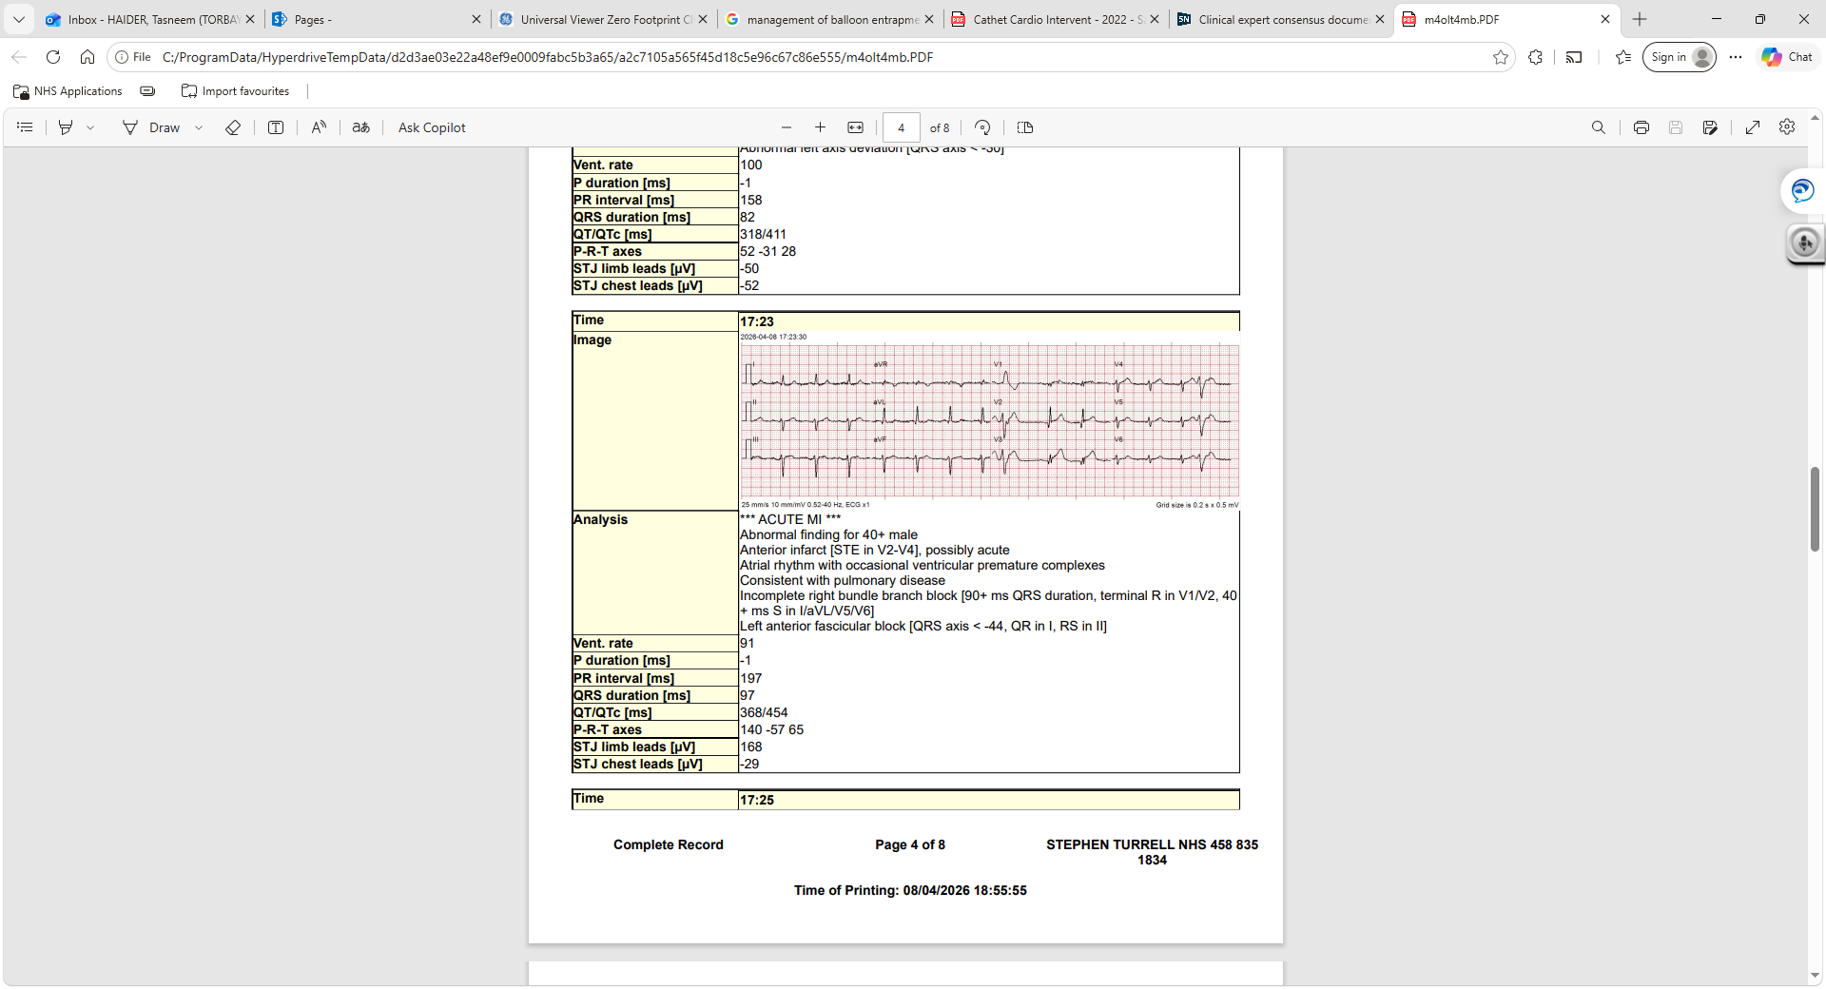
BRITISH CARDIOVASCULAR INTERVENTION SOCIETY
What do you think?
Join the conversation using #BCISAHP
Notes:
HENRY – presenting ECG ….. AUDIENCE Question…..

Slide 7
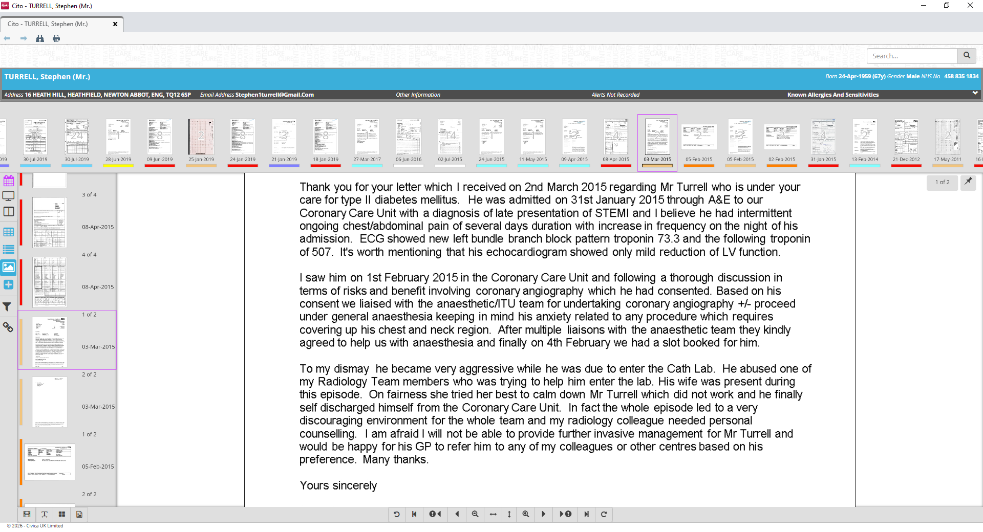
BRITISH CARDIOVASCULAR INTERVENTION SOCIETY
Mr X
Mr X
Join the conversation using #BCISAHP
Notes:
ALICE: Like to share an additional information – this extract from a letter following the patients encounter in 2015…Draw attention to the patient described as aggressive and abusive to staff, and eventually self-discharging without invasive intervention for the late presenting STEMI.

Slide 8
BRITISH CARDIOVASCULAR INTERVENTION SOCIETY
How to proceed here?
Proceed as usual
Decline
Join the conversation using #BCISAHP
Notes:
ALICE: AUDIENCE Q: Knowing this additional info and the presenting complaint….how would you proceed here?
(More than just PCI or not….ideas for approach to patient and the case?)

Slide 9
Optimisation- Set up for success
BRITISH CARDIOVASCULAR INTERVENTION SOCIETY
Pre-case team huddle
Early Anaesthetic Support
Slow and Calm
Reassurance
Join the conversation using #BCISAHP
Notes:
HENRY: Confirm we decided to accept patient for STEMI pathway.

Slide 10
BRITISH CARDIOVASCULAR INTERVENTION SOCIETY
Let the case begin…
Join the conversation using #BCISAHP
Notes:
ALICE: Operator obtained 6F RRA, with the ECG showing an anterior STEMI, we started with a Diagnostic JR4 to shoot the RCA.

Slide 11
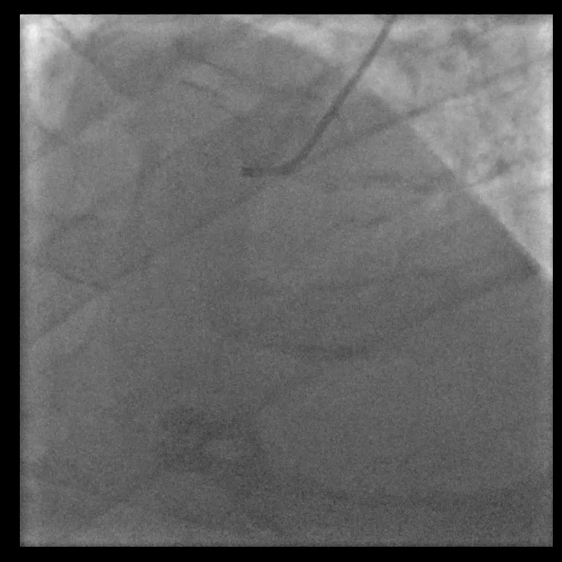
RCA
BRITISH CARDIOVASCULAR INTERVENTION SOCIETY
Join the conversation using #BCISAHP
Notes:
ALICE: As you can see, this will be a left dominant system, RCA is small and with calcific disease.

Slide 12
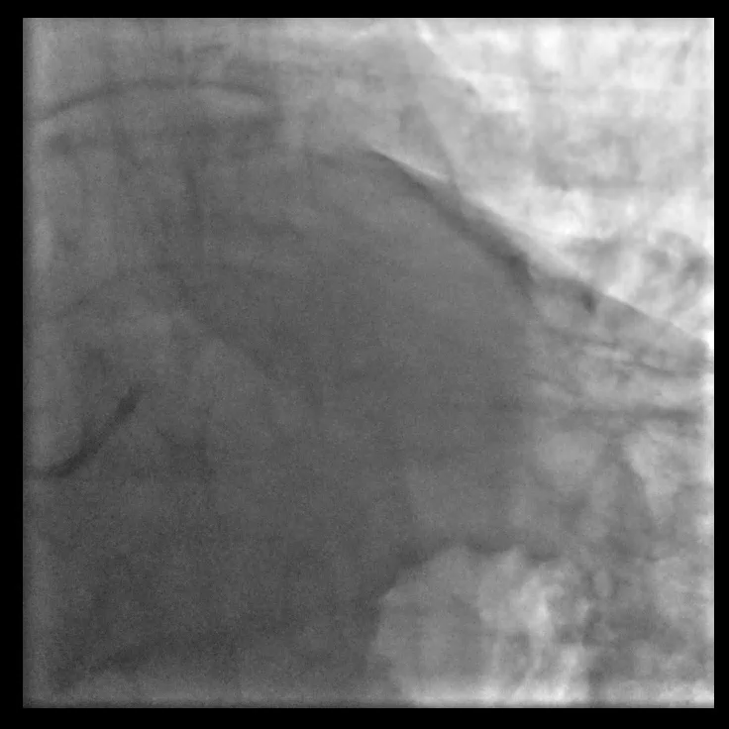
Left
BRITISH CARDIOVASCULAR INTERVENTION SOCIETY
Join the conversation using #BCISAHP
Notes:
ALICE: We then took an EBU3.5 Guide Cath to look at the Left System…here’s the images we were met with…

Slide 13
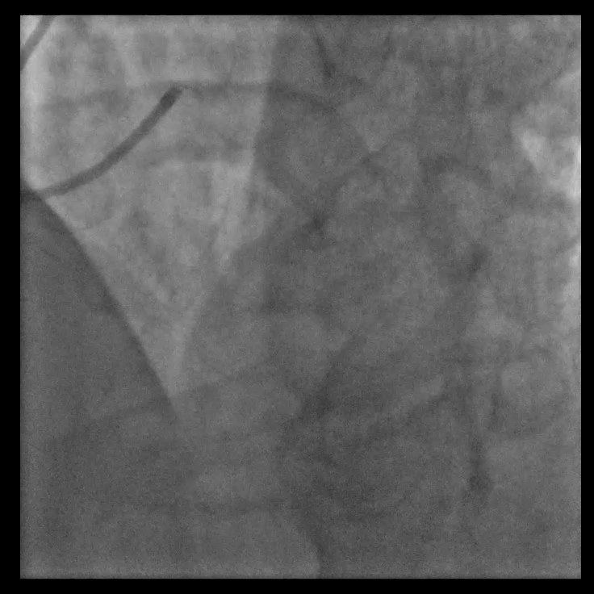
Left
BRITISH CARDIOVASCULAR INTERVENTION SOCIETY
Join the conversation using #BCISAHP
Notes:
ALICE: As you can see the prox - mid LAD, 95-99% stenosed with TIMI 1 flow. The 1st diag also has 95-99% stenosis with TIMI 1 flow.

Slide 14
BRITISH CARDIOVASCULAR INTERVENTION SOCIETY
Audience Question
What’s next?
Join the conversation using #BCISAHP
Notes:
HENRY: What’s next? – Await responses? Prompt: PCI/MDT/Med Management? If needed…

Slide 15
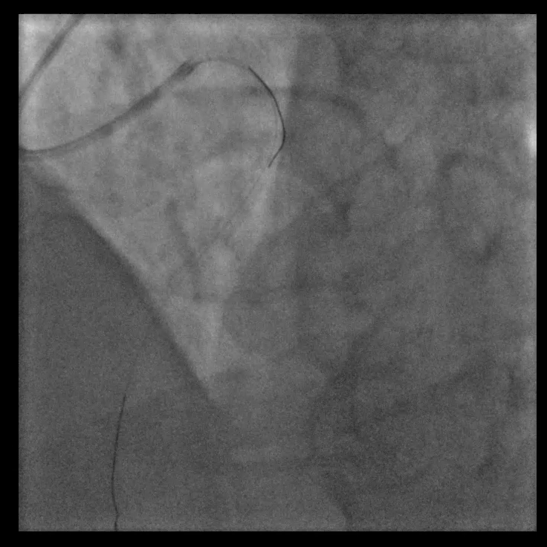
Wire the LAD and D1
BRITISH CARDIOVASCULAR INTERVENTION SOCIETY
Join the conversation using #BCISAHP
Notes:
ALICE: Operator decided to proceed and treat the LAD. Planning a bifurcation PCI approach so took 2 workhorse wires and wired the LAD and 1st Diag.

Slide 16
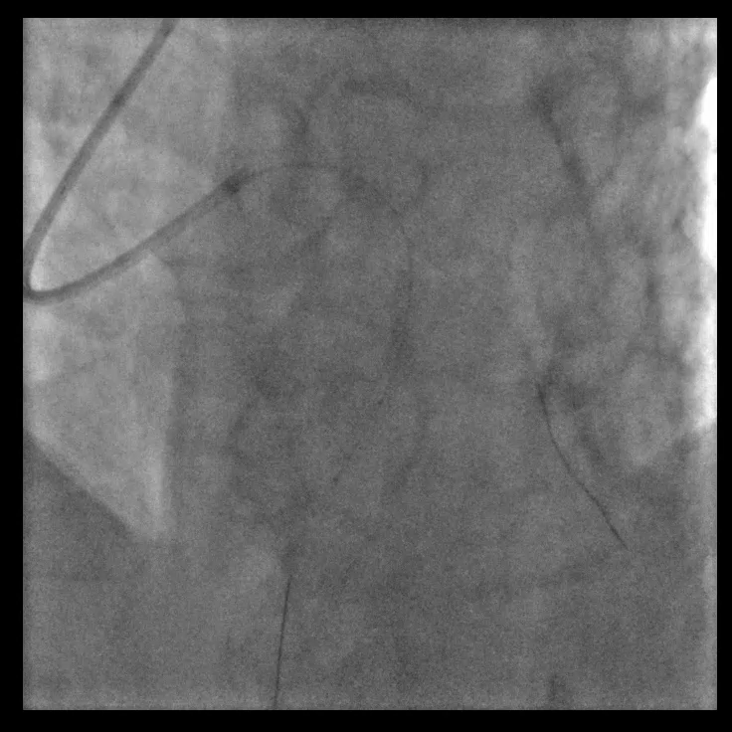
2.5 x 15 NC
BRITISH CARDIOVASCULAR INTERVENTION SOCIETY
Join the conversation using #BCISAHP
Notes:
ALICE: Then pre-dilated with a 2.5 x 15 NC at nominal pressure, 12atm. Multiple inflations.
(NC used commonly used over SC in calcified lesions due to them exerting even force and uniform expansion – this force could crack the calcium. SC compliant balloons conform to the vessel wall when expanding and naturally may over-expand in healthier areas (this is dog-boning) and uneven expansion risks dissections or perforations)

Slide 17
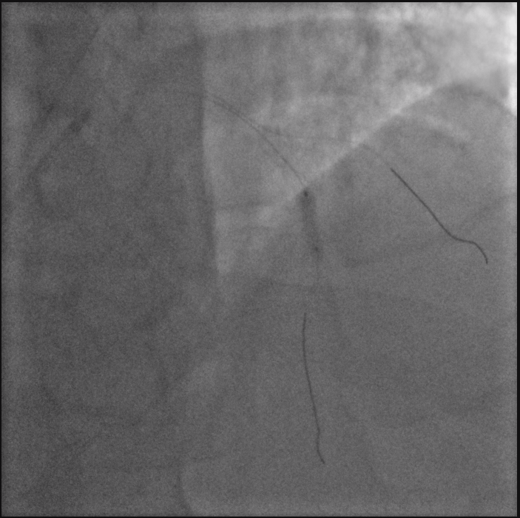
3.0 x 15 NC
BRITISH CARDIOVASCULAR INTERVENTION SOCIETY
Join the conversation using #BCISAHP
Notes:
ALICE: We then attempted to take IVUS, but were unable to pass it beyond the mid-LAD.
So we continued to pre-dilate with a 3.0 NC but as you can see we had some dog-boning across the lesion…
Dog-boning-Balloons tend to over-expand where there is least resistance…tight lesion restricts inflation, so the balloon over expands in the healthier segments/where there is less resistance, giving the appearance of a dog-bone.

Slide 18
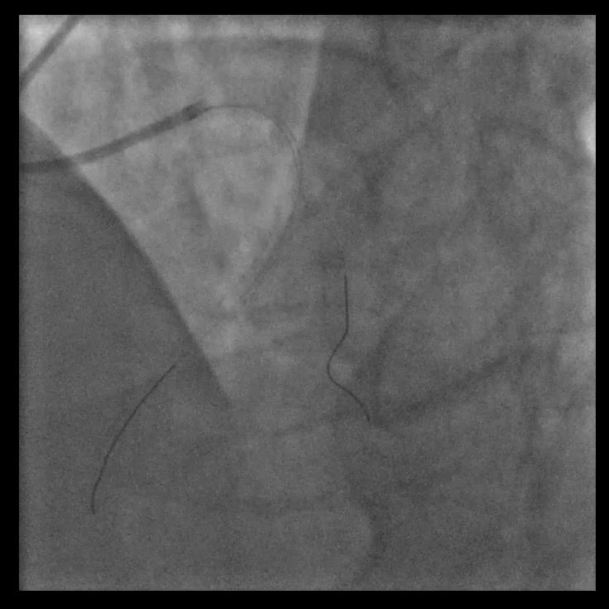
After Pre-Dilatation
BRITISH CARDIOVASCULAR INTERVENTION SOCIETY
Join the conversation using #BCISAHP
Notes:
ALICE: This is how the vessel looked after our pre-dilatation attempts.

Slide 19
BRITISH CARDIOVASCULAR INTERVENTION SOCIETY
Audience Question
What’s next?
Join the conversation using #BCISAHP
Notes:
ALICE/HENRY: (Ideas re: next interventions…?IVL ?More Ballooning? ?Cutting balloons ?Scoring balloons?)

Slide 20
BRITISH CARDIOVASCULAR INTERVENTION SOCIETY
Patient Update
Join the conversation using #BCISAHP
Notes:
HENRY: Update on patient – stable and still tolerating with sedation, not yet requiring a GA.

Slide 21
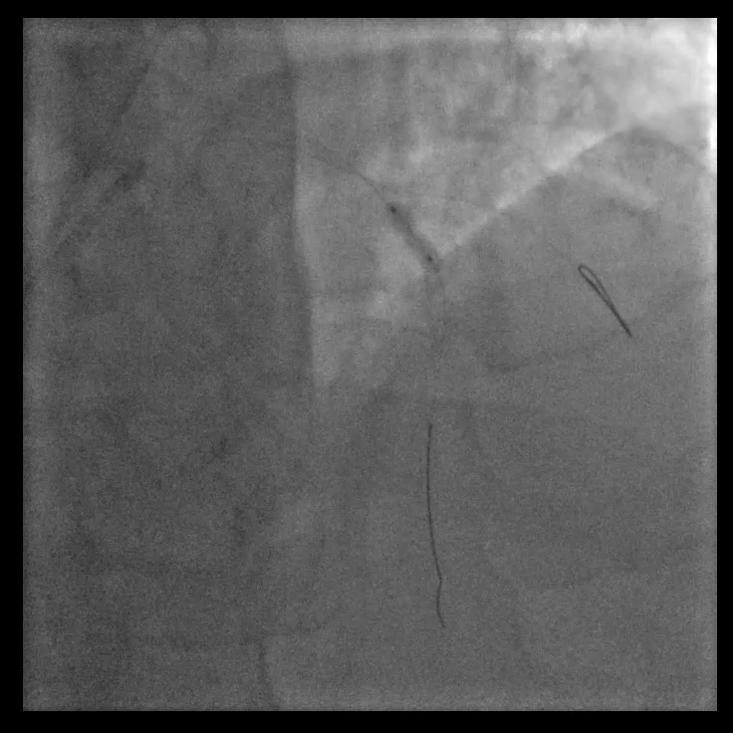
3.5 x 12 IVL
BRITISH CARDIOVASCULAR INTERVENTION SOCIETY
Join the conversation using #BCISAHP
Notes:
ALICE: Thank you for all your ideas….Our Operator opted for IVL and we took a 3.5 x 12 IVL and delivered 40 pulses in the mid-LAD

Slide 22
More agitated
BRITISH CARDIOVASCULAR INTERVENTION SOCIETY
Increasing anterior ST elevation
Chest Pain
Visibly anxious
Join the conversation using #BCISAHP
Notes:
HENRY: At this point, the patient started c/o chest pain, STs were increasing in the anterior leads. The patient was becoming increasingly agitated and visibly anxious.

Slide 23
BRITISH CARDIOVASCULAR INTERVENTION SOCIETY
Audience Question
What do you think has happened?
Join the conversation using #BCISAHP
Notes:
HENRY: What do you think has happened to cause this change in the patients state?

Slide 24
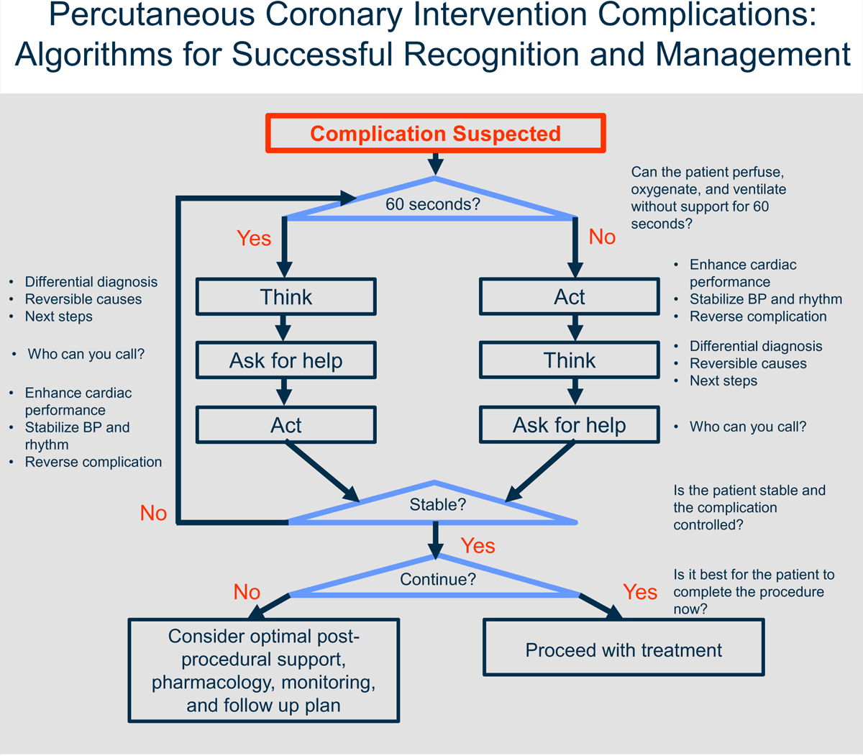
BRITISH CARDIOVASCULAR INTERVENTION SOCIETY
Join the conversation using #BCISAHP
Doll, J.A. et al. (2020) ‘Management of percutaneous coronary intervention complications’, Circulation: Cardiovascular Interventions, 13(6). doi:10.1161/circinterventions.120.008962.
Notes:
HENRY: Recognised complication – reassessed patient, stable…more pain relief, aware something was wrong but still tolerating procedure without GA

Slide 25
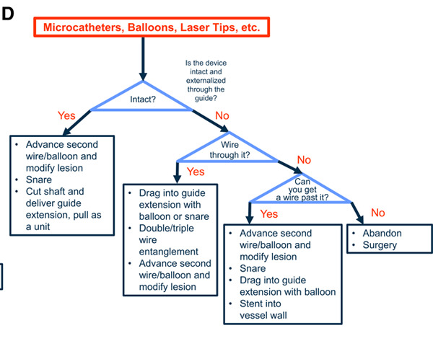
BRITISH CARDIOVASCULAR INTERVENTION SOCIETY
Join the conversation using #BCISAHP
Doll, J.A. et al. (2020) ‘Management of percutaneous coronary intervention complications’, Circulation: Cardiovascular Interventions, 13(6). doi:10.1161/circinterventions.120.008962.
Notes:
ALICE: Operator quickly realised the IVL balloon was entrapped…he was unable to advance or withdraw the balloon – it was indeed stuck within the calcium in the LAD. And he shifted his mind to the algorithm for attempting retrieval of entrapped devices.

Slide 26
BRITISH CARDIOVASCULAR INTERVENTION SOCIETY
Join the conversation using #BCISAHP
Doll, J.A. et al. (2020) ‘Management of percutaneous coronary intervention complications’, Circulation: Cardiovascular Interventions, 13(6). doi:10.1161/circinterventions.120.008962.
Notes:
ALICE: Our first step in attempted retrieval was to use the Sion Blue from the 1st Diag to parallel wire across the trapped balloon. (RUN next)

Slide 27
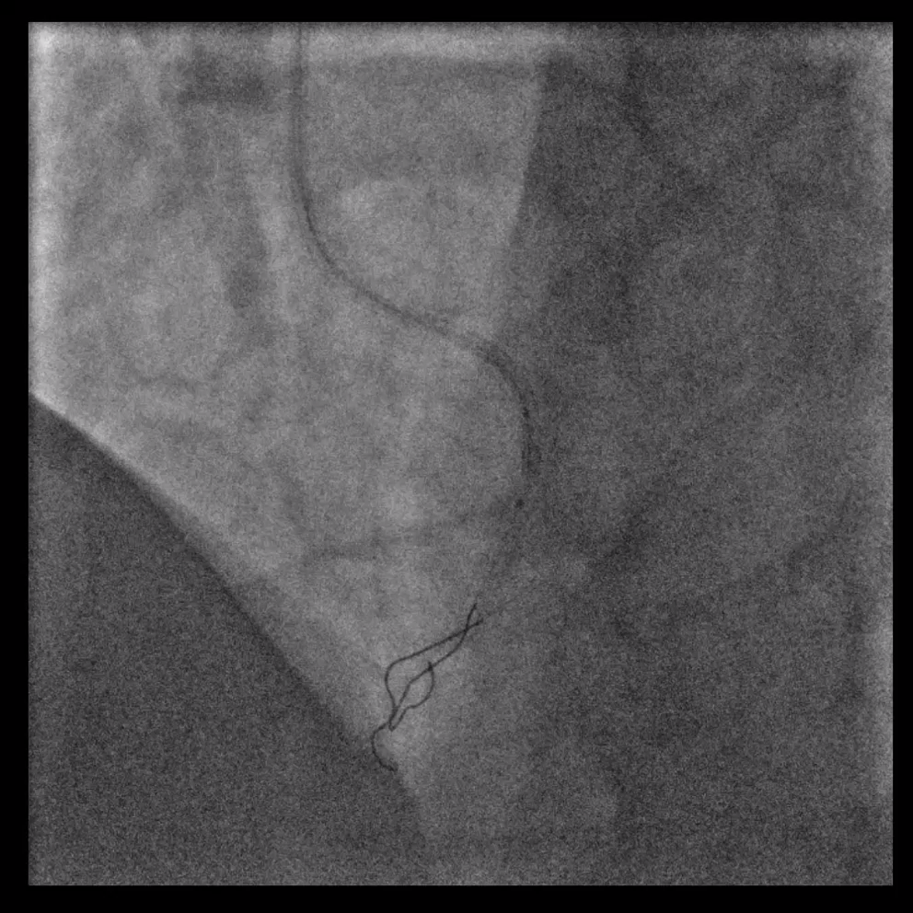
Parallel wire
BRITISH CARDIOVASCULAR INTERVENTION SOCIETY
Join the conversation using #BCISAHP
Notes:
ALICE: You can see both wires in the LAD…

Slide 28
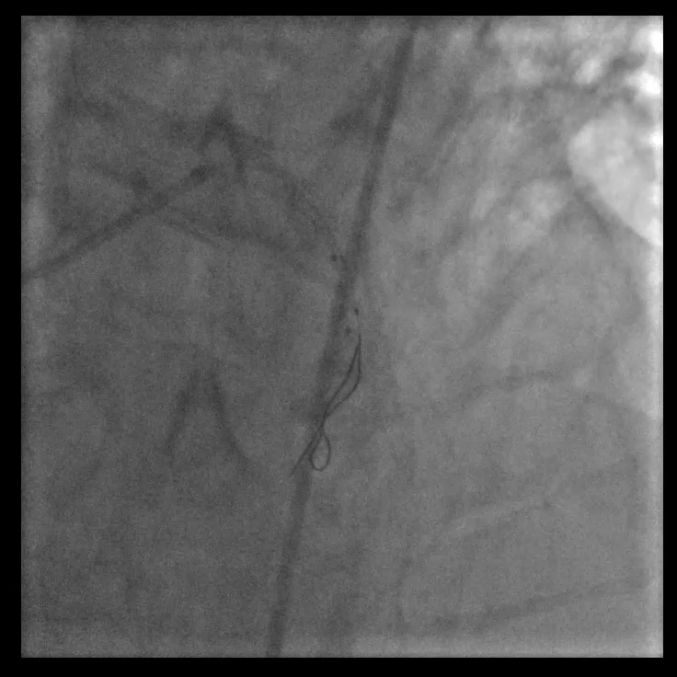
Parallel wire ballooning
BRITISH CARDIOVASCULAR INTERVENTION SOCIETY
Join the conversation using #BCISAHP
Notes:
ALICE: Whilst locating a snare, we attempted to balloon the segment where the balloon was entrapped, with a balloon on the parallel wire.

Slide 29
BRITISH CARDIOVASCULAR INTERVENTION SOCIETY
Join the conversation using #BCISAHP
Doll, J.A. et al. (2020) ‘Management of percutaneous coronary intervention complications’, Circulation: Cardiovascular Interventions, 13(6). doi:10.1161/circinterventions.120.008962.
Notes:
ALICE: The next step was to advance the guide cath and attempt a deep engagement and a gentle pulling approach.
The operator took a trapping balloon within the guide cath to trap the shaft of the IVL balloon and pull as a unit. A few attempts of this manoeuvre was made… before the shaft of the balloon unfortunately snapped within the guide catheter….we lost wire positions at this point…

Slide 30
BRITISH CARDIOVASCULAR INTERVENTION SOCIETY
Audience Question
What would you be expecting next?
Join the conversation using #BCISAHP
Notes:
Audience question – What would your thinking be at this point? What would you be anticipating next? (YES absolutely – the operator gained 6F RFA under US guidance.

Slide 31
BRITISH CARDIOVASCULAR INTERVENTION SOCIETY
Change in dynamic
Maintaining effective communication is as important as technical skill
Join the conversation using #BCISAHP
Notes:
HENRY: At this point the patient was becoming panicked…moving a lot on the table, increasingly anxious and agitated decision was made with the patient to start the GA at this point. Change in environment – more people entered, importance of communication.

Slide 32
BRITISH CARDIOVASCULAR INTERVENTION SOCIETY
Join the conversation using #BCISAHP
Doll, J.A. et al. (2020) ‘Management of percutaneous coronary intervention complications’, Circulation: Cardiovascular Interventions, 13(6). doi:10.1161/circinterventions.120.008962.
Notes:
ALICE: As the GA is being started, as the scrub nurse, myself and the operator were discussing the next steps…

Slide 33
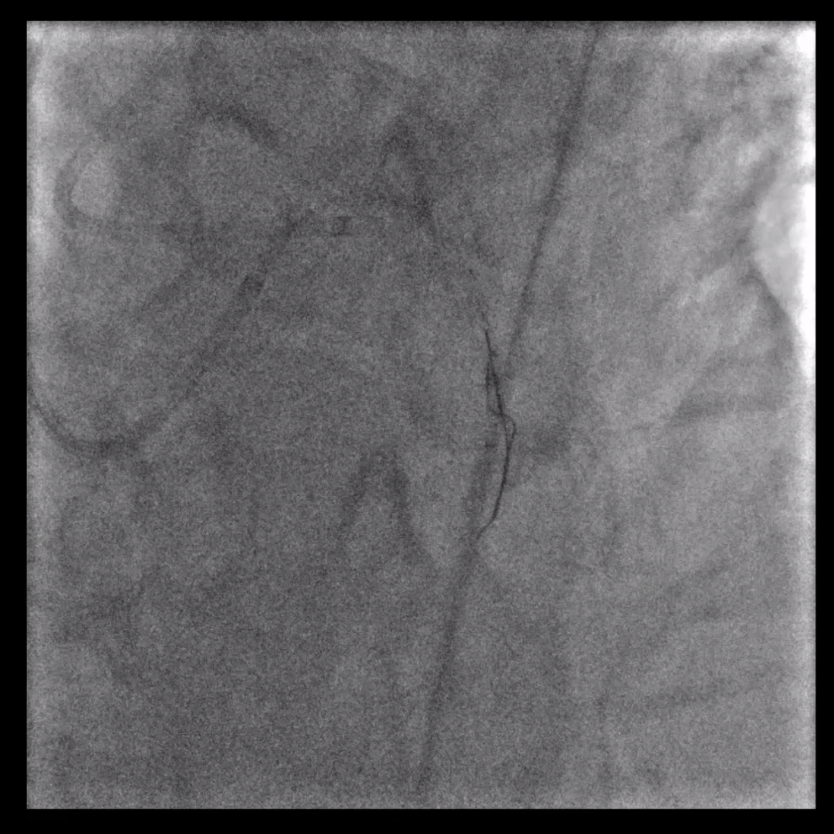
Entanglement Attempt
BRITISH CARDIOVASCULAR INTERVENTION SOCIETY
Join the conversation using #BCISAHP
Notes:
ALICE: The operator re-parallel wired with a Microcatheter & Pilot50 and a Sion Blue. We attempted entanglement using wire wrapping but were unsuccessful. As you can see the wires come back without any impact on the entrapped balloon.

Slide 34
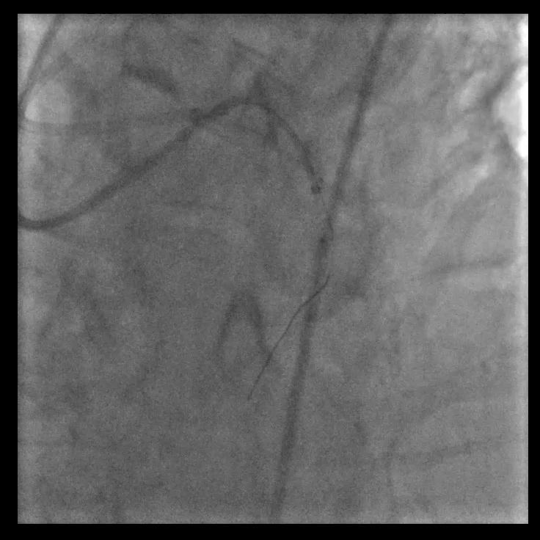
RFA Guide Extension
BRITISH CARDIOVASCULAR INTERVENTION SOCIETY
Join the conversation using #BCISAHP
Notes:
ALICE: Using the RFA, the operator re-wired - then attempted to further pre-dilate & modify the lesion around the trapped balloon… using a SC 1.25, 1.5 and then a 2.0 NC but were still unable to retrieve.

Slide 35
BRITISH CARDIOVASCULAR INTERVENTION SOCIETY
AHP Input
Second Circulating Nurse
Additional Consultant Support
Anticipating kit
Join the conversation using #BCISAHP
Notes:
HENRY: Found the only snare….too short…

Slide 36
BRITISH CARDIOVASCULAR INTERVENTION SOCIETY
Join the conversation using #BCISAHP
Doll, J.A. et al. (2020) ‘Management of percutaneous coronary intervention complications’, Circulation: Cardiovascular Interventions, 13(6). doi:10.1161/circinterventions.120.008962.
Notes:
ALICE: The operator was transparent with the team, that we had exhausted all options available to us at Torbay- he’d followed the recommended bailout options and what we had available… no longer a bailout-able in our centre….

Slide 37
BRITISH CARDIOVASCULAR INTERVENTION SOCIETY
Audience Question
What conversations would be happening at this point?
Join the conversation using #BCISAHP
Notes:
ALICE: What things would we be discussing with our operators as AHPs at this point??
Operator recognised patient was having ongoing anterior STEMI, unable to retrieve IVL
Operator called the cardiac surgeons at nearest tertiary centre, pt accepted for surgery.
Before inserting the balloon pump, the operator felt it was important to attempt to restore some flow to the LAD
Wired the lesion (unsure if sub-intimal/intimal at this point)
Ballooned alongside the entrapped balloon
(RUN) Restored TIMI 2 flow to LAD and Diagonals

Slide 38
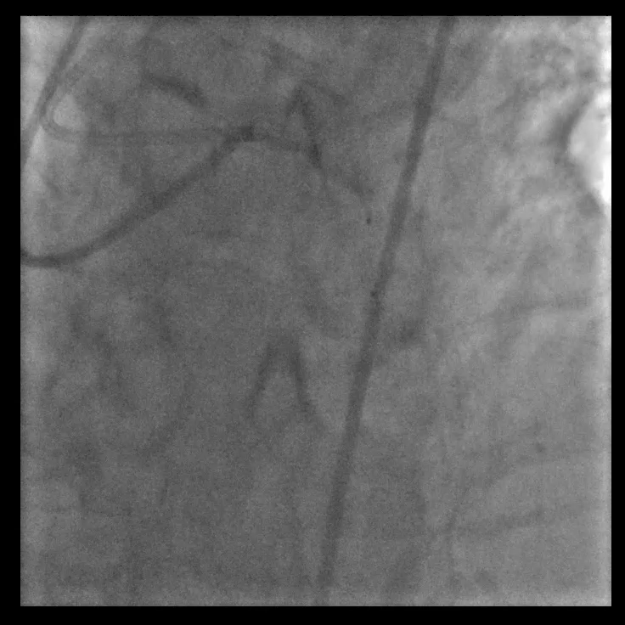
Final Run
BRITISH CARDIOVASCULAR INTERVENTION SOCIETY
Join the conversation using #BCISAHP
Notes:
ALICE: Final Run – as you can see, IVL Balloon still in the LAD, with some flow having been restored down the LAD and the diagonals.

Slide 39
BRITISH CARDIOVASCULAR INTERVENTION SOCIETY
Outcome
Surgeons accepted patient
Relatives updated
Team Debrief
Patient transferred on IABP
Surgery the following day
Ongoing team support
Lessons learnt
Patient survived
Join the conversation using #BCISAHP
Notes:
ALICE: IABP inserted, Bedside Echo performed (moderate LVSD, previously mild) , patient prepped for immediate transfer, it was close to midnight by the time the transfer took place….patient was stable so they operated the following morning….and he survived and is doing well.
Let’s look at the outcomes/actions for the team….Debrief in this case didn’t happen as a hot debrief due to time of the case and changing over of staff – but operator open to discussing with any staff who wanted to debrief…ongoing team support, discussions, support offered – we now give people the chance to step back if they feel they can’t work in certain cases….Lessons learnt, we have taken forward some of the things we’ve learnt and feel better prepared…

Slide 40
Thank you
Join the conversation using #BCISAHP
Notes:
Lead discussion?
What went well? What could’ve been done better?
Smaller IVL – the operator felt from the short IVUS run we were able to do, the LAD was appropriate for a 3.5mm IVL…however we appreciate the suggestion, as we recognise we’d previously used a 3.0 NC but not a 3.5 NC, and IVL balloons are bulkier.

