Slide 1

BRITISH CARDIOVASCULAR INTERVENTION SOCIETY
AHP ANNUAL CONFERENCE 2026
Live Complex PCI MDT
Craig Robertson· Lead PCI Clinical Nurse Specialist · Essex CTC
Dr John Davies· Interventional Cardiologist · Essex CTC
Professor Thomas Keeble· Interventional Cardiologist · Essex CTC
13–14 July 2026
Birmingham Conference & Events Centre
Notes:
Introductions
Download millbrook app
Overview of session

Slide 2

BRITISH CARDIOVASCULAR INTERVENTION SOCIETY
Declaration of Interests
Craig Robertson - I have no conflicts of interest to declare.
John Davies - I have no conflicts of interest to declare.
Thomas Keeble –Abbott, Terumo, Nipro
Join the conversation using #BCISAHP
Notes:
Required by the meeting. Keep ONE of the two statements and delete the other.

Slide 3
BRITISH CARDIOVASCULAR INTERVENTION SOCIETY
Who is needed for a good Complex PCI MDT
Interventional Cardiologist
Cardiothoracic Surgeon
Imaging Cardiologist
Radiologist
Specialist Registrar
An MDT Co-Ordinator
Trainee Doctors
Cardiac Nurse Specialist
Ward Nurse
Radiographer
Cardiac Physiologist
Physiotherapist
Dietician
Research Teams
Other Specialist Doctor / AHP
Students
Join the conversation using #BCISAHP
Notes:
I always say the skill in being a consultant is knowing when to stop – step back and ask your colleague opinions.
We use MDTs to discuss complex cases with our colleagues to get a group consensus on the best treatment for a patient.
To do this properly we need a range of specialties.
I have made a short list on who I think is important for a Complex PCI MDT.
However, depending on the scenario – this can be extended even further.
Everyone is welcome at an MDT whether is is for input or for learning

Slide 4
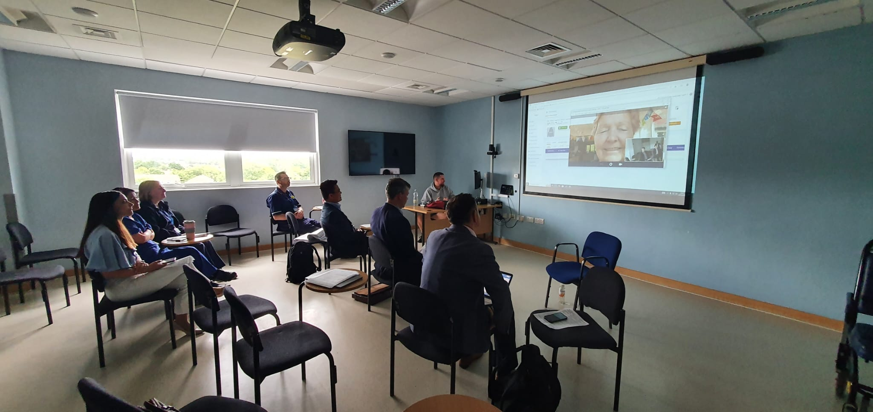
BRITISH CARDIOVASCULAR INTERVENTION SOCIETY
What about the patient?
Join the conversation using #BCISAHP
Notes:
Should we include the patient?
Longer time
More accurate clinical history
Very important person missing ….

Slide 5
SECTION
Case Presentation
AHP ANNUAL CONFERENCE 2026
Notes:
Housekeeping
Live patient
Professionalism

Slide 6
BRITISH CARDIOVASCULAR INTERVENTION SOCIETY
62 year old man
Past Medical History
Hypertension
Aortic Stenosis - Reported as preserved biventricular function with bicuspid aortic valve with mild AS.
Referred to RACPC from GP with exertional Chest Pains and SOB
Seen in clinic started on medications and referred for CTCA
Went for an Angiogram +/- PCI at an external centre
Conclusion:
Multiple partly-calcified plaques, spotty calcifications (high-risk plaque feature) and positive remodelling (high-risk plaque feature) within multiple coronary segments, as detailed above causing minimal-to-moderate stenoses, as detailed above.
Join the conversation using #BCISAHP

Slide 7

BRITISH CARDIOVASCULAR INTERVENTION SOCIETY
Medications List
Aspirin 75mg Once daily
Calci D one tablet Once daily
Alendronic Acid 70mg Once weekly
Atorvastatin 40mg Once daily
Lercanidipine 20mg Once daily
Bisoprolol 5mg Once daily
Clopidogrel 75mg Once daily
Lansoprazole 30mg Once daily
Doxazosin 4mg Twice daily
Isosorbide Mononitrate Modified Release 25mg Once daily
Bloods and Observations
Hb 146g/L
Platelets 265
MCV 93
WCC 7.4
Total Cholesterol 3.94
HDL 1.52
LDL 1.79
Tri 1.37
Non-Smoker
Na 139
Potassium 4.5
Ur 9.6
Cr 98
eGFR 67
BP 135/71mmHg
HR 61bpm
Height 163cm
Weight 83kg
Join the conversation using #BCISAHP
Notes:
Before we look at his images – lets get a bit of background.
Any antianginals
Any concerns with his bloods
Risk prevention wise (LDL + Weight)

Slide 8
BRITISH CARDIOVASCULAR INTERVENTION SOCIETY
Over to the patient
Join the conversation using #BCISAHP
Notes:
Explain your cardiac symptoms to us – how does living with coronary artery disease affect you day to day

Slide 9
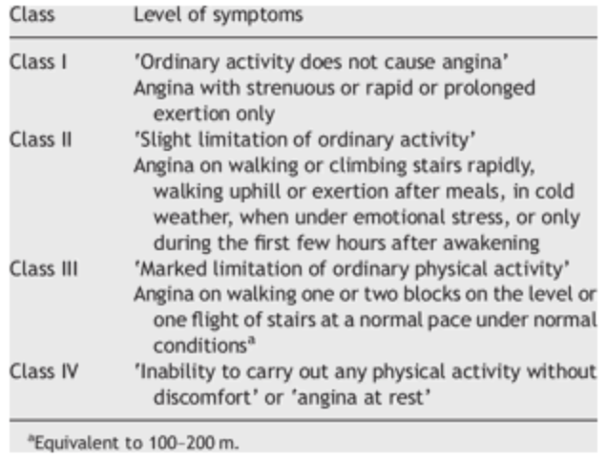
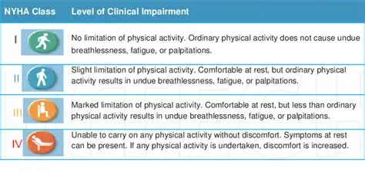
BRITISH CARDIOVASCULAR INTERVENTION SOCIETY
New York Heart Association Functional Classification
Canadian Cardiovascular Society (CCS) Angina Grade
Join the conversation using #BCISAHP
Notes:
Canadian Cardiovascular Society (CCS)
New York Heart Association (NYHA)

Slide 10

BRITISH CARDIOVASCULAR INTERVENTION SOCIETY
Medications List
Aspirin 75mg Once daily
Calci D one tablet Once daily
Alendronic Acid 70mg Once weekly
Atorvastatin 40mg Once daily
Lercanidipine 20mg Once daily
Bisoprolol 5mg Once daily
Clopidogrel 75mg Once daily
Lansoprazole 30mg Once daily
Doxazosin 4mg Twice daily
Isosorbide Mononitrate Modified Release 25mg Once daily
BP 135/71mmHg
HR 61bpm
Ranolazine 375mg twice daily
In view of increasing
Potential
Join the conversation using #BCISAHP
Notes:
Based on his symptoms.
Before we discuss intervention would we want to change anything.
Biso X
Lercandipine X
ISMN maybe
Ranlolazine maybe

Slide 11
BRITISH CARDIOVASCULAR INTERVENTION SOCIETY
Angiogram Images
Join the conversation using #BCISAHP
Notes:
Go through all
Say what you see
Shout at me

Slide 12
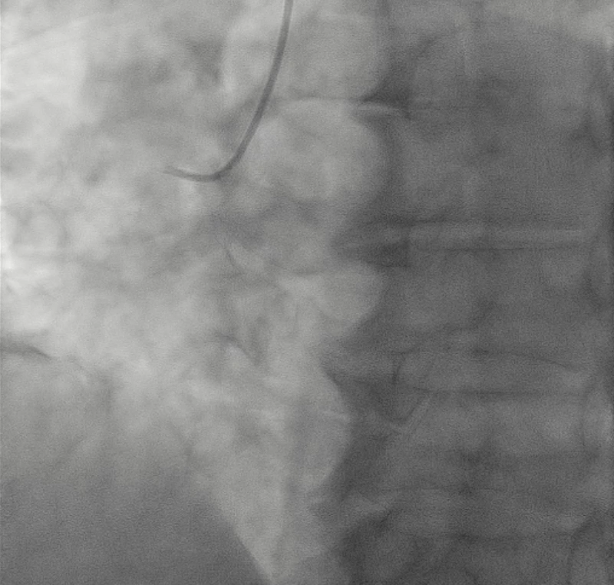
BRITISH CARDIOVASCULAR INTERVENTION SOCIETY
Join the conversation using #BCISAHP

Slide 13
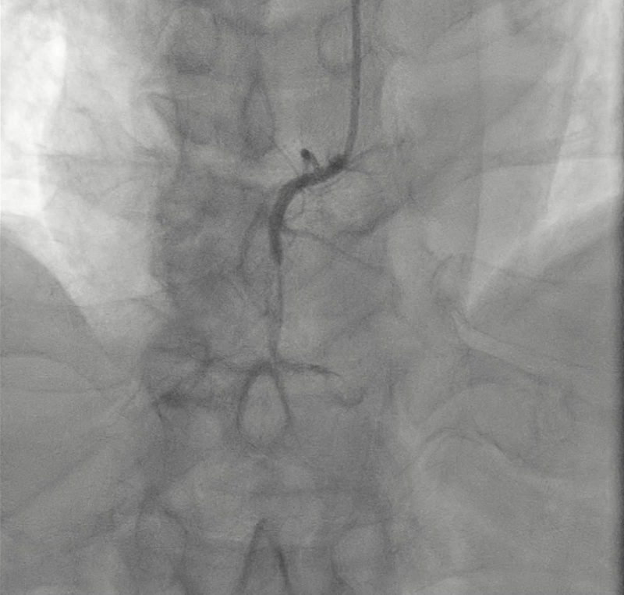
BRITISH CARDIOVASCULAR INTERVENTION SOCIETY
Join the conversation using #BCISAHP

Slide 14
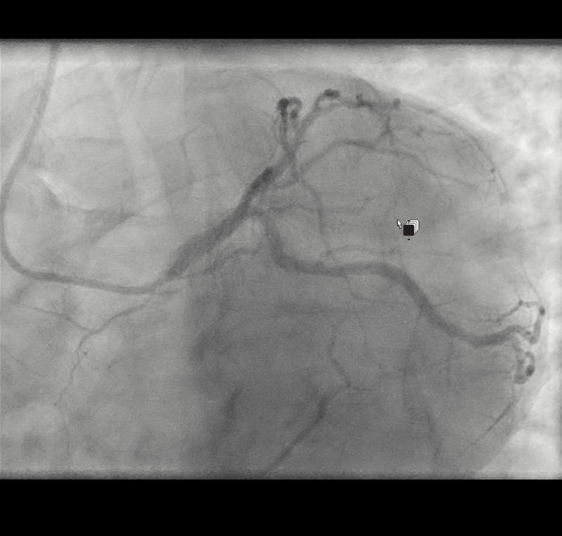
BRITISH CARDIOVASCULAR INTERVENTION SOCIETY
Join the conversation using #BCISAHP
Notes:
Spider LAO Caudal

Slide 15
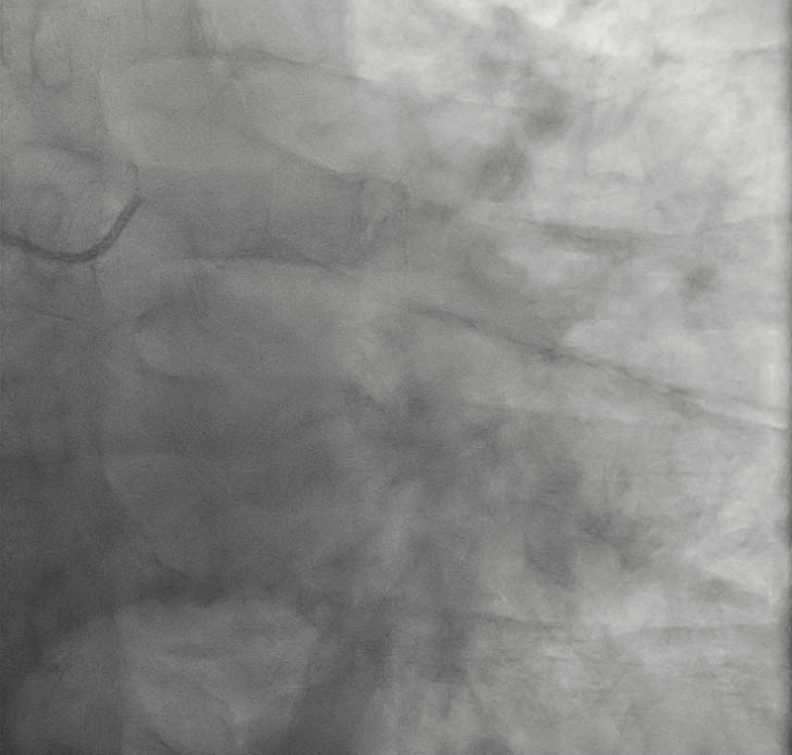
BRITISH CARDIOVASCULAR INTERVENTION SOCIETY
Join the conversation using #BCISAHP
Notes:
AP Cordal

Slide 16
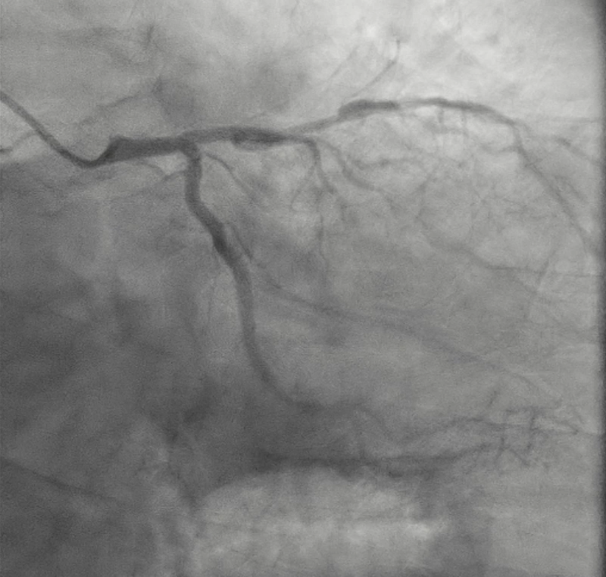
BRITISH CARDIOVASCULAR INTERVENTION SOCIETY
Join the conversation using #BCISAHP

Slide 17
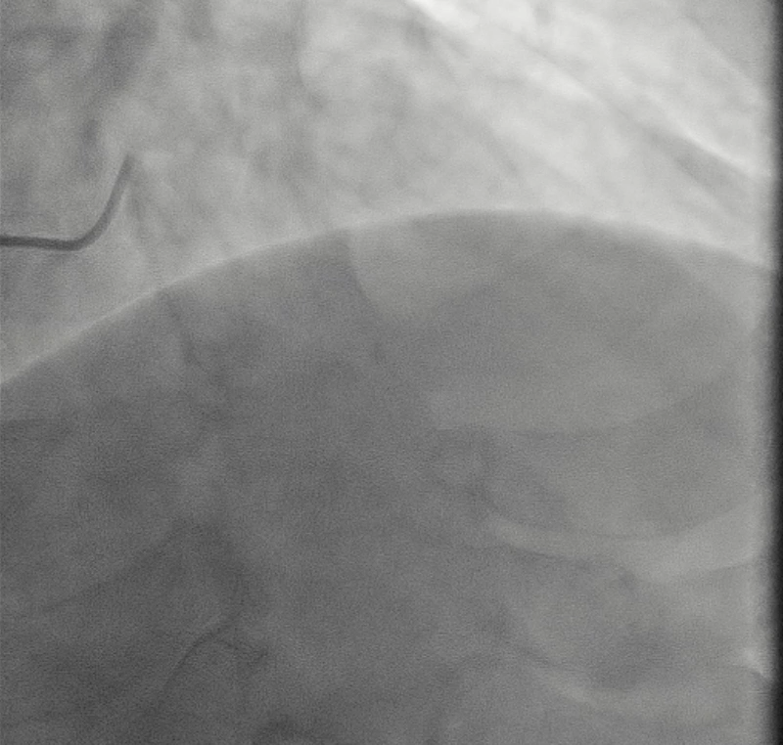
BRITISH CARDIOVASCULAR INTERVENTION SOCIETY
Join the conversation using #BCISAHP
Notes:
RAO Cranial

Slide 18
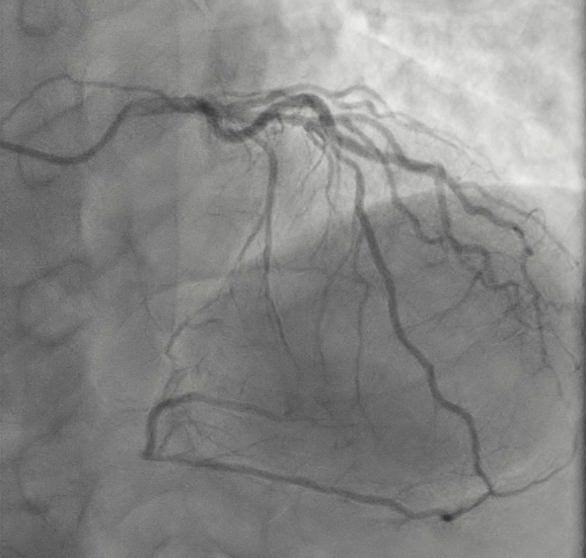
BRITISH CARDIOVASCULAR INTERVENTION SOCIETY
Join the conversation using #BCISAHP

Slide 19
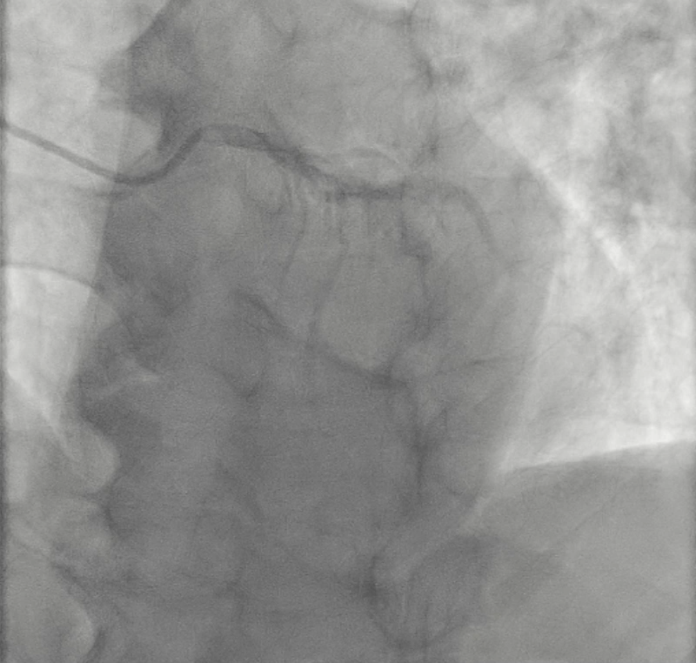
BRITISH CARDIOVASCULAR INTERVENTION SOCIETY
Join the conversation using #BCISAHP
Notes:
AP Cranical

Slide 20
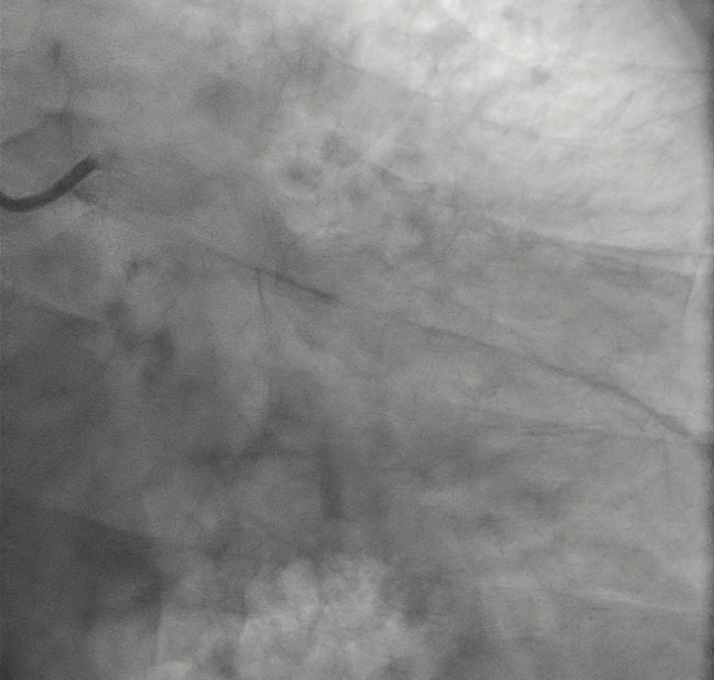
BRITISH CARDIOVASCULAR INTERVENTION SOCIETY
Join the conversation using #BCISAHP

Slide 21
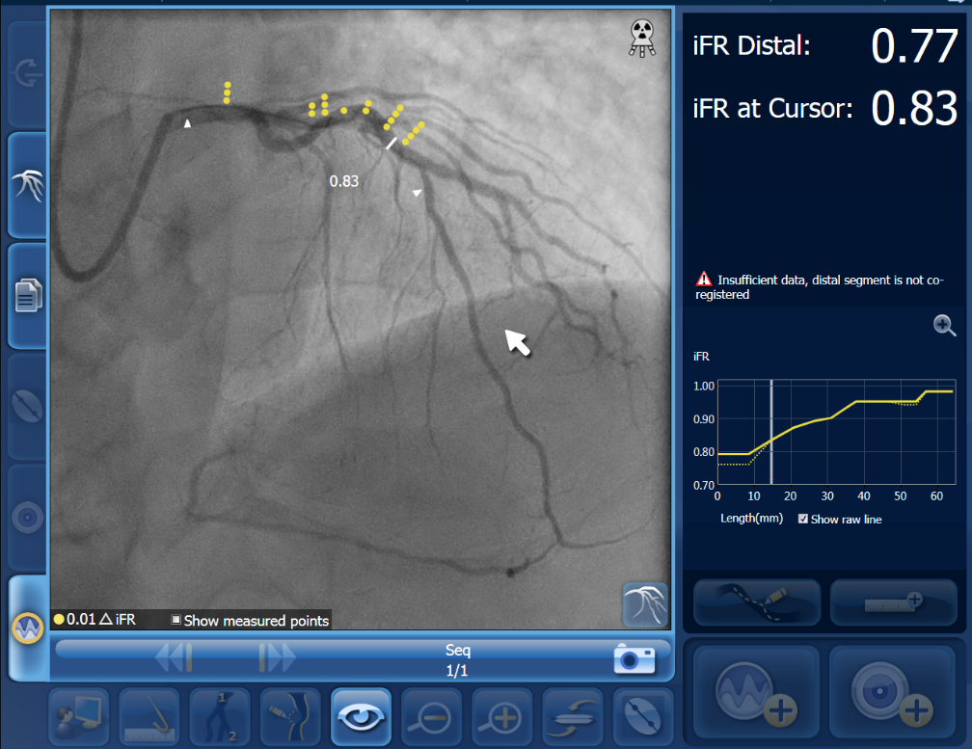
BRITISH CARDIOVASCULAR INTERVENTION SOCIETY
Join the conversation using #BCISAHP

Slide 22
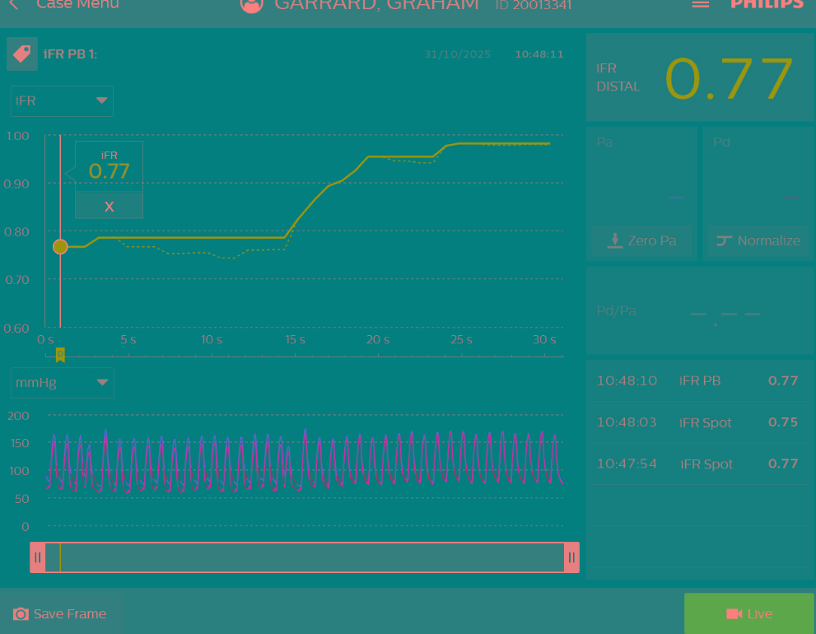
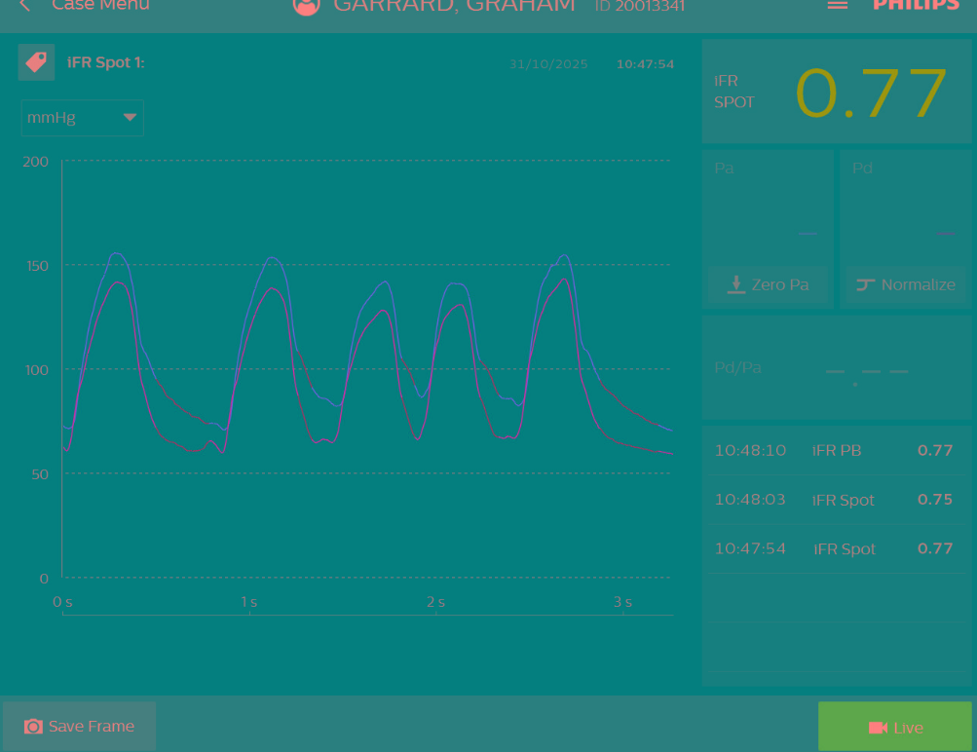
BRITISH CARDIOVASCULAR INTERVENTION SOCIETY
Join the conversation using #BCISAHP

Slide 23
BRITISH CARDIOVASCULAR INTERVENTION SOCIETY
Summary;
Severe Proximal Stenosis RCA
Chronic Total Occlusion distal RCA
Pressure Wire Positive LAD Stenosis
Referrers Question to the MDT;
CABG or PCI
Join the conversation using #BCISAHP

Slide 24
BRITISH CARDIOVASCULAR INTERVENTION SOCIETY
Poll
PCI or CABG
Join the conversation using #BCISAHP

Slide 25
Pro PCI – Dr John Davies
BRITISH CARDIOVASCULAR INTERVENTION SOCIETY
Feel free to go to previous slides if needed.
Join the conversation using #BCISAHP

Slide 26
Pro CABG – Professor Thomas Keeble
BRITISH CARDIOVASCULAR INTERVENTION SOCIETY
Feel free to go to previous slides if needed.
Join the conversation using #BCISAHP

Slide 27
BRITISH CARDIOVASCULAR INTERVENTION SOCIETY
Poll
PCI or CABG
Join the conversation using #BCISAHP

Slide 28
Thank you
Join the conversation using #BCISAHP
craig.robertson6@nhs.net

