Slide 1

BRITISH CARDIOVASCULAR INTERVENTION SOCIETY
AHP ANNUAL CONFERENCE 2026
Top 5 things I look for during a case – Insights into acute changes in PCI
Mark Passey· Principal Cardiac Physiologist· Mid and South Essex NHS Trust
13–14 July 2026
Birmingham Conference & Events Centre
Notes:
Speaker title slide. Replace the title and your name/role/organisation. Event branding is fixed.

Slide 2


BRITISH CARDIOVASCULAR INTERVENTION SOCIETY
Declaration of Interests
I have no conflicts of interest to declare.
Join the conversation using #BCISAHP
Notes:
Required by the meeting. Keep ONE of the two statements and delete the other.

Slide 3
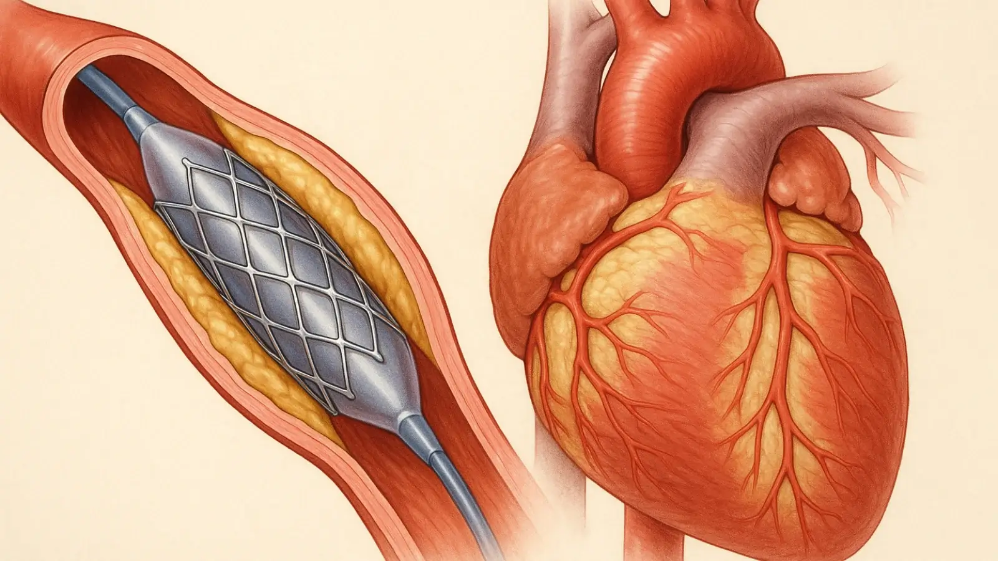
BRITISH CARDIOVASCULAR INTERVENTION SOCIETY
Changes During Balloon Inflation
Balloon inflation occludes the coronary artery, producing acute ischemia. Key haemodynamic changes occur during and immediately after occlusion.
By understanding these changes more fully we can respond earlier to changes and adapt the procedure to improve outcomes.
Join the conversation using #BCISAHP
Notes:
Required by the meeting. Keep ONE of the two statements and delete the other.

Slide 4
BRITISH CARDIOVASCULAR INTERVENTION SOCIETY
↓ Coronary blood flow → immediate ischemia
↑ LVEDP due to impaired relaxation and rising filling pressures
↓ Systolic blood pressure in some patients due to reduced stroke volume (ischemia‑induced LV dysfunction)
∆ Heart rate
∆ Pulse Oximetry
Join the conversation using #BCISAHP
Notes:
Required by the meeting. Keep ONE of the two statements and delete the other.

Slide 5
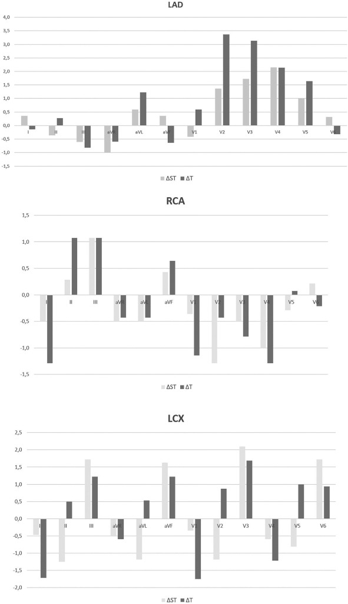
BRITISH CARDIOVASCULAR INTERVENTION SOCIETY
Studies show that within seconds of inflation, the following ECG changes may occur:
ST‑segment elevation in the territory of the occluded arter
Reciprocal ST depression in opposing leads T‑wave peaking or inversion
QRS widening due to conduction delay in ischemic myocardium
Wide distribution of changes seen in studies when the LCx is occluded – probably reflects the anatomy of the LCx artery and its side branches.
Time to reach maximal ΔST was 20–111 s (mean 67 s) and time to reach maximal ΔT was 23–111 s (mean 66 s).
Takeaway
Significant acute ischaemia may not necessarily associated with ST Elevation or seen in the classic ECG leads
Mazal-Anna Pessah, Heini Huhtala, Petteri Kosonen, Markku Eskola, Andrés Ricardo Pérez-Riera, Kjell Nikus, Jani Rankinen, Early ischemic ST-segment and T-wave changes during balloon angioplasty, Journal of Electrocardiology, Volume 73, 2022, Pages 87-95, ISSN 0022-0736, https://doi.org/10.1016/j.jelectrocard.2022.06.003.
Join the conversation using #BCISAHP
Notes:
2022 paper from Journal of electrocardiology small study of 34 patients with continuous 12 lead ECG monitoring
Highlights
•The most evident ischemic ECG changes during planned balloon occlusion are:
•LAD: increased amplitude of the ST segment T wave maximally in leads V2-V4
•RCA: increased amplitudes of the ST segment and T waves in the inferior leads and decrease in leads I and V1-V4
•LCx: large differences between the 12 leads and between the ST segment and T wave
•A change in polarity of T-wave changes during balloon occlusion is a rare finding.
During balloon occlusion, the STEMI criteria from the Fourth Universal Definition of Myocardial Infarction [3] were fulfilled in 25/34 (73%) of the patients. The criteria were fulfilled in 10/11 patients in the LAD group, in all of the seven patients in the RCA group, and in half (8/16) of the patients in the LCx group.
IN the LAD The increase in the amplitude of the T waves was greater than that of the ST segment in most of the precordial leads, but the difference in mean values was statistically significant only in lead V2

Slide 6
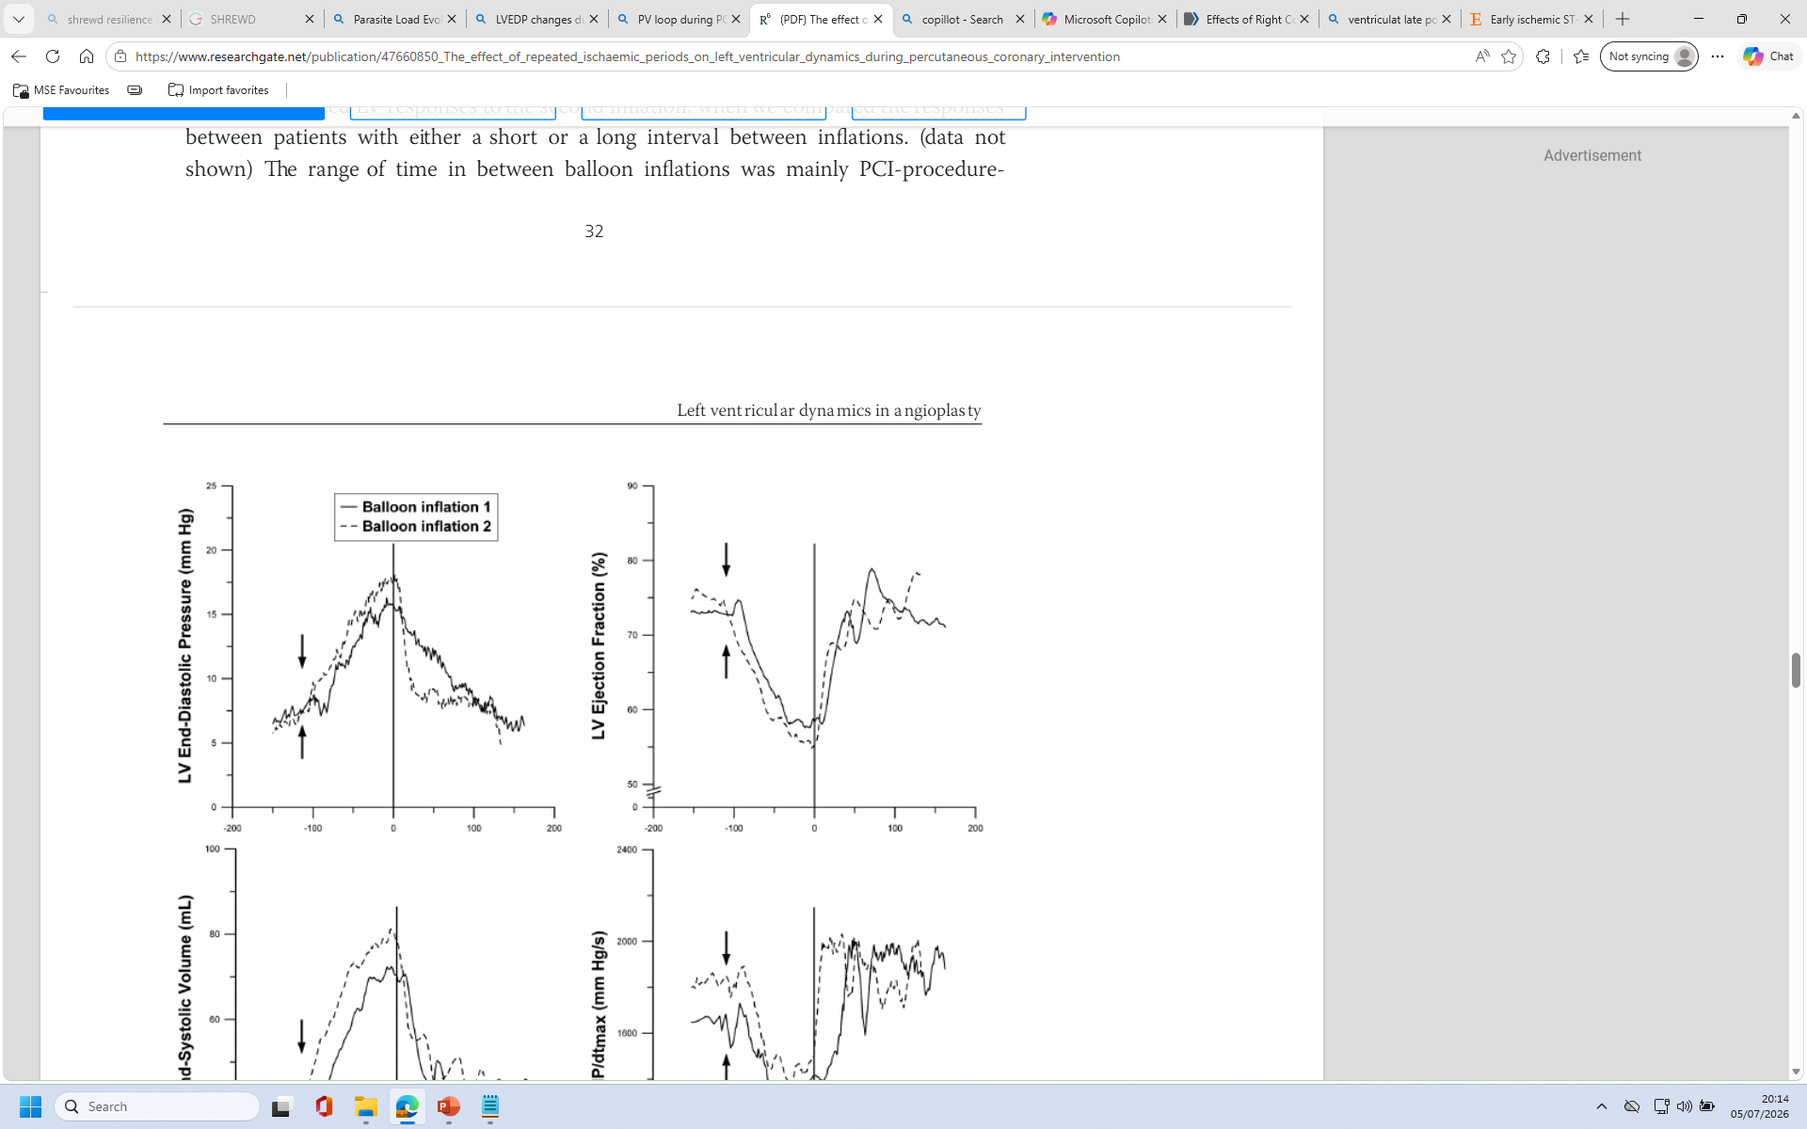
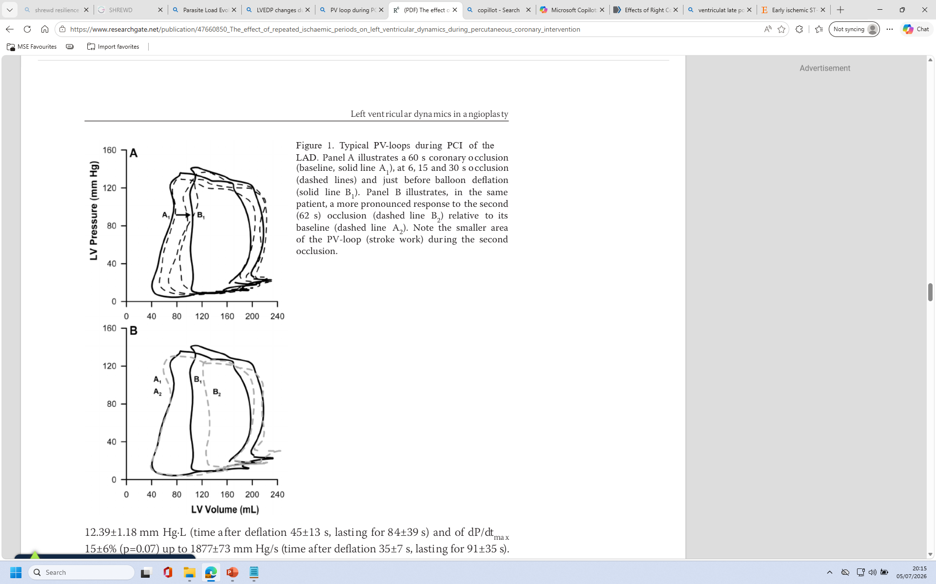
BRITISH CARDIOVASCULAR INTERVENTION SOCIETY
↑ LVEDP due to impaired relaxation and rising filling pressures
Ischaemic myocardium loses ATP rapidly. Without ATP, the myocytes cannot relax properly. This leads to:
Stiffening of the LV wall
Slower and incomplete relaxation
Higher pressure at the end of diastole (LVEDP)
This is why LVEDP is often the earliest haemodynamic marker of ischaemia.
Does significant acute LVEDP change predict pulmonary congestion, worsening ischaemia, and arrhythmia risk?
Takeaway
In unstable patients or balloon occlusions affecting large territories acute changes in LVEDP may precipitate significant pulmonary oedema
Remmelink, Maurice & Winter, Robbert & Henriques, José & Koch, Karel & Schaaf, René & Vis, Maartje & Tijssen, Jan & Piek, Jan & Baan, Jan. (2010). The effect of repeated ischaemic periods on left ventricular dynamics during percutaneous coronary intervention. EuroIntervention : journal of EuroPCR in collaboration with the Working Group on Interventional Cardiology of the European Society of Cardiology. 6. 623-9. 10.4244/EIJV6I5A104.
Join the conversation using #BCISAHP
Notes:
Required by the meeting. Keep ONE of the two statements and delete the other.

Slide 7
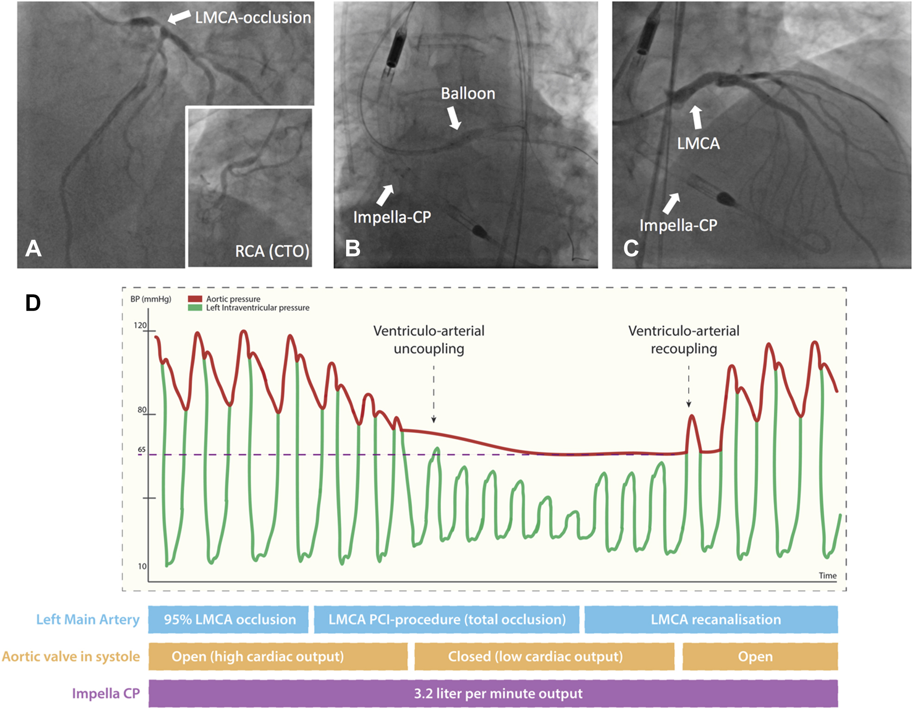
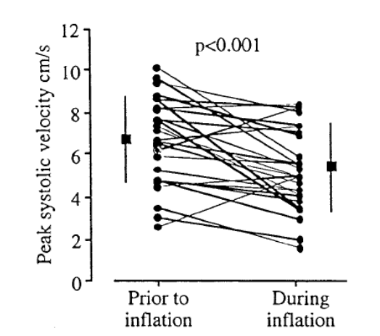
BRITISH CARDIOVASCULAR INTERVENTION SOCIETY
Acute balloon inflation causes an instant drop in systolic function due to abrupt ischaemia. This leads to:
↓ contractility
↑ ESV
↓ stroke volume
↓ systolic pressure
↑ LVEDP
↑ arrhythmia risk
Potential myocardial stunning
These changes explain why balloon inflations must be kept short and why patients can become hypotensive or symptomatic during PTCA.
Takeaway
In patients with poor cardiac output, acute changes in systolic function association with balloon occlusion could cause haemodynamic collapse
Vandenbriele, C, Balthazar, T, Janssens, S. et al. Impella Protected PCI: Exploring the Mechanism of Ventriculoarterial Uncoupling. J Am Coll Cardiol Intv. 2019 Oct, 12 (19) 1979–1980.
https://doi.org/10.1016/j.jcin.2019.05.037
JENSEN, Jens & Brodin, Lars-Ake & LIND, Britta & Eriksson, Sven & Jensen-Urstad, Mats & SYLVÉN, Christer. (2001). Deterioration in peak systolic velocity is closely related to ischaemia during angioplasty: A vectorcardiographic and tissue Doppler imaging study. Clinical science (London, England : 1979). 100. 137-43. 10.1042/cs1000137.
Join the conversation using #BCISAHP
Notes:
Required by the meeting. Keep ONE of the two statements and delete the other.

Slide 8

Increased Heart Rate
BRITISH CARDIOVASCULAR INTERVENTION SOCIETY
baroreceptors in the aortic arch and carotids sense this drop in effective output. They respond by triggering:
↑ sympathetic tone
↑ heart rate
↑ contractility
↑ peripheral vasoconstriction
Baroreceptors
Ischaemic metabolites stimulate cardiac afferents
Within seconds of balloon inflation, the myocardium accumulates:
Lactate
H⁺ ions
Adenosine
Potassium
These stimulate cardiac sympathetic afferent fibres, which feed into the medulla and increase sympathetic outflow.
This is why the heart rate rise is often faster and sharper than you’d expect from haemodynamics alone.
Ischaemic metabolites
Pain amplifies the sympathetic surge
Not the primary driver — but it adds fuel.
Chest discomfort activates:
Sympathetic pathways
Adrenal medulla release of catecholamines
This is why heart rate often rises before the patient even verbalises pain.
Pain
Join the conversation using #BCISAHP
Notes:
Required by the meeting. Keep ONE of the two statements and delete the other.
Ischaemia weakens contraction in the affected territory. Stroke volume falls. The baroreceptors in the aortic arch and carotids sense this drop in effective output.
They respond by triggering:
↑ sympathetic tone
↑ heart rate
↑ contractility
↑ peripheral vasoconstriction
This is the classic compensatory tachycardia you see during inflation.
Ischaemic metabolites stimulate cardiac afferents
Within seconds of balloon inflation, the myocardium accumulates:
Lactate
H⁺ ions
Adenosine
Potassium
These stimulate cardiac sympathetic afferent fibres, which feed into the medulla and increase sympathetic outflow.
This is why the heart rate rise is often faster and sharper than you’d expect from haemodynamics alone.
Pain amplifies the sympathetic surge
Not the primary driver — but it adds fuel.
Chest discomfort activates:
Sympathetic pathways
Adrenal medulla release of catecholamines
This is why heart rate often rises before the patient even verbalises pain.
Which vessels cause the biggest HR rise?
LAD inflation → largest HR increase (biggest myocardial territory, biggest drop in stroke volume)
LCx → moderate
RCA → variable
If AV node ischaemia causes junctional rhythm or bradycardia, HR may fall, not rise
zz

Slide 9
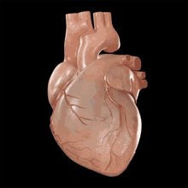
Why this matters in the cath lab
The heart‑rate response is one of your earliest and most sensitive markers of how well the patient is tolerating the inflation. A rising HR tells you:
The baroreflex is intact
The patient is compensating
The LV is struggling but coping
A blunted or falling HR tells you:
The patient is not compensating
AV nodal ischaemia is occurring
You may need to shorten inflation or deflate immediately
This is the kind of real‑time physiology that makes PCI such a powerful teaching tool.
BRITISH CARDIOVASCULAR INTERVENTION SOCIETY
Takeaway
Changes in heart rate are important indicators of patient physiology
WHY?
Join the conversation using #BCISAHP
Notes:
Required by the meeting. Keep ONE of the two statements and delete the other.

Slide 10

Pulse oximetry permits non-invasive determination of oxyhaemoglobin saturation of arterial blood (Sao₂). It is a rapid, non-invasive, and inexpensive procedure.
BRITISH CARDIOVASCULAR INTERVENTION SOCIETY
The forgotten parameter!
Join the conversation using #BCISAHP
Notes:
Required by the meeting. Keep ONE of the two statements and delete the other.

Slide 11
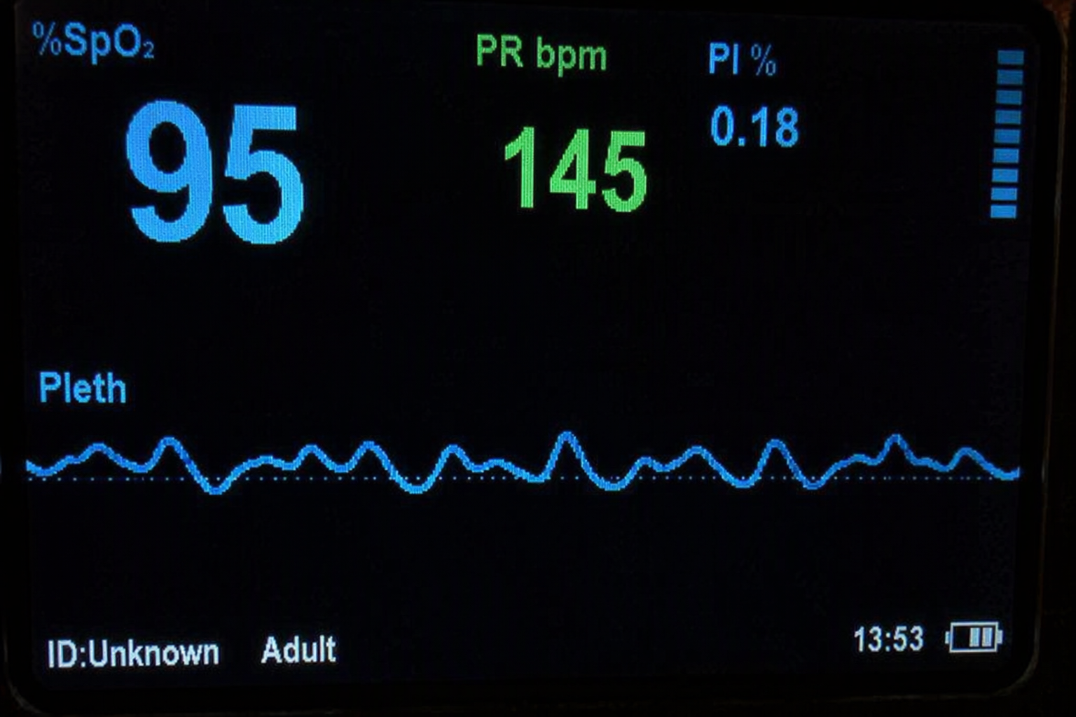
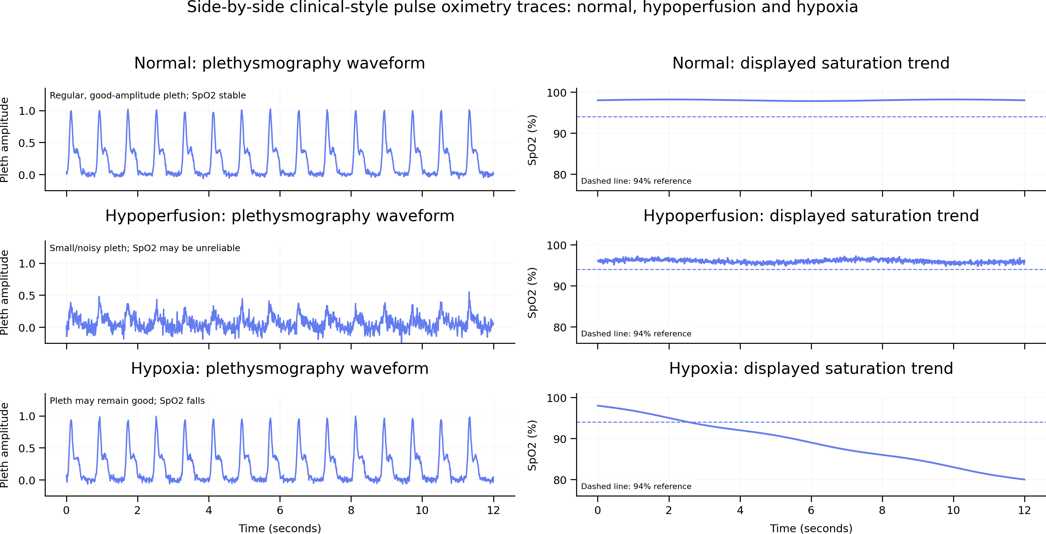
Pulse oximetry permits non-invasive determination of oxyhaemoglobin saturation of arterial blood (Sao₂). It is a rapid, non-invasive, and inexpensive procedure.
BRITISH CARDIOVASCULAR INTERVENTION SOCIETY
DON’T IGNORE the SATS!
Don’t assume the probe has dropped off!!
Hypoperfusion
Hypoxia / Respiratory arrest
Takeaway
Don’t ignore the SATs probe, its an important indicator of hypoxia but also hypoperfusion
Join the conversation using #BCISAHP
Notes:
Required by the meeting. Keep ONE of the two statements and delete the other.

Slide 12
BRITISH CARDIOVASCULAR INTERVENTION SOCIETY
Balloon inflation creates a controlled ischaemic event
Predictable changes in haemodynamics (↑ LVEDP, ↓ BP, reflex ↑ HR)
Rapid, territory‑specific ECG changes (ST elevation, reciprocal depression, conduction delay)
🔹 The heart’s response tells you how well the patient is coping
LVEDP rise = early marker of impaired relaxation
Reflex tachycardia = intact baroreflex compensation
Hypotension or bradyarrhythmia = poor tolerance → shorten inflation
🔹 Deflation and reperfusion should normalise physiology quickly
ST segments fall
LVEDP returns to baseline
HR stabilises
Delayed recovery suggests microvascular obstruction or no‑reflow
🔹 ECG + haemodynamics = real‑time feedback
Together they guide safe inflation duration, timing of deflation, and assessment of reperfusion quality
They remain the most immediate, sensitive indicators of procedural success
Join the conversation using #BCISAHP
Notes:
Required by the meeting. Keep ONE of the two statements and delete the other.

Slide 13
BRITISH CARDIOVASCULAR INTERVENTION SOCIETY
Take‑Home Message
PCI gives you a live window into coronary physiology. We can consider the ECG and haemodynamic information more widely.
The connection between the cellular and macro effects of acute balloon induced ischaemia is often immediate and can provide greater insights into the safety and likely outcome of PCI cases. We should continue to look for any changes in these measures to ensure safe and effective PCI.
Join the conversation using #BCISAHP
Notes:
Required by the meeting. Keep ONE of the two statements and delete the other.

Slide 14
Thank you
Join the conversation using #BCISAHP
Notes:
Closing slide. Add your contact / handle for follow-up questions.

