Slide 1

BRITISH CARDIOVASCULAR INTERVENTION SOCIETY
AHP ANNUAL CONFERENCE 2026
Renal Denervation for Hypertension
Michael Galinato· Cath Lab Manager · Essex Cardiothoracic Centre
13–14 July 2026
Birmingham Conference & Events Centre
Notes:
"Good afternoon everyone. My name is Michael Galinato, Cath Lab Manager at the Essex Cardiothoracic Centre.
Today I'll be discussing renal denervation for hypertension, looking at why this therapy has re-emerged as an important treatment option.

Slide 2

BRITISH CARDIOVASCULAR INTERVENTION SOCIETY
Declaration of Interests
I have no conflicts of interest to declare.
Join the conversation using #BCISAHP

Slide 3
Why Renal Denervation?
AHP ANNUAL CONFERENCE 2026

Slide 4
BRITISH CARDIOVASCULAR INTERVENTION SOCIETY
Hypertension affects 30% of UK adults — a major cardiovascular risk factor
Resistant hypertension: BP uncontrolled despite 3+ agents including a diuretic
Medication non-adherence is common and underdiagnosed
RDN reduces sympathetic nervous system overactivity in the kidney
Offers a non-pharmacological treatment option with a low complication profile
Join the conversation using #BCISAHP
Notes:
"Hypertension remains the most significant modifiable cardiovascular risk factors worldwide.
In the UK, around one third of adults are affected with an estimated up to 5 million further patients undiagnosed with hypertension. Even small reductions in blood pressure can have a major impact. A reduction of just 2 mmHg in systolic blood pressure can significantly reduce the risk of stroke and cardiovascular mortality.
Despite the availability of effective medications, blood pressure control remains poor. Many patients require multiple drugs, and medication adherence is often overestimated and difficult to assess.
The kidneys play a key role in blood pressure regulation through sympathetic nervous system activity. Renal denervation works by disrupting these renal sympathetic nerves, reducing sympathetic drive and lowering blood pressure.

Slide 5
Patient Selection
AHP ANNUAL CONFERENCE 2026
Notes:
"Patient selection is probably the single most important determinant of success.

Slide 6




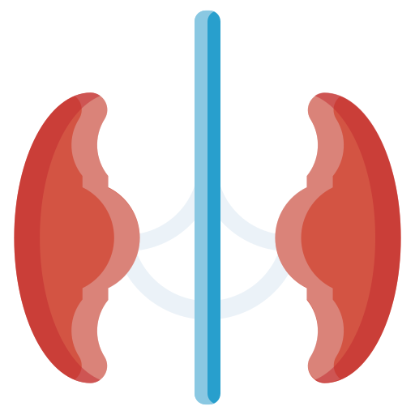
BRITISH CARDIOVASCULAR INTERVENTION SOCIETY
Inclusion Criteria
Resistant hypertension
Medication intolerance or non-adherence
Suitable renal artery anatomy
Patient preference
Earlier intervention
Join the conversation using #BCISAHP
Notes:
Traditionally, renal denervation has been considered for patients with resistant hypertension, meaning persistently elevated blood pressure despite three or more antihypertensive drugs including a diuretic. In our centre we do a 24hour BP monitoring to ensure they ar
Other suitable candidates include patients who cannot tolerate medications because of side effects, those with documented non-adherence, or patients who prefer a non-pharmacological treatment option.
There has been an increase movement towards earlier intervention in selected patients.
Anatomy is crucial. Every patient needs appropriate renal artery imaging, usually CT or MR angiography, to confirm suitability."

Slide 7
BRITISH CARDIOVASCULAR INTERVENTION SOCIETY
Exclusion Criteria
Secondary hypertension not excluded (renal artery stenosis, phaeochromocytoma, Conn’s)
Renal artery diameter < 3 mm or length < 20 mm
eGFR < 30 mL/min/1.73m²
Renal artery stent or previous denervation
Pregnancy or planned pregnancy
Notes:
"It's equally important to recognise who should not undergo renal denervation.
Secondary causes of hypertension must be excluded before treatment. Examples include renal artery stenosis, Conn's syndrome, and pheochromocytoma.
Patients with severe renal impairment, previous renal artery intervention, unsuitable anatomy, or pregnancy are generally not candidates.

Slide 8
Renal Anatomy & X-ray Views
AHP ANNUAL CONFERENCE 2026
Notes:
"Before discussing the procedure, let's review the anatomy that underpins treatment."

Slide 9
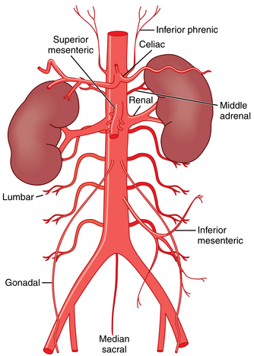
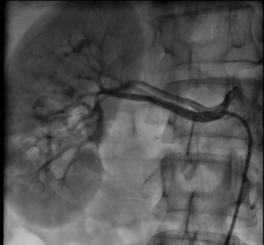
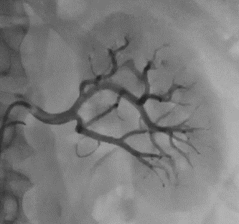
BRITISH CARDIOVASCULAR INTERVENTION SOCIETY
Join the conversation using #BCISAHP
Notes:
"The renal arteries originate from the abdominal aorta around the L1-L2 vertebral level.
The right renal artery is usually longer and passes behind the inferior vena cava, while the left renal artery tends to be shorter.
Understanding fluoroscopic views is important. Standard AP views provide an overview, while LAO and RAO projections help visualise the left and right renal arteries respectively.
Evidence suggests that treating not only the main artery but also distal branches improves denervation effectiveness.

Slide 10
Equipment Needed
AHP ANNUAL CONFERENCE 2026

Slide 11
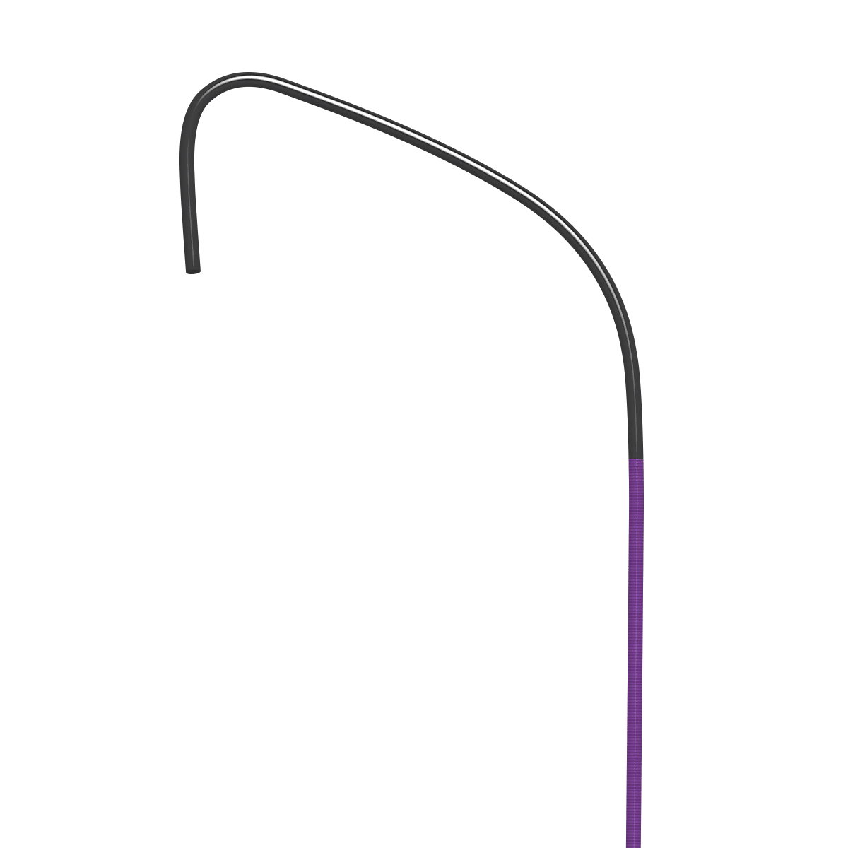
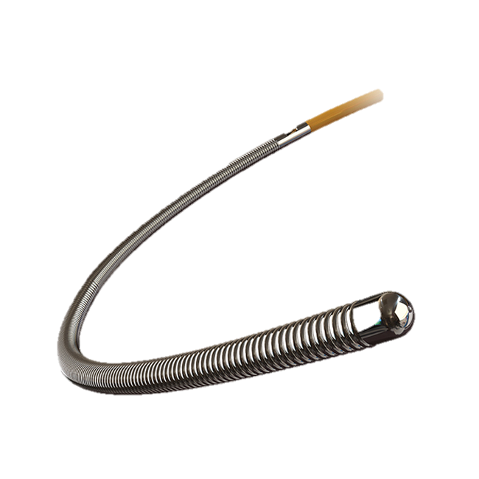
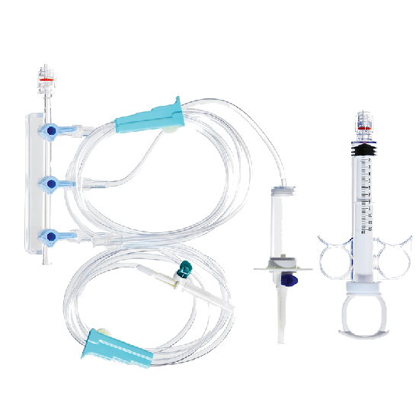
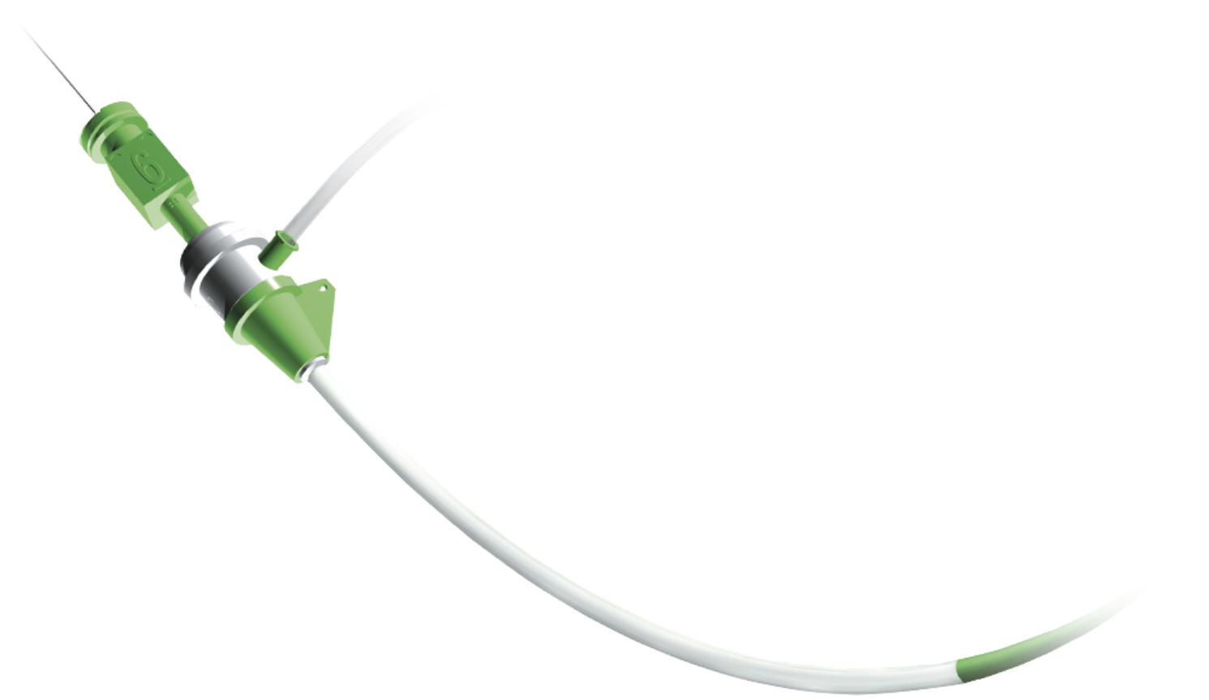
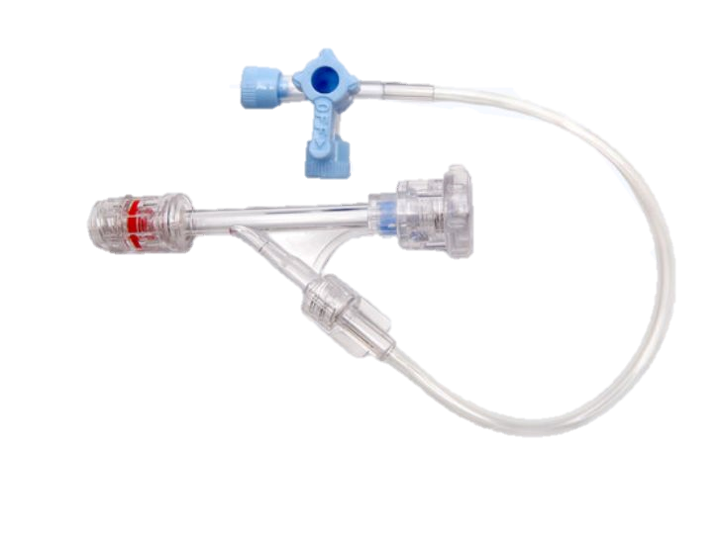
BRITISH CARDIOVASCULAR INTERVENTION SOCIETY
Vascular Access & Navigation
6F Femoral Sheath
6F Guide Catheter
0.014” non-hydrophilic workhorse wire
Manifold System
Haemostatic Kit
Join the conversation using #BCISAHP
Notes:
"From an operator's perspective, the equipment is familiar to anyone working in coronary intervention.
We typically use a 6 French femoral sheath, an appropriate guide catheter, a standard 0.014-inch coronary guidewire, contrast administration equipment and our routine haemostasis kit.
One of the advantages of renal denervation is that it utilises equipment and skills already present in most Cath Lavs

Slide 12
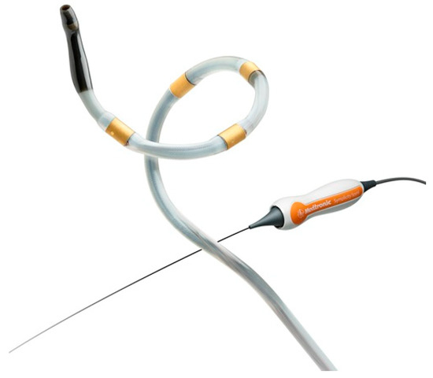
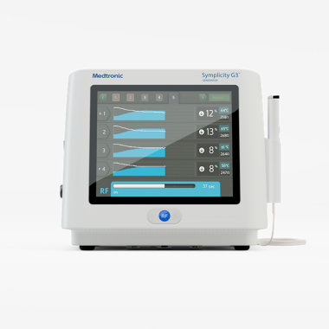
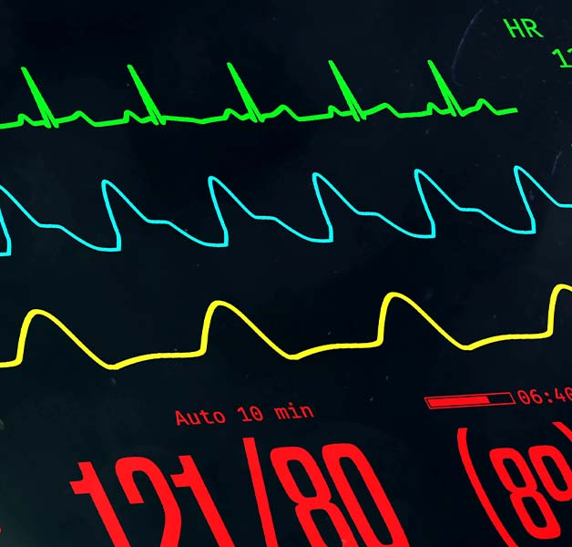

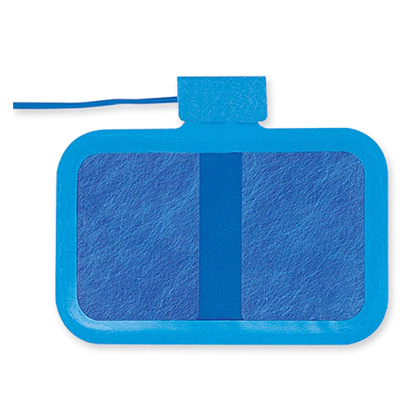
BRITISH CARDIOVASCULAR INTERVENTION SOCIETY
RDN-Specific Equipment
RDN Catheter
RF Generator
Dispersive Electrode
Monitoring
Sedation / Analgesia
Join the conversation using #BCISAHP
Notes:
Current systems use either radiofrequency energy or ultrasound energy.
Alongside the treatment catheter, we require the appropriate generator or console, grounding pads, continuous physiological monitoring, and adequate analgesia and sedation.
Pain management is particularly important because energy delivery can cause significant discomfort."

Slide 13
SECTION
Procedure Workflow
AHP ANNUAL CONFERENCE 2026

Slide 14
BRITISH CARDIOVASCULAR INTERVENTION SOCIETY
1
Assessment / & Consent
2
Femoral / Access
3
Renal / Angiography
4
Ablation / Delivery
5
Recovery / & Discharge
Join the conversation using #BCISAHP

Slide 15


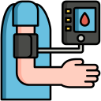


BRITISH CARDIOVASCULAR INTERVENTION SOCIETY
1
Assessment / & Consent
2
Femoral / Access
3
Renal / Angiography
4
Ablation / Delivery
5
Recovery / & Discharge
Join the conversation using #BCISAHP
Notes:
"Before entering the cath lab, every patient undergoes a thorough assessment led by our PCI specialist nurses.
This ensures they meet the eligibility criteria for renal denervation and that there are no factors that would make the procedure unsuitable.
Blood tests are performed and reviewed, baseline observations are completed, medications are assessed, and relevant imaging is reviewed to confirm anatomical suitability.
Once suitability has been established, informed consent is obtained, ensuring the patient fully understands the procedure, its benefits, limitations and potential risks."

Slide 16




BRITISH CARDIOVASCULAR INTERVENTION SOCIETY
1
Assessment / & Consent
2
Femoral / Access
3
Renal / Angiography
4
Ablation / Delivery
5
Recovery / & Discharge
Join the conversation using #BCISAHP
Notes:
Before the patient enters the cath lab, the room should be fully set up with all required equipment checked and readily available.
The appropriate team must be assembled, and a pre-procedure huddle should take place to discuss the patient's history, procedural plan, anticipated challenges and individual team responsibilities.
Adequate sedation planning is particularly important, as renal denervation can be a painful procedure. The team should ensure appropriate analgesia and sedation strategies are in place before starting.
Once the patient is prepared, vascular access is typically obtained via the common femoral artery, with ultrasound-guided puncture recommended to optimise access and minimise vascular complications.

Slide 17
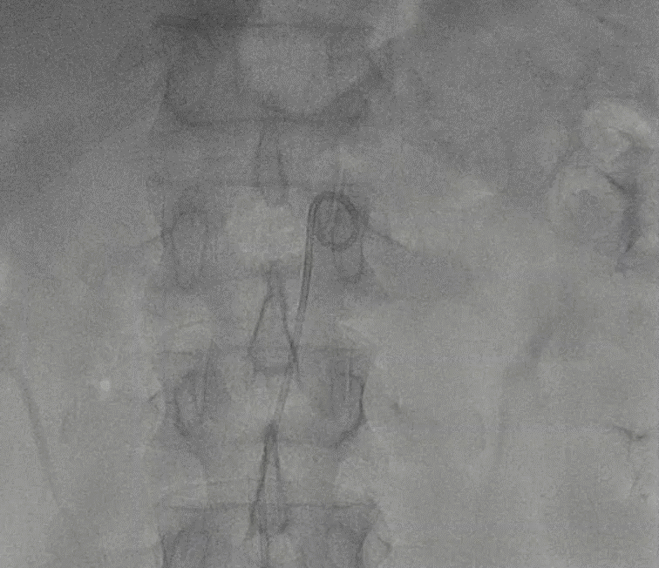
BRITISH CARDIOVASCULAR INTERVENTION SOCIETY
1
Assessment / & Consent
2
Femoral / Access
3
Renal / Angiography
4
Ablation / Delivery
5
Recovery / & Discharge
Join the conversation using #BCISAHP
Notes:
Once access complete, we use a pigtail to do the renal angigraphy
"Once we've completed the aortogram, we're asking a few key questions. Are the renal arteries within the treatment range, typically around 3 to 8 millimetres? Are there any accessory arteries? Which branches are suitable for treatment, and how distal can we safely position the catheter?
"Following completion of the aortogram and identification of the target vessels, the pigtail catheter is removed and exchanged for a guide catheter.
Give heparin and nitrates
A standard 0.014-inch workhorse wire is advanced into the renal artery and its branches to provide support for the denervation catheter.

Slide 18
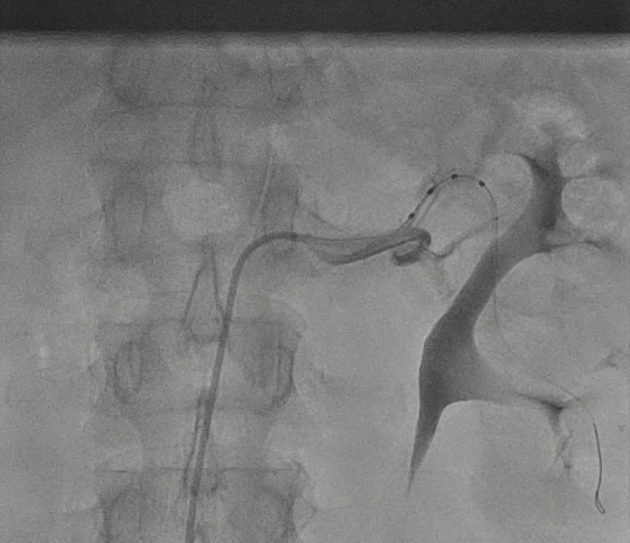
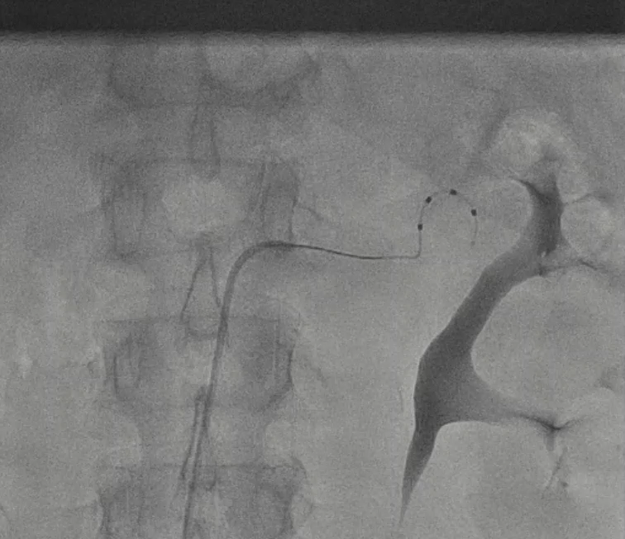
BRITISH CARDIOVASCULAR INTERVENTION SOCIETY
1
Assessment / & Consent
2
Femoral / Access
3
Renal / Angiography
4
Ablation / Delivery
5
Recovery / & Discharge
Join the conversation using #BCISAHP
Notes:
Once the RDN catheter is in place we remove the workhorse wire allowing the RDN catheter to take its shape.
"This is usually the point in the procedure where the patient starts to feel the effects of the treatment, so additional sedation and analgesia are often required. We make sure the patient knows to expect some discomfort, and it's good practice to let the whole team know when RF delivery is about to begin so everyone is prepared.
During ablation, close monitoring is essential. Watch carefully for bradycardia, hypotension, or a vagal response. If that occurs, treat promptly with fluids and atropine if required.
The generator is largely automated and will switch off electrodes if adequate vessel contact is not achieved.
A successful treatment is usually considered at least 45 seconds of energy delivery, with a full ablation lasting 60 seconds.
The operator can stop treatment at any time if there is significant pain, heart block, or any other concern.
After each treatment, the catheter is rewired, rotated approximately 90 degrees, and repositioned to achieve a circumferential pattern of ablations.
We also give the patient a minute or two to recover between applications and top up sedation as needed.
Once treatment of one renal artery is complete, the catheter is straightened, withdrawn into the guide, and a final angiogram is performed to exclude complications such as dissection. The same process is then repeated on the opposite side."

Slide 19
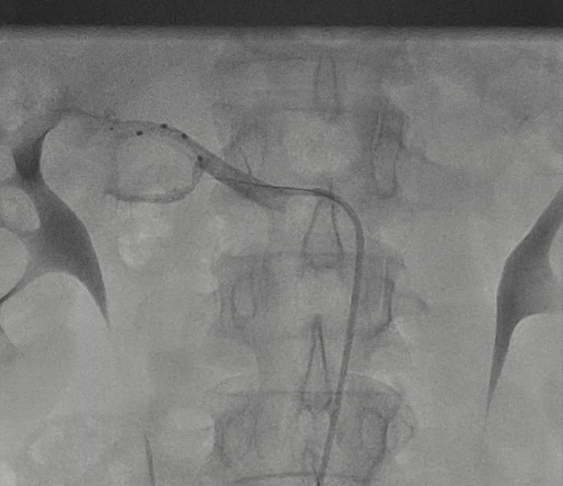
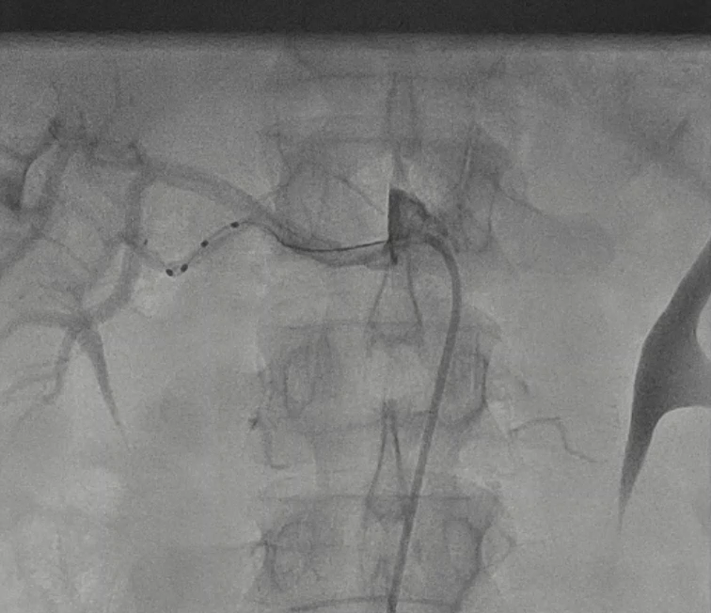
BRITISH CARDIOVASCULAR INTERVENTION SOCIETY
1
Assessment / & Consent
2
Femoral / Access
3
Renal / Angiography
4
Ablation / Delivery
5
Recovery / & Discharge
Join the conversation using #BCISAHP

Slide 20




BRITISH CARDIOVASCULAR INTERVENTION SOCIETY
1
Assessment / & Consent
2
Femoral / Access
3
Renal / Angiography
4
Ablation / Delivery
5
Recovery / & Discharge
Join the conversation using #BCISAHP
Notes:
"Once the procedure is complete, recovery is usually straightforward. Following femoral access, patients typically remain on bed rest for around two to four hours, with routine observations and access-site checks.
Unlike some interventions, the effect of renal denervation develops gradually over weeks and months.
Before discharge, we ensure haemostasis is satisfactory, the patient is mobilising safely, and there are no concerns regarding the access site or renal function. Most patients can be discharged home on the same day.
Follow-up is a key part of the pathway. Blood pressure is reassessed using home monitoring or ambulatory blood pressure monitoring, medications are reviewed, and renal function is checked. We also reinforce that renal denervation complements lifestyle modification and medication therapy rather than replacing them completely.

Slide 21
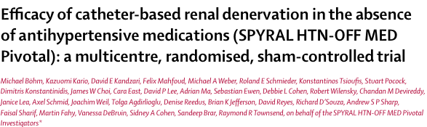
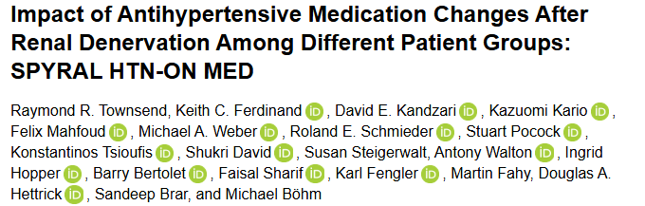
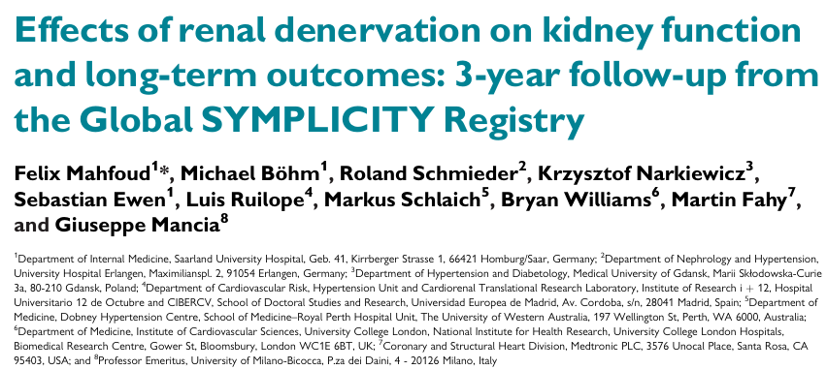
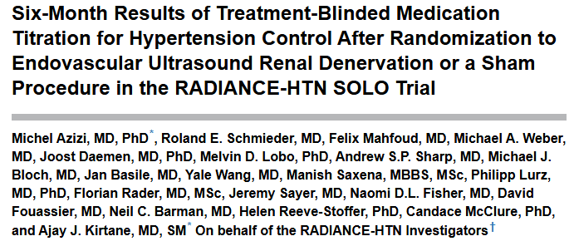
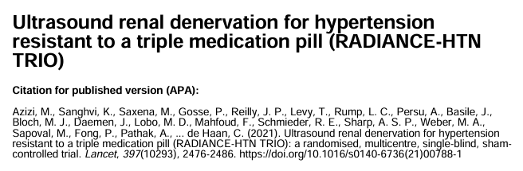
BRITISH CARDIOVASCULAR INTERVENTION SOCIETY
Key Trials in Renal Denervation
Notes:
"The evidence base for renal denervation has expanded significantly over the past decade.
The SPYRAL and RADIANCE programmes demonstrated meaningful and sustained reductions in blood pressure compared with sham controls, helping to establish the efficacy of the therapy.
These findings have been reinforced by real-world data from the Global Symplicity Registry (GSR), which has shown that approximately 80% of patients achieve a clinically meaningful blood pressure response following treatment.

Slide 22
BRITISH CARDIOVASCULAR INTERVENTION SOCIETY
RDN is evidence-based Modern sham-controlled trials consistently demonstrate safe, sustained BP reductions of up to 20 mmHg
Patient selection is key Exclude secondary hypertension; confirm anatomy; consider medication adherence before labelling resistant
The procedure is low-risk Complication profile compares favourably with other cardiovascular interventions; spasm and access site issues are the main concerns
MDT teamwork is essential Nurses, radiographers and physiologists each have distinct and critical roles throughout the pathway
The field is evolving NHS commissioning is anticipated; now is the time for AHPs to build knowledge and shape local pathways
Notes:
"If you remember five things from today:
First, renal denervation is now supported by high-quality evidence.
Second, patient selection is critical.
Third, the procedure has a favourable safety profile.
Fourth, success depends on effective multidisciplinary teamwork.
And finally, this is a rapidly evolving field with growing interest and likely expansion of services across the NHS."

Slide 23
Thank you
Join the conversation using #BCISAHP
michael.galinato@nhs.net
Notes:
Closing slide. Add your contact / handle for follow-up questions.

