Slide 1

BRITISH CARDIOVASCULAR INTERVENTION SOCIETY
AHP ANNUAL CONFERENCE 2026
Raising the Bar (and the Band)
Henry Jr. Parza· Cath Lab Manager
Torbay and South Devon NHS Foundation Trust
13–14 July 2026
Birmingham Conference & Events Centre
Notes:
In a few seconds, I’ll discuss how I have successfully achieved rebanding my cath lab band 5 RN to Band 6
But before I dive straight to the topic of AFC …
Few slides focusing on the COMPETENCIES IN LINE with the
SERVICE SCOPE AND RESPONSIBILITIES of a Cath lab Nurse at Torbay

Slide 2

BRITISH CARDIOVASCULAR INTERVENTION SOCIETY
Declaration of Interests
I have no conflicts of interest to declare.
Join the conversation using #BCISAHP
Notes:
I have no conflicts of Interest to declare.

Slide 3
SECTION
Torbay Cath Lab Nurse – Service Scope and Responsibility
AHP ANNUAL CONFERENCE 2026
Notes:
Use between sections of your talk. Duplicate this slide as needed.

Slide 4
















1. Assessment & Prep
BRITISH CARDIOVASCULAR INTERVENTION SOCIETY
7. Emergency & Critical Care Response
2. Scrub & Assistant Role
Cath Lab
Nurse
6. Professional Practice & Leadership
3. Circulate or Runner Role
4. Recovery & Post-Care
5. Radiation & Equipment Safety
Join the conversation using #BCISAHP
Notes:
Cath Lab Nurse Competencies are outlined by nursing frameworks and link with the
BRITISH ASSOCIATION OF NURSING IN CARDIOVASCULAR CARE (BANCC)
7 CORE DOMAINS ARE DELIVERED.
THESE ARE COMBINATION of
4 pillars of advanced practice and 3 core skills
While I understand that this is most likely similar amongst the other trusts
But I just want to highlight some of the service scope that promotes autonomy.
Assessment and Prep
FULL PATIENT PREP
Organising Medication and Blood
Providing Procedure information as
Part of consenting
NO SEPARATE PA Team
Scrub &Assisting Role
Acts as SECOND OPERATOR
COMPETENTLY HANDLES all types of
Procedure including Complex Devices and Complex Interventions such as, Rotablation, CTO and other a lot more
Circulate or Runner Role
SAFETY CORRDINATOR while the procedure is underway
Administer IV medication including conscious sedation and Tracking all EVENTS
Provides procedural items/equipments
MAINTAINING PATIENT SAFETY through Monitoring and Managing Haemodynamic
Recovery & Post Care
POST PROCEDURAL CARE
INVOLVES/INCLUDING
COMPLICATIONS MANAGEMENT
NO SEPARATE RECOVERY TEAM
NURSE LED DISCHARGE IS PART OF OUR PRACTICE
Helps us facilitate efficient patient flow and experience
PROMOTES autonomy and INDEPENDENT decision making
Following Crossed-referenced to our Consultant as part of the post procedural Discharge Plan
Radiation and Equipment Safety
Adhering to strict radiation protection guidelines.
INCLUDING Local Rules and Ionising Radiation Regulations
CONDUCTS daily safety checks in lab Involving equipment and supplies
Professional Practice and Leadership
OVERALL code of Practice
Adhering to NMC code of Practice
Engaging in continuing professional development, involvement with MDT and Research
Emergency and Critical Care Response
Providing Immediate life support and primary interventions.
PROMOTING Autonomous response during emergency situations
Involves advance clinical competencies

Slide 5

BRITISH CARDIOVASCULAR INTERVENTION SOCIETY
Band 5 vs Band 6: Clinical Responsibility
Entry Level
Category
Specialist
Band 5 Role
Band 6 Role
Developing foundational knowledge
Knowledge
Specialist cardiology knowledge
Assists during standard cases
Procedures
Independent practitioner
Standard daytime hours only
On-Call
24/7 pPCI on-call service
Limited participation with specialised clinics
Other Clinics
Advanced recovery & clinics
Participates as directed
Emergency
Leads clinical response
Informal peer support
Leadership
Shift coordination & education
Current Reality
These are established duties at Torbay, not future proposals.
Join the conversation using #BCISAHP
Notes:
THIS IS A GENERAL COMPARISSION OF
DISCLAIMER : NOT to UNDERMINE all the Experienced Band 5 Nurses in the cath lab across the UK
The comparison is to understand and justify INVOLVED RESPOSIBILITIES as part of WEIGHT scores when I started the process of agenda for change
PARTICULARLY to newly hired cath lab nurse or no previous cath lab experience.
BAND 5 – ENTRY LEVEL INTO CATH LAB
BAND 6 ROLE – Advanced Cath Lab nurse/ or specialist role
Basic Interpretation to ECG, Heart Anatomy and Physiology
Supervised during standard procedures
Limitation to participate to specialize clinic like; Stress MRI
Minimal exposure to coordinating or charge roles.
AND>..
Summarise by stating ENTRY LEVEL TO CATH LAB
EXPERIENCED CATH LAB –
Give Example for other centers might have CTO/Complex PCI Lead
ON- CALL SUPPORT
The core uplift lies in autonomy, accountability, on-call readiness, and service leadership — not a different clinical environment.

Slide 6

BRITISH CARDIOVASCULAR INTERVENTION SOCIETY
Why this
topic matters?
Join the conversation using #BCISAHP
Notes:
Tell your personal experience and questions to yourself.
What’s in it for the service?
What’s in it for our patients?
What’s in it for my team?
What’s in it for me?
Same questions goes to all band 5 nurses in who are thinking on how they are able to achieve growth in their career.
Or thinking of upskilling such as learning radial access, or accessing higher education such as practitioner courses to be able to achieve being rebanded?
AND BENEFIT THE DEPARTMENT AS A WHOLE

Slide 7

BRITISH CARDIOVASCULAR INTERVENTION SOCIETY
Why This Topic Matters
1
Significant Role Evolution
The Mismatch
2
National Banding Variation
"Doing more for the same band"
3
Higher Patient Acuity
Responsibility
Recognition
4
Increasingly Complex Procedures
HIGH
LOW
5
24/7 Emergency Services
Band 6+ workload
Band 5 pay
Join the conversation using #BCISAHP
Notes:
CATH LAB Practice has ADVANCED Rapidly with COMPLEX PROCEDURES, Such as Complex Devices and CTO, ROTA and ADVANCE IMAGERY and other Equipment involved
NATIONAL JOB PARITY INCONSISTENCIES – affects both Recruitment and Retention
Staff banding and progression has frequently remained STAGNANT – despite INCREASING CLINICAL RESPONSIBILITIES
HIGH RIKS WORK is being routinely performed at BAND 5 level recognition

Slide 8
BRITISH CARDIOVASCULAR INTERVENTION SOCIETY
Key Factor: On-Call & Emergency Service
EVIDENCE
Band 6 factors supported by:
Primary Impact
The Autonomy Shift
⏱
24/7 On-Call Rota
Out-of-hours responsibility significantly increases scores in Freedom to Act and Responsibility domains.
♥
Primary PCI Service
Delivering 24/7 emergency care requires independent, out-of-hours practice and advanced competencies. Managing critically ill patients represents a fundamental shift in autonomy and accountability.
◆
Working Without Supervision
⚖
High-Risk Decision Making
Exceeds B5 Scope
✚
Critically Ill Patients
"If it is not written in the JD, it cannot be scored."
Join the conversation using #BCISAHP
Notes:
This slide highlights the On-call and Emergency Service that PLAYED as critical differentiator for Agenda for Change Scoring.
Delivering 24/7 emergency care requires
INDEPENDENT DECISION MAKING or AUTONOMY , regardless if it’s in-hours or most specially out-of-hours practice and involves advanced competencies.
On-call is considered as DEVELOPMENTAL ROLE and
ON CALL MIGHT BE or should be JUST ENOUGH TO BE UPLIFTED TO BAND 6

Slide 9
BRITISH CARDIOVASCULAR INTERVENTION SOCIETY
Extended Roles Supporting Band 6
✚
Pre-Assessment
♥
Recovery Nurse Leadership
◆
Teaching & Competency Sign-Off
◉
Other Non-Invasive Clinics — Stress MRI, TOE & Bubble Studies
✦
Complex Procedures & Devices
∎
Stock, Audit & MDT Protocols
CURRENT REALITY · SERVICE-CRITICAL FUNCTIONS ALREADY DELIVERED
Join the conversation using #BCISAHP
Notes:
ONE OF THE ADVANTAGES with
Expanded clinical scope requiring AUTONOMOUS practice BEYOND OR OUTSIDE the procedure room:
HIGHLIGHTING THE FLEXIBILITY that the TORBAY CATHLAB TEAM achieved:
DO WE OUR OWN PA
WE ROTATE RECOVERY AND LAB DAILY
Everyone Participates on STOCKS AND AUDITS
PROMOTES LEADERSHIP ROLES
SENIORS acts as FORMAL Precptors for junior staff, provides hands on training
Helps facilitate other Non-Invasive Procedures
MOST IMPORTANTLY….
COMPLEX PROCEDURE-
having the Same level of skills and knowledge who are able to perform all types of Cath Lab Cases ANY GIVEN DAY AT ANY GIVEN TIME
AND BE ABLE TO ACHIVE this FLEXIBILITY, has resulted STABILITY IN THE DEPARTMENT

Slide 10
BRITISH CARDIOVASCULAR INTERVENTION SOCIETY
What is Agenda for Change?
"
Equal pay for work of equal value
The national grading and pay structure for nearly all NHS-employed staff, excluding doctors, dentists, and some very senior managers.
Source:National Job Profiles Guidance for panels on the updated job matching profiles for nursing and midwifery | NHS Employers
Join the conversation using #BCISAHP
Notes:
WE HAVE FINALLY ARRIVED TO THIS TOPIC
What is agenda for change?
Introduced in 2004 Every role is evaluated against a standard set of criteria to EQUAL PAY FOR WORK OF EQUAL VALUE
It provides a systematic, analytical approach to measuring the demands of different roles.
There are total of 16 JE factors as part of the JE/Matching scheme
In which I will be discussing in the next few slides

Slide 11
BRITISH CARDIOVASCULAR INTERVENTION SOCIETY
Evaluation Process Checklist
Documents and steps used in the Torbay re-banding submission.
‘’Ensures correct banding based on actual clinical practice’’ — not simply rewarding time served.
1
Update Cath Lab Job Description
2
Appendix 6 — Application to re-evaluate an existing post
3
Complete the JE Effort Form
Source: Job Matching, AFC NHS Job Evaluation Handbook | NHS Employers
Join the conversation using #BCISAHP
Notes:
Matches role evidence against national profiles and 16 JE factors.
Accurately evaluates role content including:
responsibility, Freedom to ACT , knowledge, skills and effort, and working conditions.
Update real Cath Lab Job Description#
APPENDIX 6— Application to re-evaluate an existing post
State the reason#
Obtain signatories#
Cath lab manager
Matron
ADO/ADNPP
Accts Management
System/Operations Director
COMPLETE THE JOB EVAL EFFORT FORM
INCLUDE CURRENT COMPETENCIES AND LINK THIS WITH THE SERVICE SCOPE AND RESPONSIBILITY

Slide 12
BRITISH CARDIOVASCULAR INTERVENTION SOCIETY
Job Evaluation Effort Form
01 · Effort
02 · Effort
03 · Effort
04 · Conditions
Physical Effort
Mental Effort
Emotional Effort
Working Conditions
Source: NHS Employers & NHS Staff Council job evaluation principles
Join the conversation using #BCISAHP
Notes:
PHYSICAL - Manual Handling:
Pushing, pulling, bending, kneeling, moving patients — manual handling. HOW LONG NORMALLYN THE PROCEDURE LAST
MENTAL AND EMOTIONAL - Unpredictability of work nature — emergencies, deteriorating patients
Exposure to distressing situations
WORKING CONDITIONS- Does the job-holder work in unpleasant working conditions — radiation, body fluids, biological hazards? Apart from what I have just mentioned with the Unpredictability of work

Slide 13
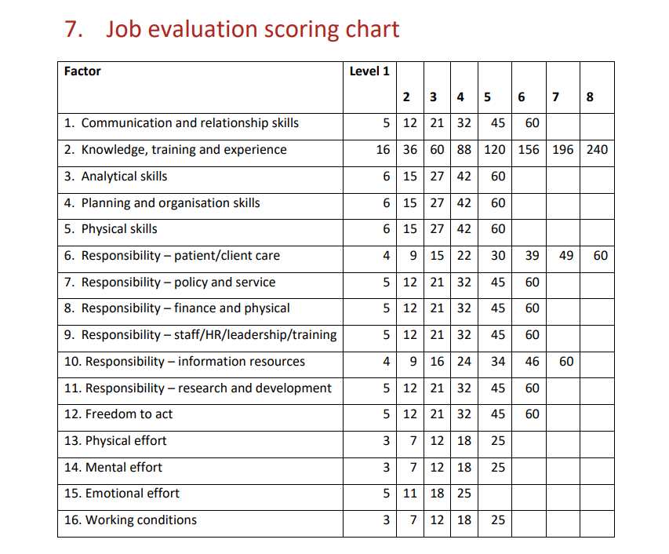
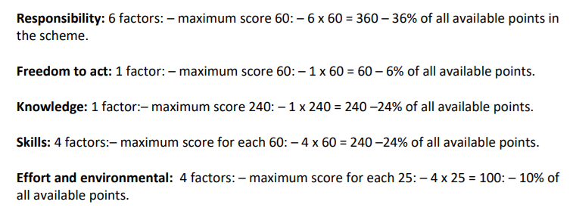
BRITISH CARDIOVASCULAR INTERVENTION SOCIETY
Job Evaluation Weighing & Scoring
Source: NHS JE Evaluation Handbook JE Handbook - 8th Edition - January 2024.pdf
Join the conversation using #BCISAHP
Notes:
THERE ARE 5 main factors are subdivided into several factors, for example:
The allocation of total points
to factors is set out below and does not mean you have to consistently hit LEVEL 6.
For example: under RESPONSIBILITY SECTION comprises or subdivided to 6 factors

Slide 14
BRITISH CARDIOVASCULAR INTERVENTION SOCIETY
Job Evaluation Variance
National Band 6i JE score range: 396-465
1
EXCEEDS B5
Knowledge
Responsibilities
2
EXCEEDS B5
3
EXCEEDS B5
Freedom to Act
4
2
LOCALLY STRONGER
Analytical
Join the conversation using #BCISAHP
Notes:
As soon we have completed role evidence submitted against JE weighing and scoring
Results for torbay IN LINE WITH the current service scope and responsibility of a cath lab nurse..
Torbay Exceeded with..
Knowledge
Responsibilities
Freedom to act,
Majority are aligned and locally stronger

Slide 15
BRITISH CARDIOVASCULAR INTERVENTION SOCIETY
Benefits of Re-banding Outcomes
↗
★
♡
Attract & Recruit
Staff Retention
Staff Morale Boost
⇄
⛨
✓
Workforce Flexibility
Service Resilience
Safer Staffing Continuity
Join the conversation using #BCISAHP
Notes:
STAFF RETENTION- advanced skills preserved highly trained staff, reducing burnout and costly turnover
WORKFORCE FLEXIBILITY- Guarantees
SERVICE RESILIENCE -
ALSO Guarantees stable, highly-skilled cover including 24/7 emergency cover.
SAFER STAFFING - Maintains high clinical standards and patient safety through consistent, experienced nursing teams.

Slide 16
BRITISH CARDIOVASCULAR INTERVENTION SOCIETY
Message to Other Cath Labs
Conclusion and strategic recommendations.
Re-banding is achievable if you:
✓
Write the real role
✓
Define competencies clearly
✓
Include on-call & emergency duties
✓
Benchmark locally and nationally
✓
Use national job profiles including JE handbook and AFC references
Join the conversation using #BCISAHP
Notes:
Band 6 (Band 5 until completion of developmental competency including On-Call competency)"
"To work in all areas of Cardiac Catheter Suite including Recovery area and other Cardiology Non-Invasive Procedures.“

Slide 17
Final Thought
Correct banding is not exceptional.
It is appropriate.
AHP ANNUAL CONFERENCE 2026
Notes:
Barts Health NHS Trust, Guy’s and St Thomas’, and University Hospitals Birmingham—
3 months Turn AROUND 14 days for review
You have 30 days following submision of request
Panel review took 1 month prior decision
Handbook & JE principles
National Nursing Profiles including National Benchmarking (PCI CENTERS AND TEACHING HOSPITALS)
Other Trust’s comparison and Local comparison

Slide 18
Thank you
Join the conversation using #BCISAHP
Notes:
Barts Health NHS Trust, Guy’s and St Thomas’, and University Hospitals Birmingham—
3 months Turn AROUND 14 days for review
You have 30 days following submision of request
Panel review took 1 month prior decision
Handbook & JE principles
National Nursing Profiles including National Benchmarking (PCI CENTERS AND TEACHING HOSPITALS)
Other Trust’s comparison and Local comparison

