Slide 1

BRITISH CARDIOVASCULAR INTERVENTION SOCIETY
AHP ANNUAL CONFERENCE 2026
Essex Cardiothoracic Centre
Michael Galinato· Cardiac Cath Lab Manager · Essex Cardiothoracic Centre
Craig Robertson· Lead PCI Clinical Nurse Specialist · Essex Cardiothoracic Centre
13–14 July 2026
Birmingham Conference & Events Centre

Slide 2

SECTION
The Essex Cardiothoracic Centre
AHP ANNUAL CONFERENCE 2026
Notes:
As we are representing Essex today, we know expectations were high that we’d include Gemma Collins or Joey Essex in our promotional video.
Unfortunately, we could not cover their budget – we did try.
But what we can offer is something we’re much prouder of – One of the Uk’s leading tertiary cardiothoracic centres.

Slide 3
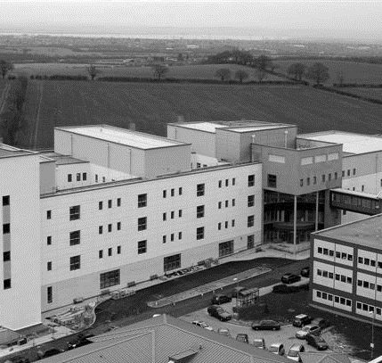





BRITISH CARDIOVASCULAR INTERVENTION SOCIETY
Opened July 2007
4 Cardiac Catheter Laboratories
4 Cardiothoracic Operating Theatres
Including Hybrid Theatre
82 Inpatient Beds
Join the conversation using #BCISAHP
Notes:
The Essex Cardiothoracic Centre opened back in 2007
Busy Tertiary Centre serving a population of 1.8 million people
We provide a full range of cardiac services including Primary PCI, Complex Coronary Intervention, Structural heart procedures, Electrophysiology and Cardiothoracic Surgery.
In addition to our inpatient services, we run a range of specialist outpatient clinics including the Care After Resuscitation Clinic, the Inherited Cardiac Conditions Service and fast track Valve clinics.
We work in collaboration with Anglia Ruskin University and are keen to participate in research. Recently we have completed the ORBITA CTO trial, however more on that tomorrow
We now have a short video giving you a quick tour of our cath labs.

Slide 4
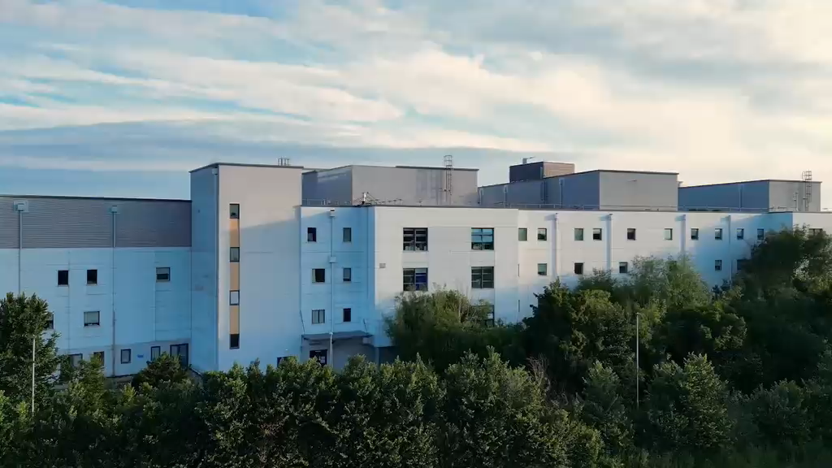
Notes:
Required by the meeting. Keep ONE of the two statements and delete the other.

Slide 5
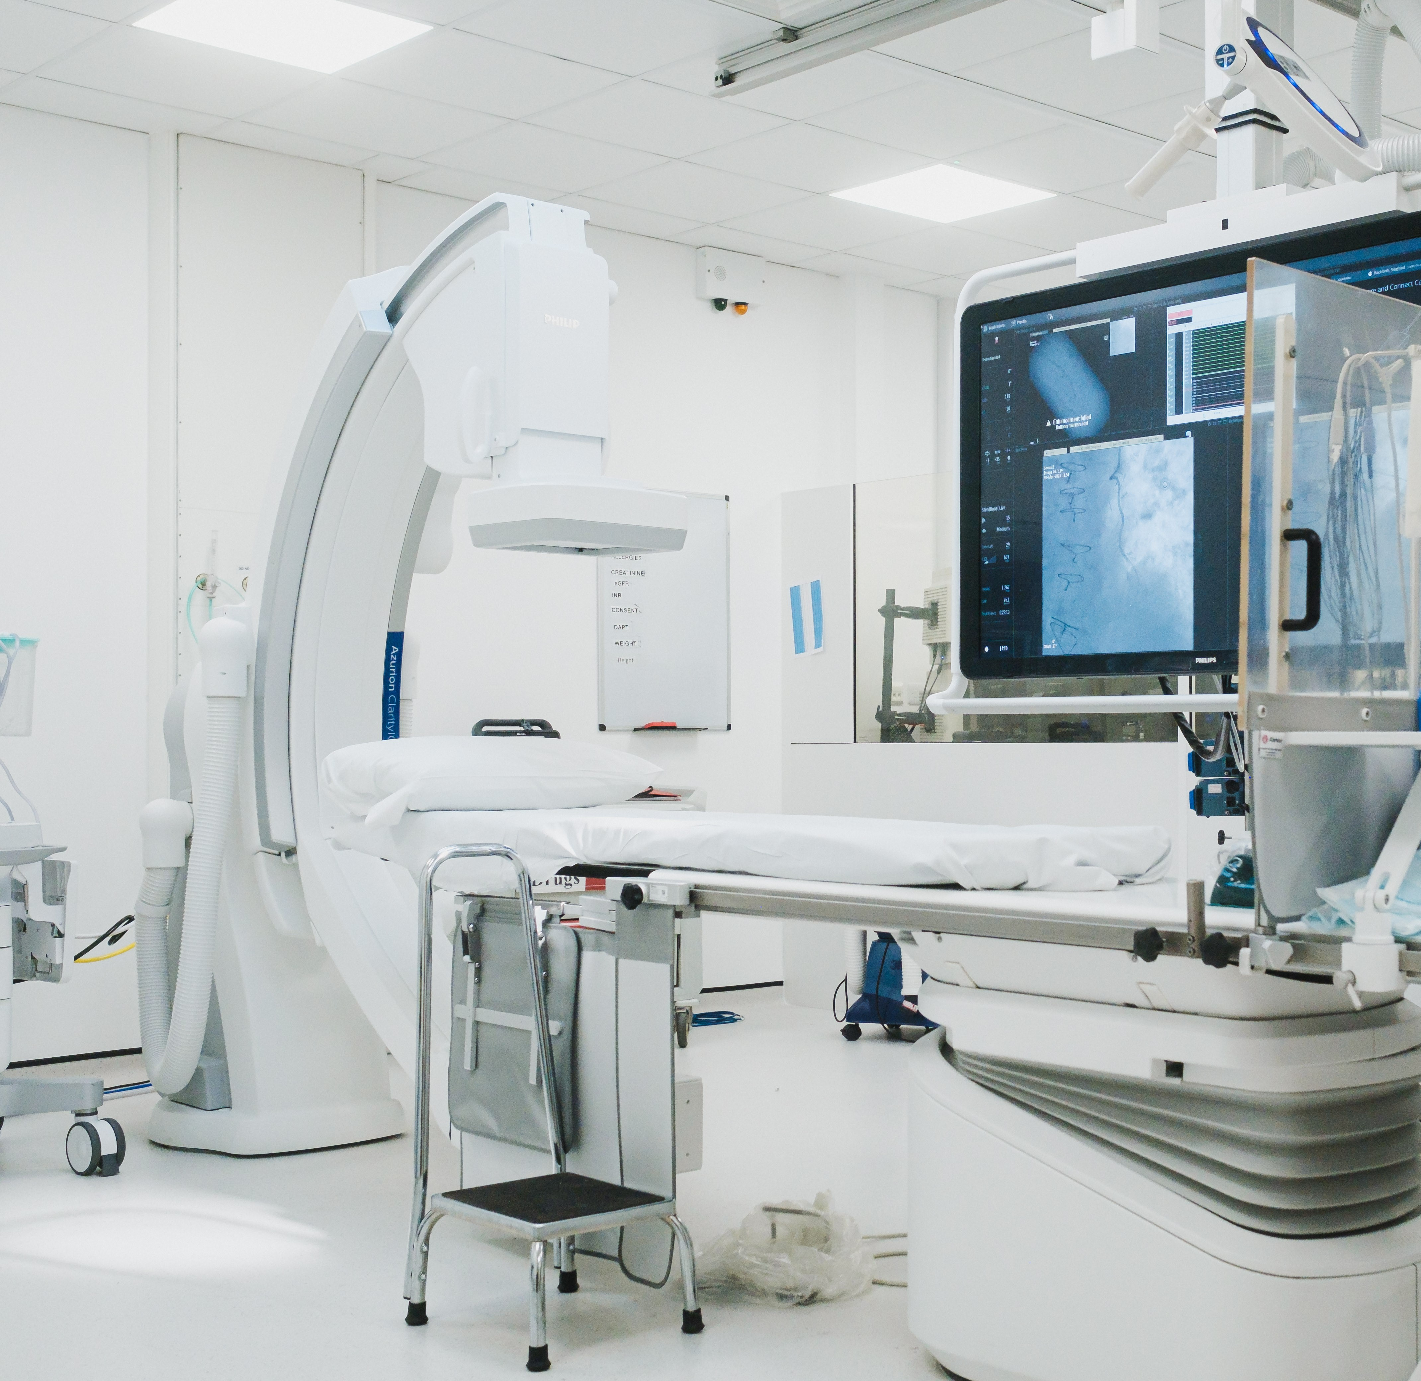
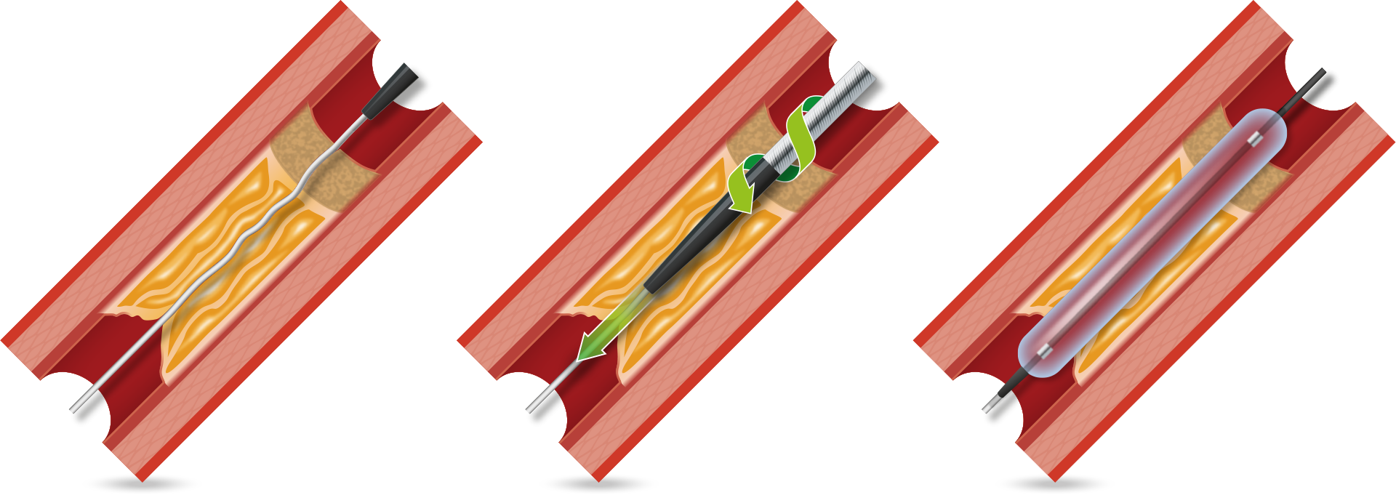
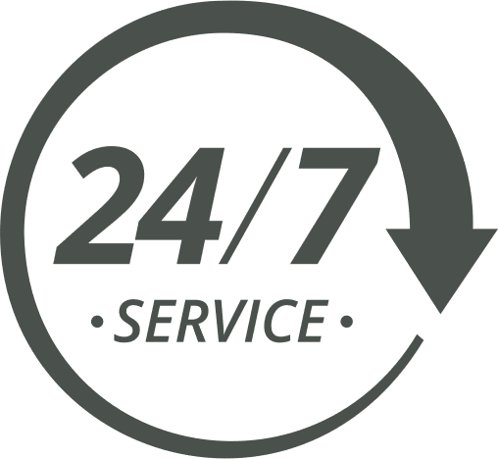



BRITISH CARDIOVASCULAR INTERVENTION SOCIETY
PCI 2500
PPCI/OOHCA 900
Ablation 600
Device 500
TAVI 300
Join the conversation using #BCISAHP
Notes:
Our cath labs is one of the busiest centre in the UK. Within a typical year ……
We have four cardiac cath labs where we deliver a range of cardiac services – we perform PCIs, PPCIs, ablations, device implantations and strutuctural procedures.
Alongside our PPCI service we established an OOH pathway for patients whereby if they suffer an OOH Cardiac arrest which is either VT / VF they are immediately fast tracked to the centres cath labs for assessment and treatment if required.
Recent refurbishment of all our labs provided us new state of the art equipment such as our xrays, imaging equipment for PCIs and the most latest treatment options for our EP and device procedures.
Our Cath Lab is fast paced and rewarding environment where no two days are the same. You will have the opportunity to work with highly skilled multidisciplinary team and have the opportunity to make a difference to patients lives everyday.

Slide 6
Thank you
Join the conversation using #BCISAHP
Notes:
Closing slide. Add your contact / handle for follow-up questions.

