Slide 1


BRITISH CARDIOVASCULAR INTERVENTION SOCIETY
AHP ANNUAL CONFERENCE 2026
DELIVERING 24/7 PPCI SERVICE AS A DISTRICT HOSPITAL​
Alisha Rai · Cath Lab Nurse
Torbay & South Devon Foundation
13–14 July 2026
Birmingham Conference & Events Centre
Notes:
Speaker title slide. Replace the title and your name/role/organisation. Event branding is fixed.

Slide 2

BRITISH CARDIOVASCULAR INTERVENTION SOCIETY
Declaration of Interests
Please keep one statement and delete the other.
I have no conflicts of interest to declare.
Join the conversation using #BCISAHP
Notes:
Required by the meeting. Keep ONE of the two statements and delete the other.

Slide 3

SECTION
Sustainable 24/7 PPCI SERVICE
AHP ANNUAL CONFERENCE 2026
Notes:
Use between sections of your talk. Duplicate this slide as needed.

Slide 4
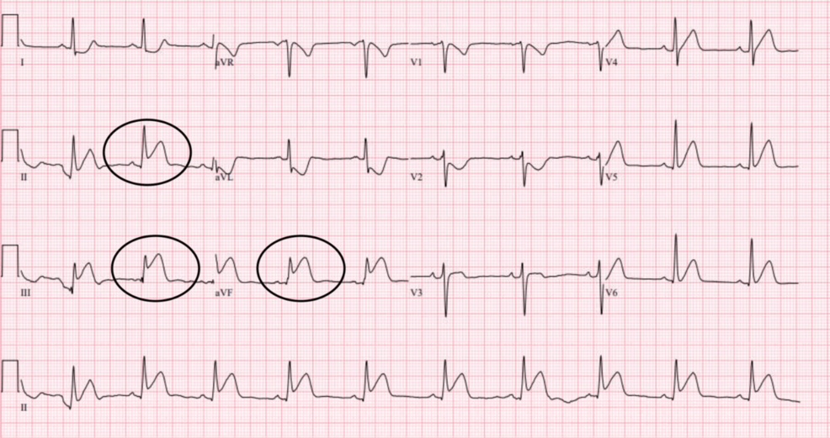
BRITISH CARDIOVASCULAR INTERVENTION SOCIETY
Cath lab team prompt response
Aiming for effective timely intervention
Join the conversation using #BCISAHP
Notes:
Required by the meeting. Keep ONE of the two statements and delete the other.

Slide 5

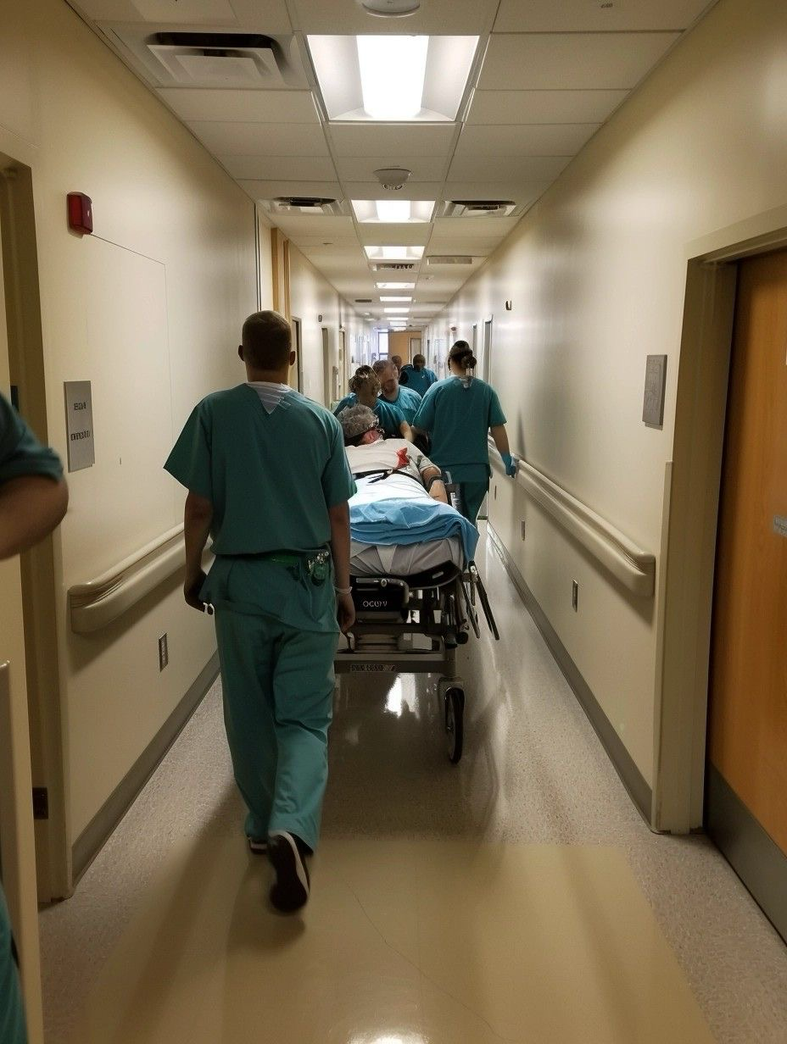
SECTION
Activity & Performance Data
AHP ANNUAL CONFERENCE 2026
Notes:
Use between sections of your talk. Duplicate this slide as needed.

Slide 6
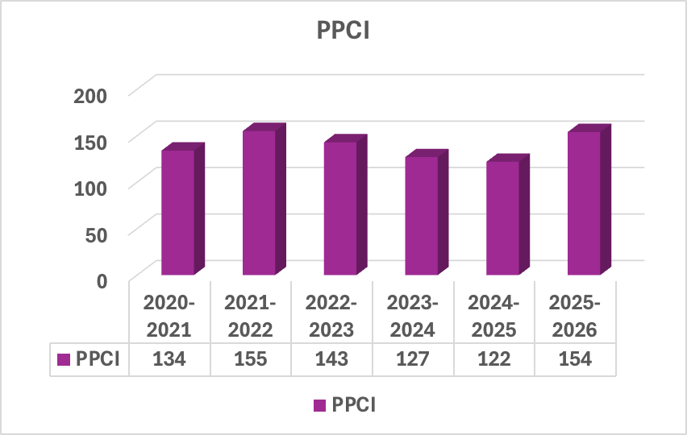
BRITISH CARDIOVASCULAR INTERVENTION SOCIETY
Annual PPCI Activity trends​
Join the conversation using #BCISAHP
Notes:
Required by the meeting. Keep ONE of the two statements and delete the other.

Slide 7
BRITISH CARDIOVASCULAR INTERVENTION SOCIETY
Join the conversation using #BCISAHP
Source – NATIONAL AUDIT OF PERCUTANEOUS CORONARY INTERVENTIONS
Notes:
Required by the meeting. Keep ONE of the two statements and delete the other.

Slide 8
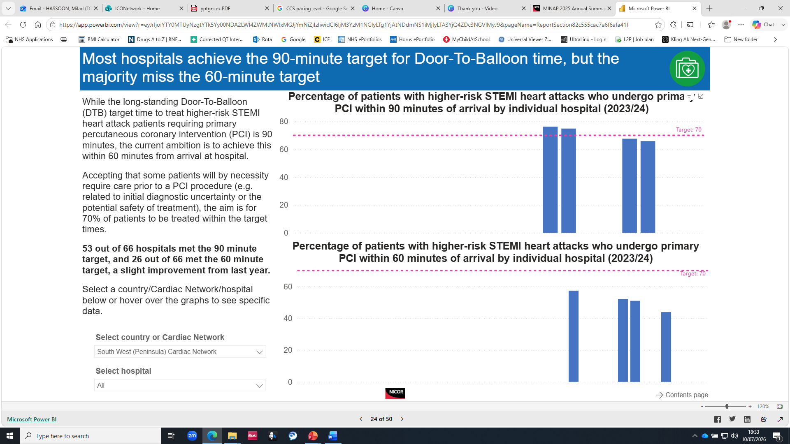
BRITISH CARDIOVASCULAR INTERVENTION SOCIETY
TSD
Join the conversation using #BCISAHP
Source – NATIONAL AUDIT OF PERCUTANEOUS CORONARY INTERVENTIONS
Notes:
Required by the meeting. Keep ONE of the two statements and delete the other.

Slide 9

SECTION
Work force Sustainability
AHP ANNUAL CONFERENCE 2026
Notes:
Use between sections of your talk. Duplicate this slide as needed.

Slide 10
BRITISH CARDIOVASCULAR INTERVENTION SOCIETY
Equitable Workload distribution
Enforced Rest period
Staffing Resilience & Flexibility
Well being & Patient outcomes
Join the conversation using #BCISAHP
Notes:
Required by the meeting. Keep ONE of the two statements and delete the other.

Slide 11
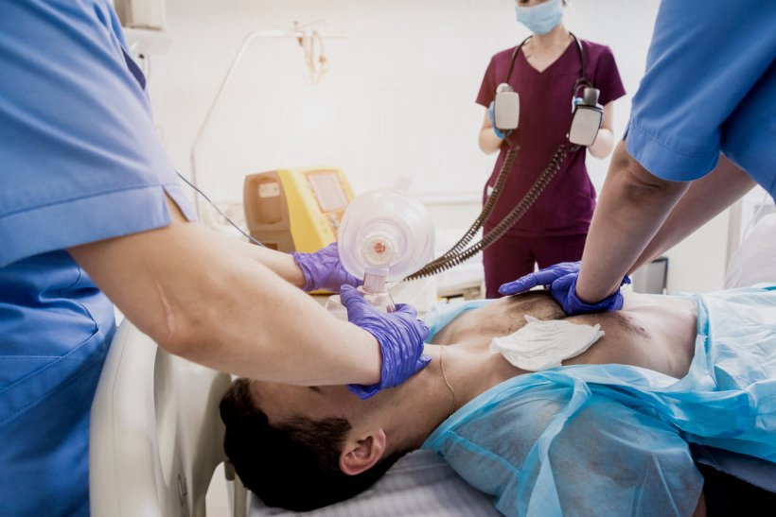
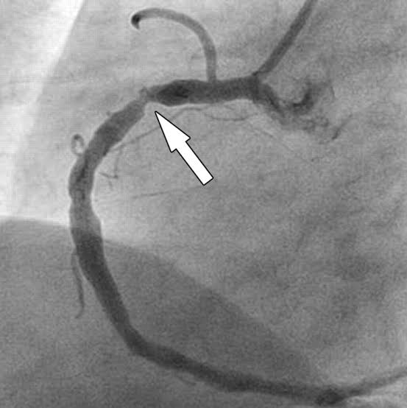
SECTION
Standardised Pathways
AHP ANNUAL CONFERENCE 2026
Notes:
Use between sections of your talk. Duplicate this slide as needed.

Slide 12
BRITISH CARDIOVASCULAR INTERVENTION SOCIETY
Early Diagnosis via ECG
Consultant led Activation
Direct Transfer to Cath Lab
Clear Activation Processes
Join the conversation using #BCISAHP
Notes:
Required by the meeting. Keep ONE of the two statements and delete the other.

Slide 13

SECTION
Relationship &Communication
AHP ANNUAL CONFERENCE 2026
Notes:
Use between sections of your talk. Duplicate this slide as needed.

Slide 14
BRITISH CARDIOVASCULAR INTERVENTION SOCIETY
Relationship & Communication
Collaboration with Ambulance services
Clarity drives speed
Structured Pre-alert handovers
CCU + ED coordination
Join the conversation using #BCISAHP
Notes:
Required by the meeting. Keep ONE of the two statements and delete the other.

Slide 15
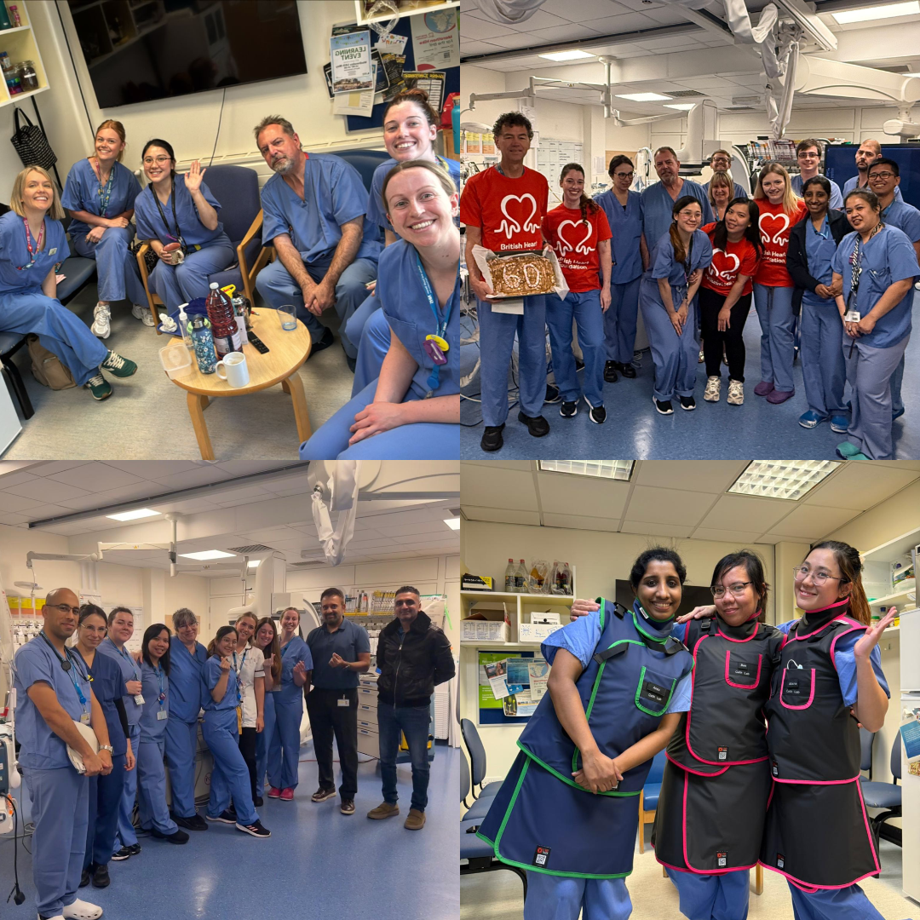
SECTION
Team Culture
AHP ANNUAL CONFERENCE 2026
Notes:
Use between sections of your talk. Duplicate this slide as needed.

Slide 16
BRITISH CARDIOVASCULAR INTERVENTION SOCIETY
Empowered team members
Supportive leadership
Flat communication structure
Psychological safety
Join the conversation using #BCISAHP
Notes:
Required by the meeting. Keep ONE of the two statements and delete the other.

Slide 17

SECTION
Debrief & Continuous Improvement
AHP ANNUAL CONFERENCE 2026
Notes:
Use between sections of your talk. Duplicate this slide as needed.

Slide 18
BRITISH CARDIOVASCULAR INTERVENTION SOCIETY
Debrief practice
Inclusive participation
Quality improvement
Reflective learning
Join the conversation using #BCISAHP
Notes:
Required by the meeting. Keep ONE of the two statements and delete the other.

Slide 19
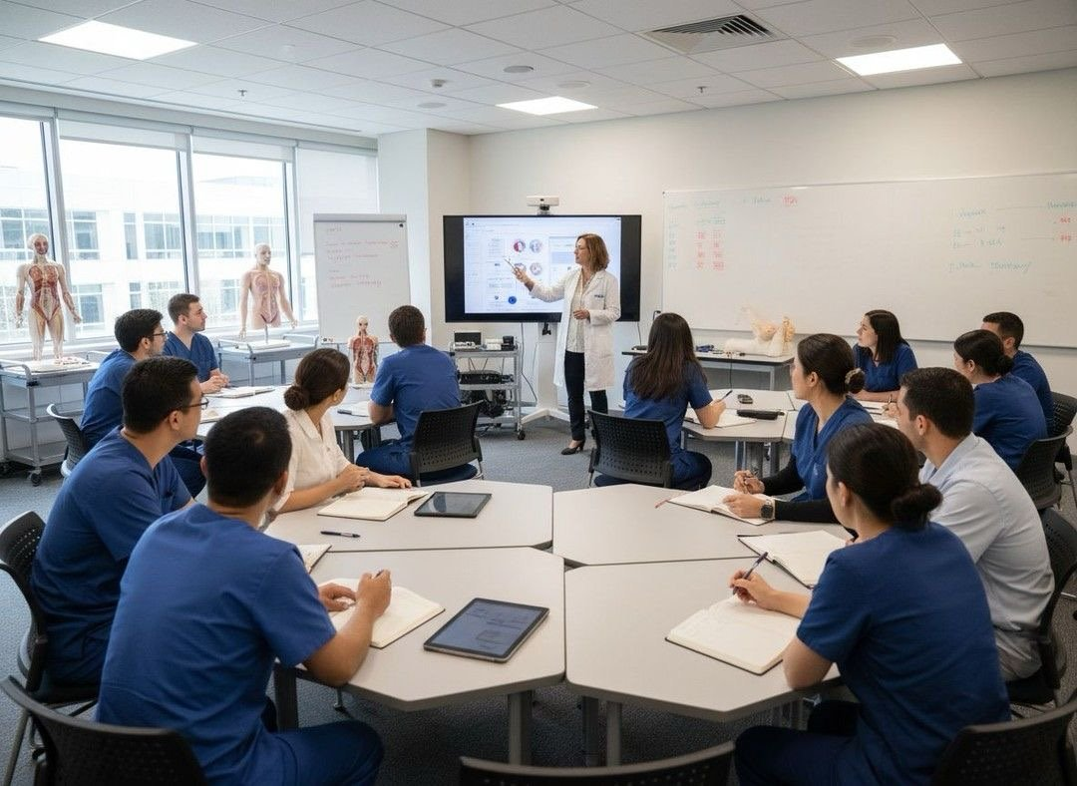
SECTION
Conclusion
AHP ANNUAL CONFERENCE 2026
Notes:
Use between sections of your talk. Duplicate this slide as needed.

Slide 20
BRITISH CARDIOVASCULAR INTERVENTION SOCIETY
System based success
Sustainable
workforce
Team based
performance
Patient & Staff well being
Join the conversation using #BCISAHP
Notes:
Required by the meeting. Keep ONE of the two statements and delete the other.

Slide 21
Thank you
Join the conversation using #BCISAHP
Notes:
Closing slide. Add your contact / handle for follow-up questions.

