Slide 1

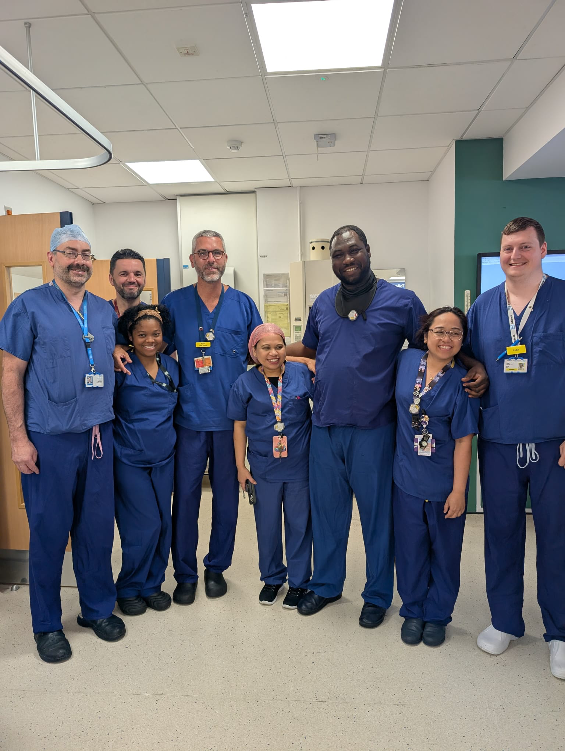
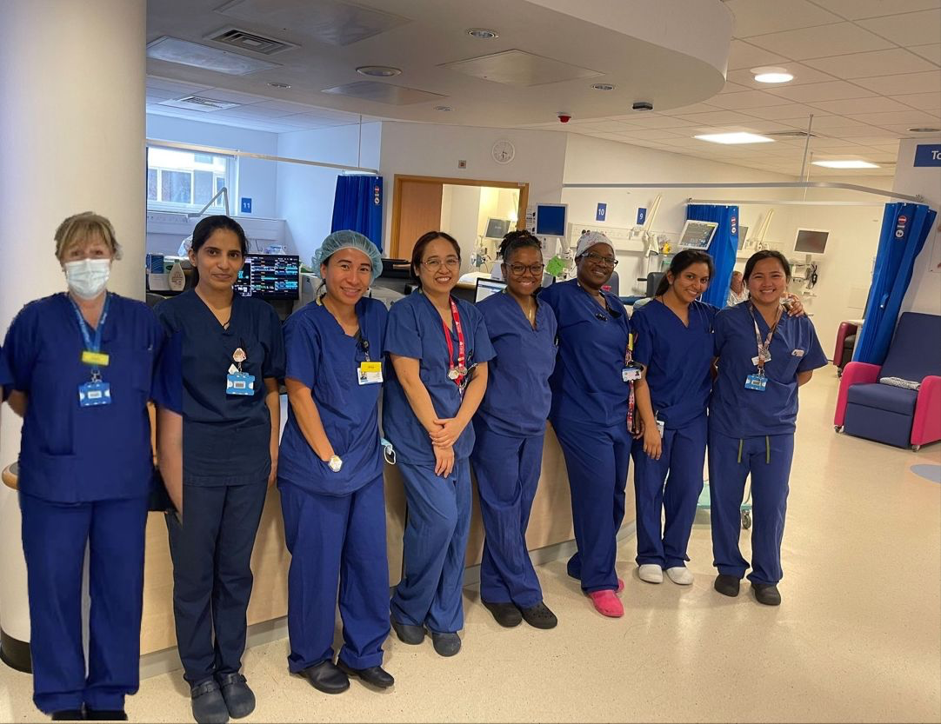
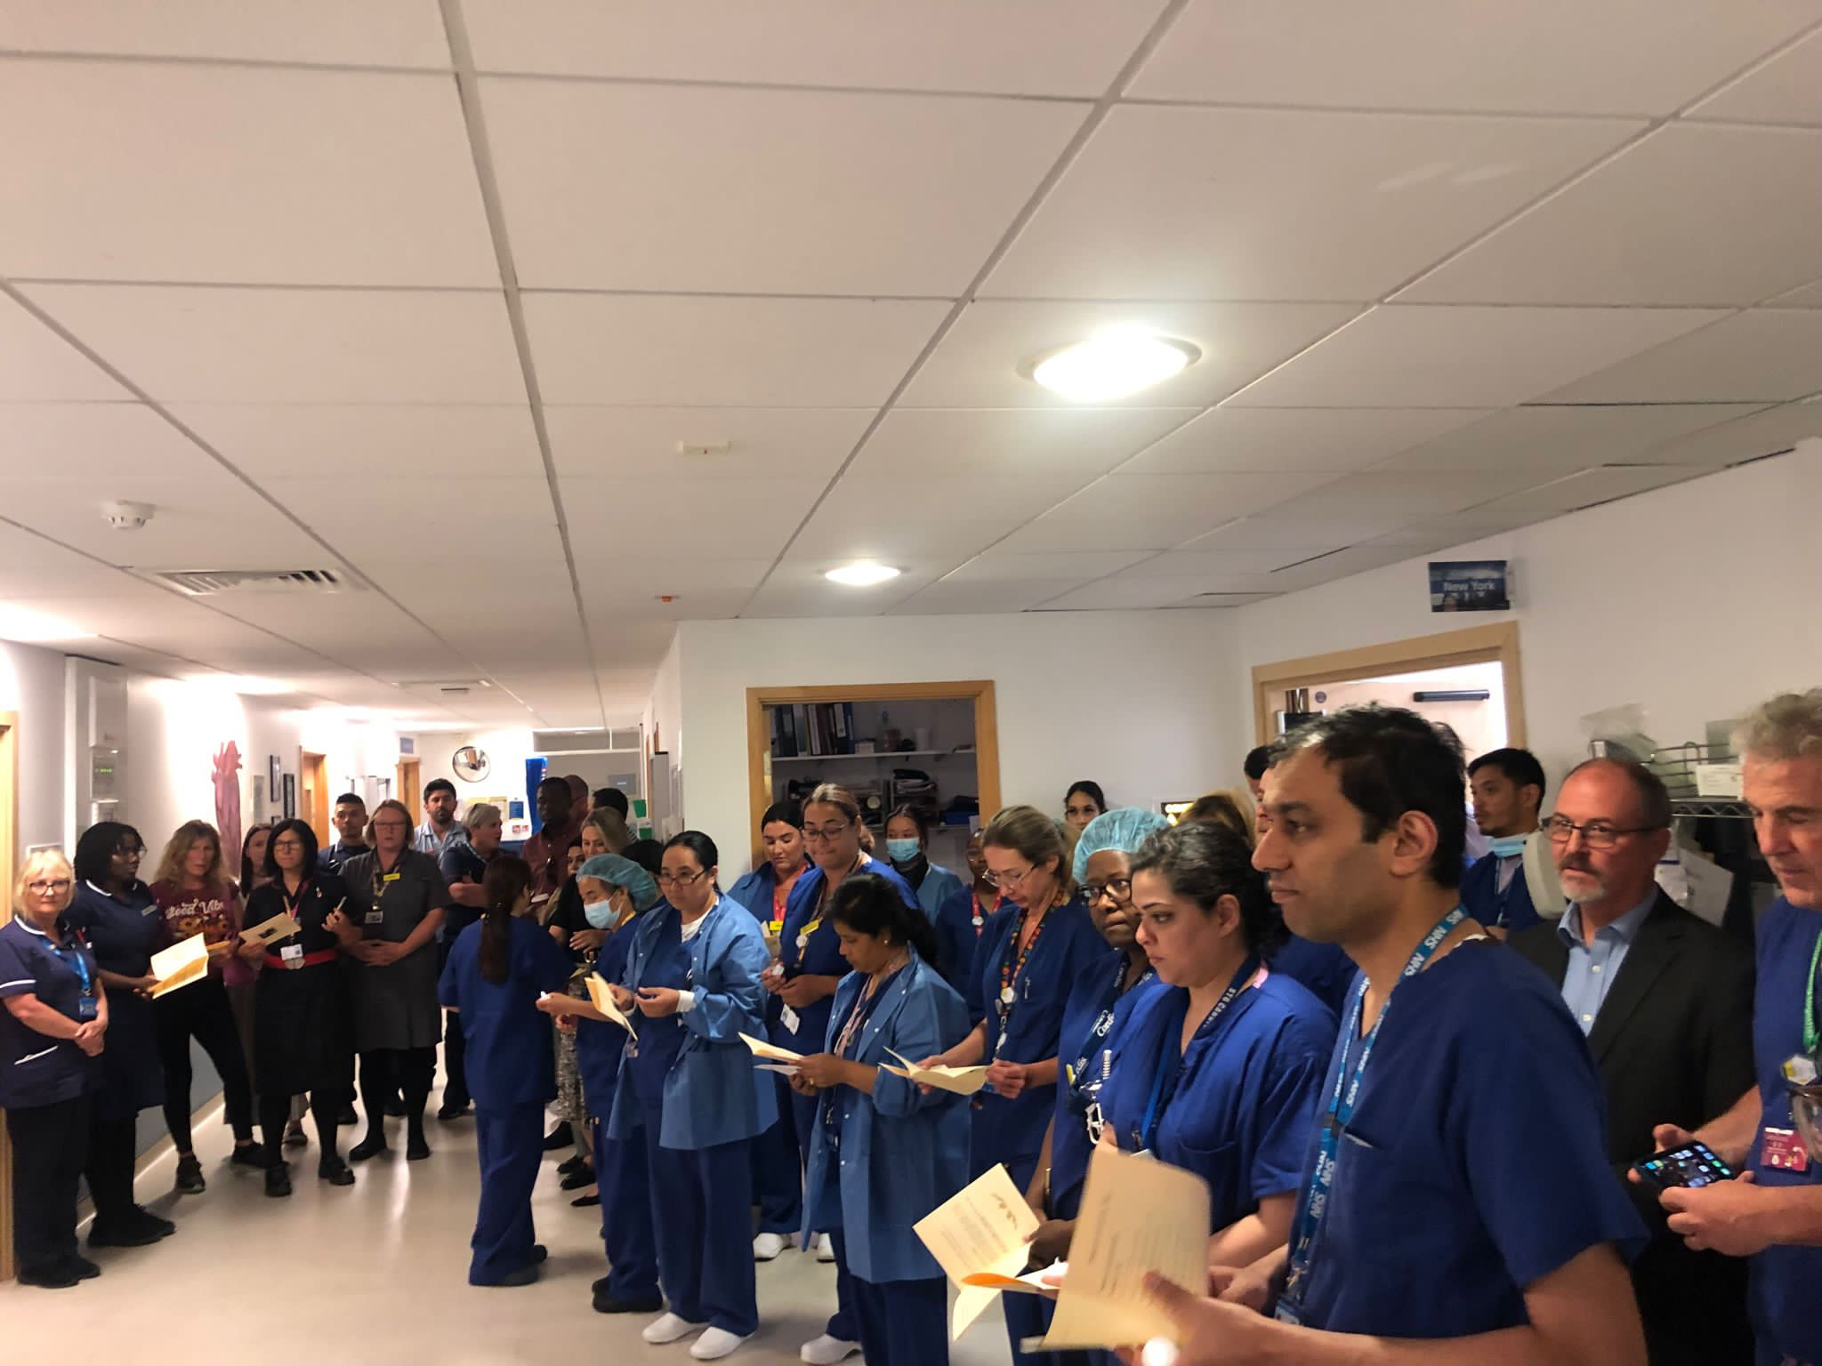
BRITISH CARDIOVASCULAR INTERVENTION SOCIETY
Daniel kyere, Cath Lab Nurse
Essex CTC
Notes:
Speaker title slide. Replace the title and your name/role/organisation. Event branding is fixed.

Slide 2
BRITISH CARDIOVASCULAR INTERVENTION SOCIETY
AHP ANNUAL CONFERENCE 2026
I have no conflicts of interest to declare
Notes:
Speaker title slide. Replace the title and your name/role/organisation. Event branding is fixed.

Slide 3

BRITISH CARDIOVASCULAR INTERVENTION SOCIETY
Case presentation
47 M heavy smoker, presents to ED
0400 CP ECG shows anterolateral ST elevation, Accepted for PPCI
04:35 has VF arrest requiring x 3 DCC
05:00 has another VF arrest requiring x 2 DCC
Arrives at ECTC 0645 with ITU escort self-ventilating with GCS of 15/15, but still in severe pain
Join the conversation using #BCISAHP
Notes:
Required by the meeting. Keep ONE of the two statements and delete the other.

Slide 4
SECTION
Procedure
AHP ANNUAL CONFERENCE 2026
Notes:
Use between sections of your talk. Duplicate this slide as needed.

Slide 5
BRITISH CARDIOVASCULAR INTERVENTION SOCIETY
Good volume pulse in RRA
6Fr GlideSheath Verapamil 2.5mg, 5mg of Diazepam, and 5mg of Metoclopramide
0.035 wire and 6Fr JR4 diagnostic catheter
Wire ascended normally on a loop
Catheter ascent met resistance at the level of the elbow with the patient reporting pain. 200mcgs of nitrates were given.
Screening confirmed the lodged catheter position and wire moving freely on a loop beyond the elbow
Attempted to withdraw the catheter but met with significant resistance and pain. Further 300mcgs of nitrates were given with 5mg of Diazepam
Connected to pressure line which showed a radial trace and wire changed to long exchange which reached the root
Further analgesia (Fentanyl) given and a pressure cuff was applied above the elbow for 5-7minutes, at approximately 180 mmHg
Join the conversation using #BCISAHP
Notes:
Required by the meeting. Keep ONE of the two statements and delete the other.

Slide 6
BRITISH CARDIOVASCULAR INTERVENTION SOCIETY
Despite treatment for 25 minutes with several interventions including verapamil, nitrates, analgesia, sedation and pressure cuff, no progress was made withdrawing and any manipulation caused severe pain.
Decision made to switch to a femoral approach and treat STEMI in the hope that resolution would reduce adrenergic drive and spasm
Join the conversation using #BCISAHP
Notes:
Required by the meeting. Keep ONE of the two statements and delete the other.

Slide 7
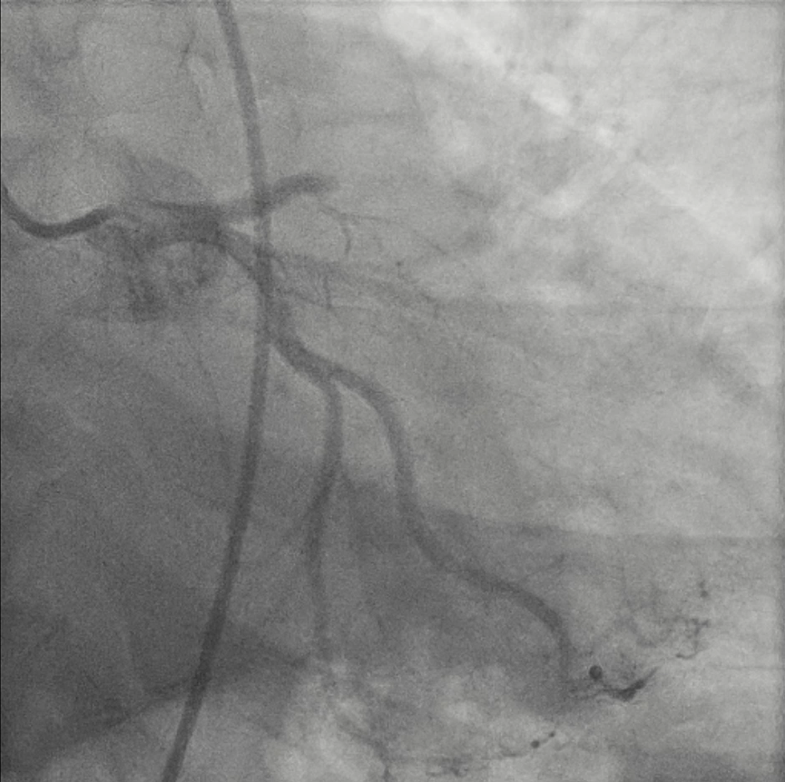
BRITISH CARDIOVASCULAR INTERVENTION SOCIETY
Angio
Treated with thrombectomy (Hunter) and IVUS/NIRS guided direct stenting with Terumo Nagomi 3x24mm DES and post-dilated with 4mm NC. MSA >8mm2
Join the conversation using #BCISAHP
Notes:
Required by the meeting. Keep ONE of the two statements and delete the other.

Slide 8
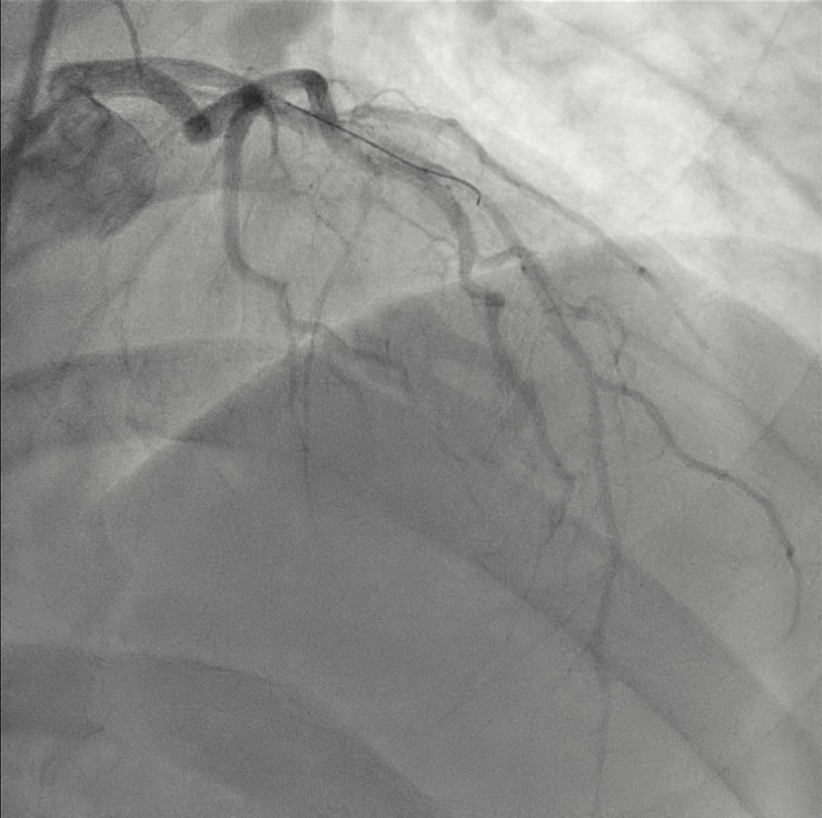
BRITISH CARDIOVASCULAR INTERVENTION SOCIETY
Join the conversation using #BCISAHP
Notes:
Required by the meeting. Keep ONE of the two statements and delete the other.

Slide 9
BRITISH CARDIOVASCULAR INTERVENTION SOCIETY
A gentle tug - no change in resistance. More Diazemols given.
Applied cuff for another 10 minutes and further Nitrates (1.5mg) from antegrade guide.
Anesthetics were called and placed under heavier sedation with propofol
The patient full GA - despite this catheter continues to resist
Entrapped catheter and sheath: Part 2
Join the conversation using #BCISAHP
Notes:
Required by the meeting. Keep ONE of the two statements and delete the other.

Slide 10
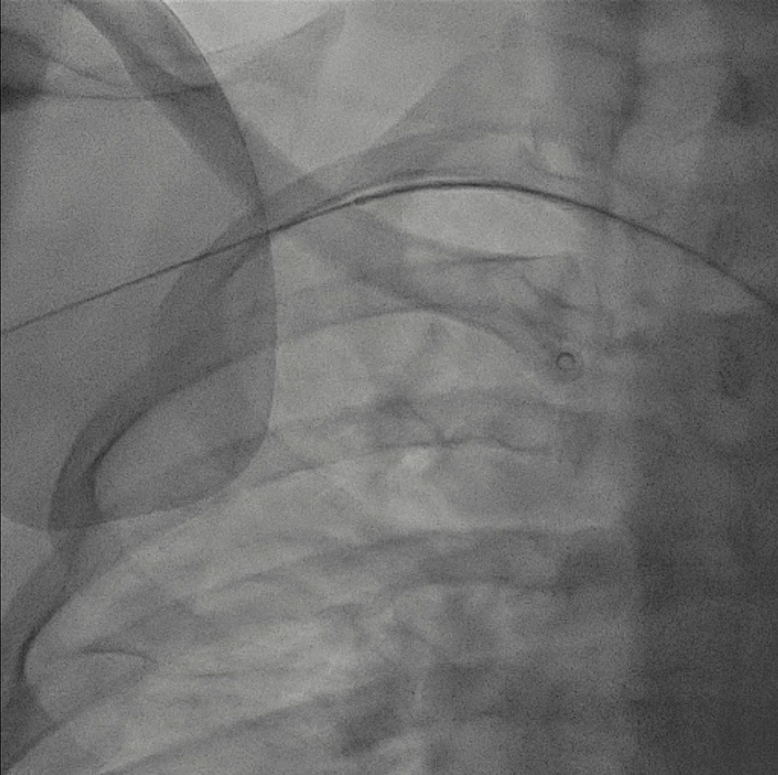
BRITISH CARDIOVASCULAR INTERVENTION SOCIETY
Join the conversation using #BCISAHP
Notes:
Required by the meeting. Keep ONE of the two statements and delete the other.

Slide 11
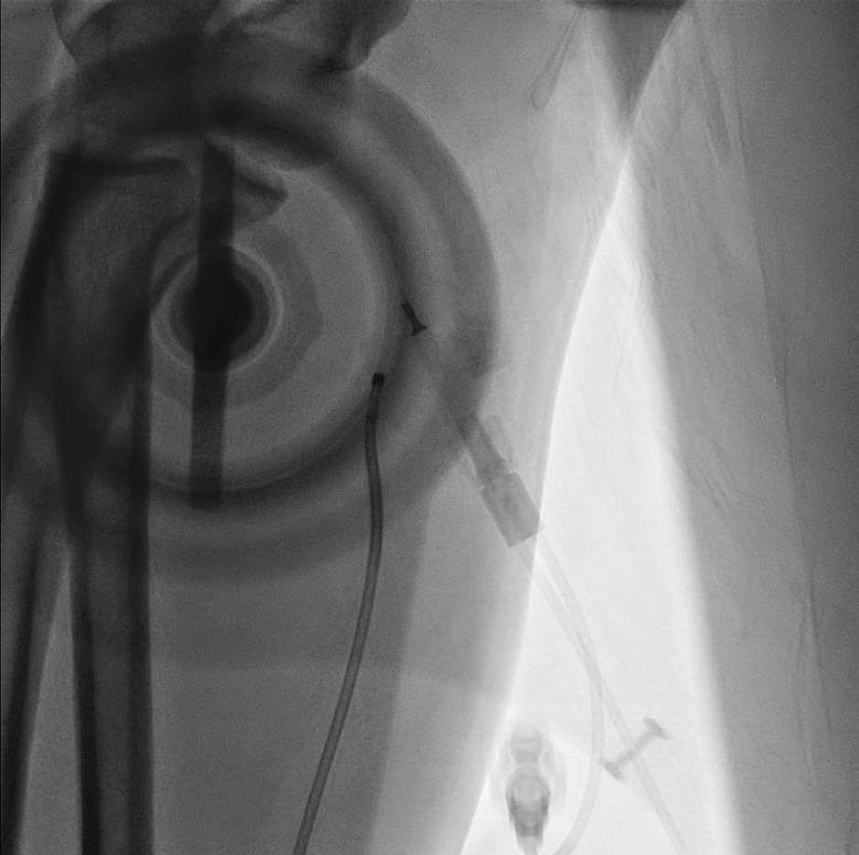
BRITISH CARDIOVASCULAR INTERVENTION SOCIETY
Cine of Ante angiogram
Join the conversation using #BCISAHP
Notes:
Required by the meeting. Keep ONE of the two statements and delete the other.

Slide 12
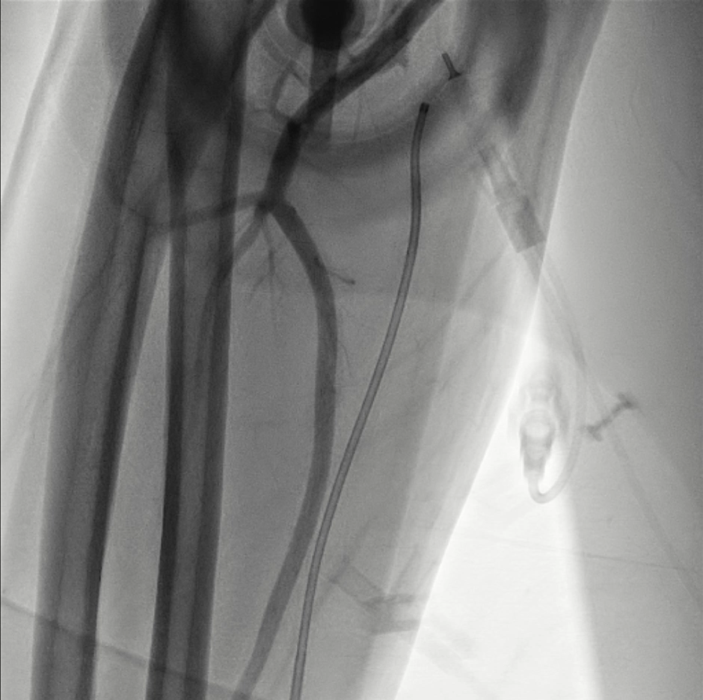
BRITISH CARDIOVASCULAR INTERVENTION SOCIETY
Preservation of distal flow
Join the conversation using #BCISAHP
Notes:
Required by the meeting. Keep ONE of the two statements and delete the other.

Slide 13
BRITISH CARDIOVASCULAR INTERVENTION SOCIETY
Antegrade angiogram of forearm
A dominant ulnar artery with the preserved flow to distal vessels and palmer branches
The radial artery appeared anatomically small with below elbow origin, possibly low origin or anomalous variant
Vascular surgeon who attended the cath lab with team and reviewed imaging and arm
Join the conversation using #BCISAHP
Notes:
Required by the meeting. Keep ONE of the two statements and delete the other.

Slide 14
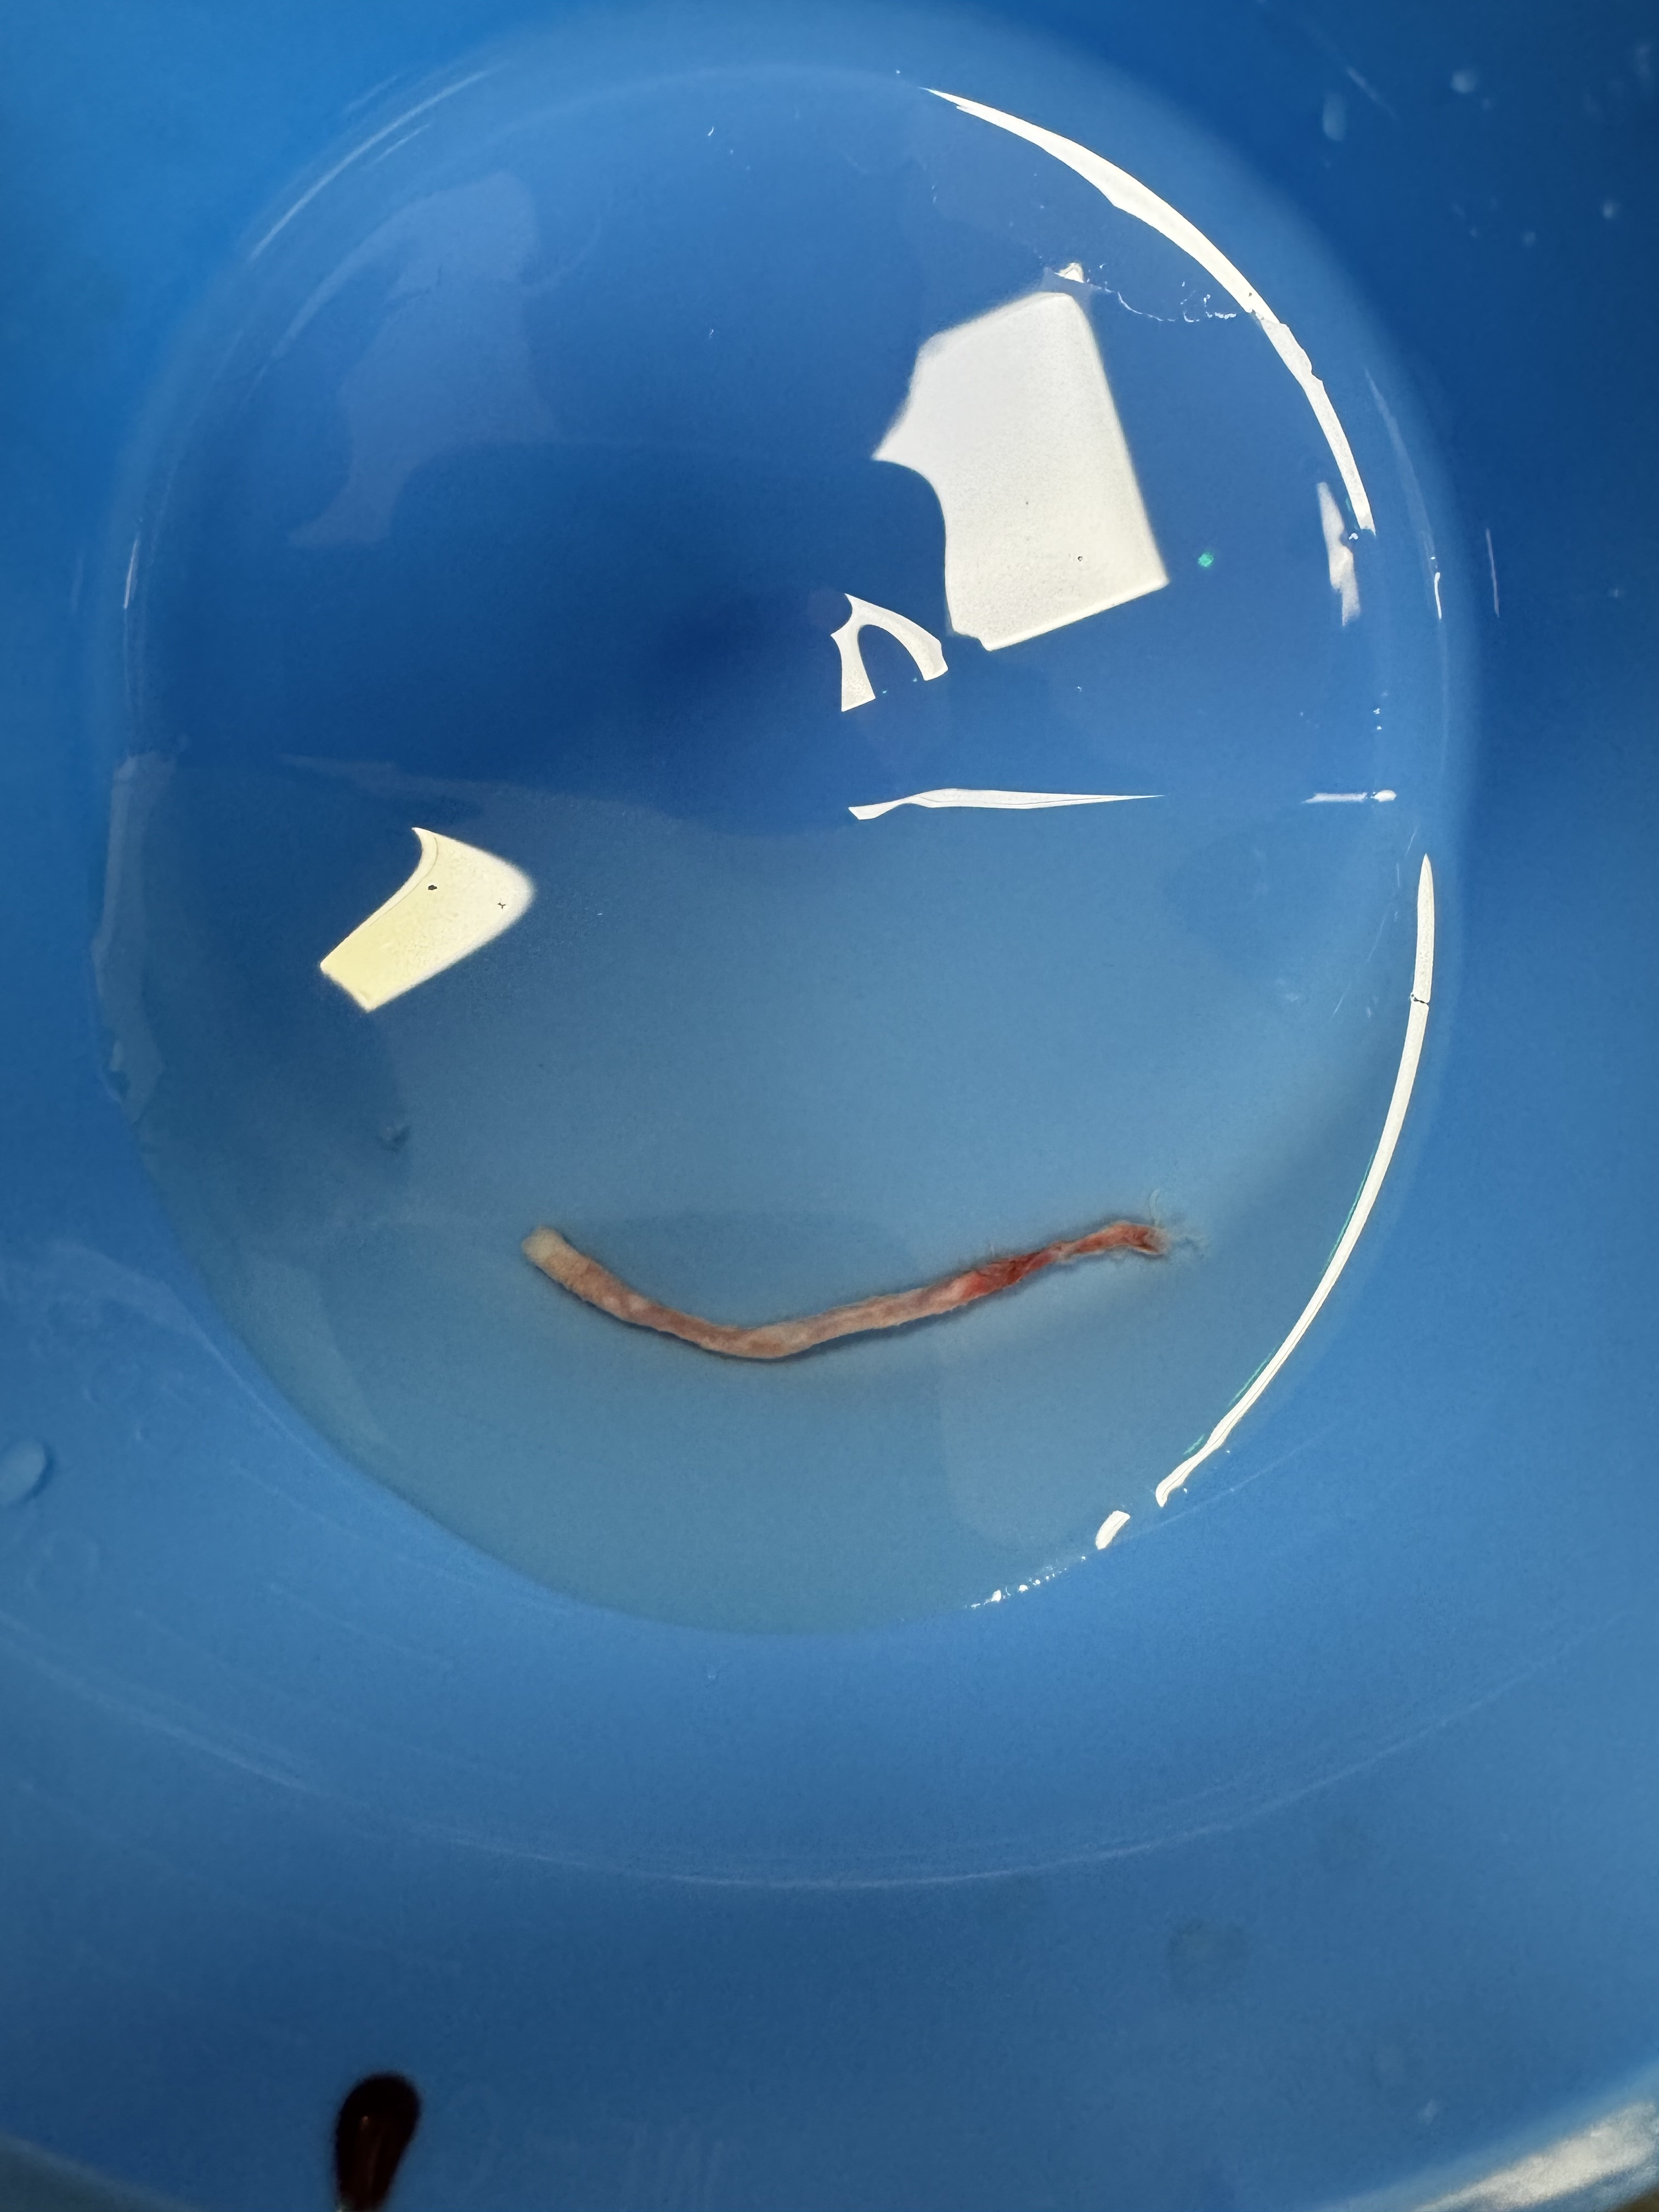
BRITISH CARDIOVASCULAR INTERVENTION SOCIETY
The surgeon pulled the catheter under fluoroscopy. Successful withdrawal but further resistance as being pulled out of the radial sheath, causing kinking of the sheath
TR band was placed over the puncture and as we withdrew the kinked sheath, approx. 5cm of the avulsed radial artery was exposed, and cut at the level of skin
Manual pressure was applied although no obvious bleeding and the forearm appeared soft. TR band applied
Removal
Join the conversation using #BCISAHP
Notes:
Required by the meeting. Keep ONE of the two statements and delete the other.

Slide 15
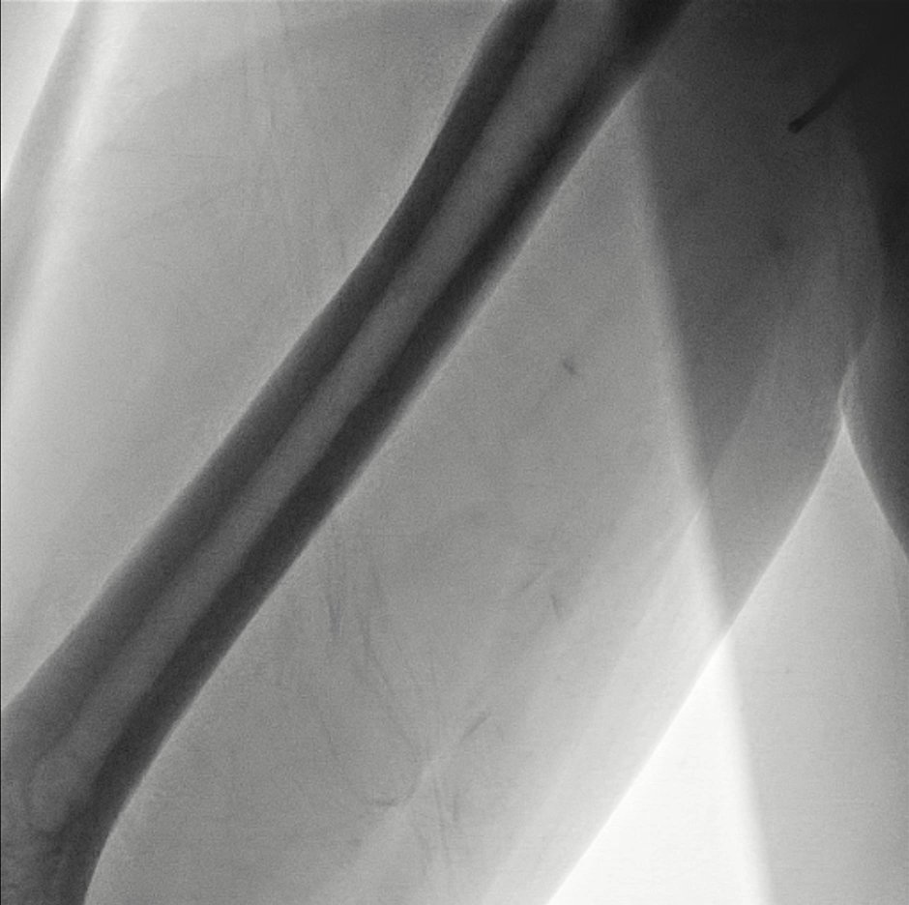
BRITISH CARDIOVASCULAR INTERVENTION SOCIETY
Join the conversation using #BCISAHP
Notes:
Required by the meeting. Keep ONE of the two statements and delete the other.

Slide 16
BRITISH CARDIOVASCULAR INTERVENTION SOCIETY
Post Procedure
Arm kept elevated and carefully monitored over the next 48 hours with only mild swelling of the forearm and no ecchymosis
Perfusion to the hand remained intact and bedside Doppler showed good flow down the ulnar and brachial vessels
Join the conversation using #BCISAHP
Notes:
Required by the meeting. Keep ONE of the two statements and delete the other.

Slide 17
BRITISH CARDIOVASCULAR INTERVENTION SOCIETY
Reflection
Discussion and reflection with the vascular surgeon suggested that this may have been anatomically a vestigial radial artery and therefore small caliber in a dominant ulnar system.
RAS fueled by high adrenergic drive further complicates this
Trauma to the artery by catheter/wire combined with severe spasm and unusual anatomy results in the extremely rare complication of avulsion/endarterectomy
Join the conversation using #BCISAHP
Notes:
Required by the meeting. Keep ONE of the two statements and delete the other.

Slide 18
BRITISH CARDIOVASCULAR INTERVENTION SOCIETY
Management of radial catheter entrapment
Dr Mahmud Tawil
Professor Keeble
Join the conversation using #BCISAHP
Notes:
Required by the meeting. Keep ONE of the two statements and delete the other.

Slide 19
BRITISH CARDIOVASCULAR INTERVENTION SOCIETY
Definition of catheter/sheath entrapment
Catheter entrapment was defined as severe local pain associated with catheter trapping which restricts manipulation of the catheter due to severe RAS
Clinical features:
Persistent forearm pain
Pain response to catheter manipulation
Pain response to sheath withdrawal
Difficult catheter manipulation after being trapped by radial artery
Considerable resistance on withdrawal of the sheath.
Join the conversation using #BCISAHP
Notes:
Required by the meeting. Keep ONE of the two statements and delete the other.

Slide 20
BRITISH CARDIOVASCULAR INTERVENTION SOCIETY
Incidence
The incidence varies greatly in current literature given the wide range of criteria used to define the RAS and subjectivity.
The reported incidence is variable, ranging from 4% to 30%
Catheter/sheath entrapment is rare, and is reported to occur in 0.1% of cases
Radial artery avulsion/endarterectomy because of entrapment is far rarer with only a few case reports
Join the conversation using #BCISAHP
Notes:
Required by the meeting. Keep ONE of the two statements and delete the other.

Slide 21
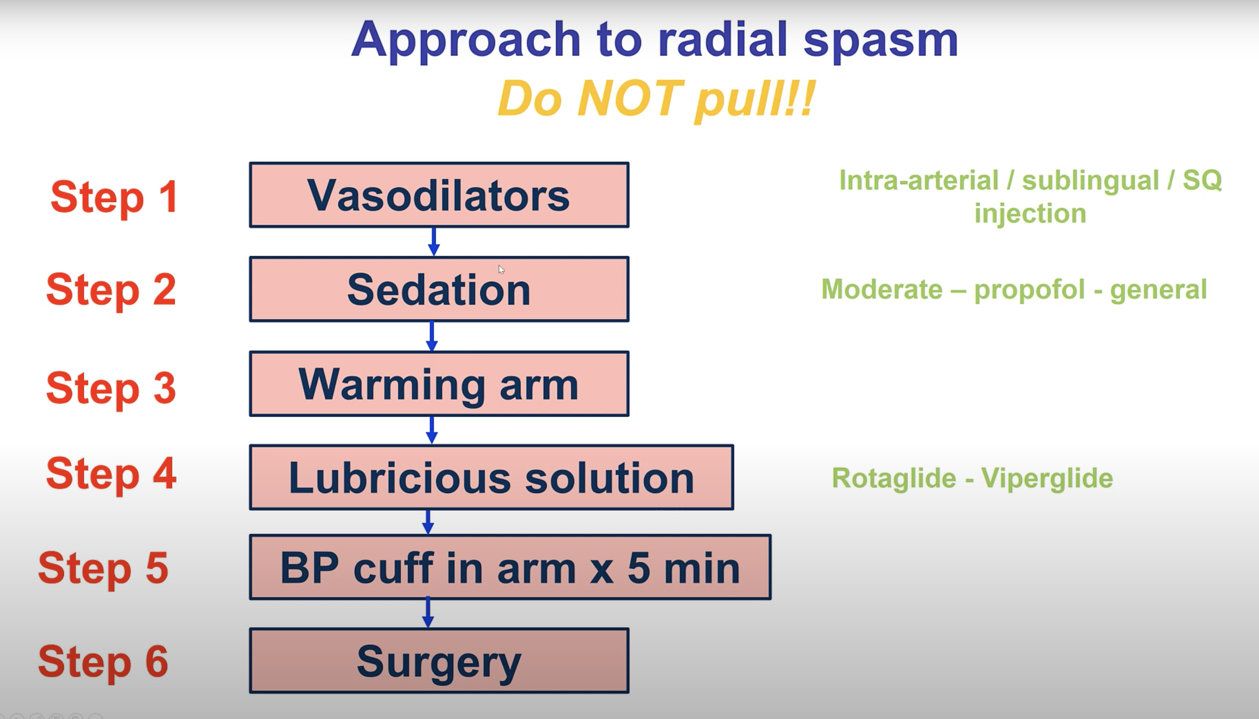
BRITISH CARDIOVASCULAR INTERVENTION SOCIETY
Join the conversation using #BCISAHP
Notes:
Required by the meeting. Keep ONE of the two statements and delete the other.

Slide 22
BRITISH CARDIOVASCULAR INTERVENTION SOCIETY
Vasodilators
Nitrates can be given IA, Subcut or sublingual
Verapamil given IA
Join the conversation using #BCISAHP
Notes:
Required by the meeting. Keep ONE of the two statements and delete the other.

Slide 23
BRITISH CARDIOVASCULAR INTERVENTION SOCIETY
Sedation
Benzos
Propofol
GA
Join the conversation using #BCISAHP
Notes:
Required by the meeting. Keep ONE of the two statements and delete the other.

Slide 24
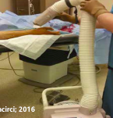
BRITISH CARDIOVASCULAR INTERVENTION SOCIETY
Warming
Blankets
Gauze towels, soaked in warm water
Warm air
Join the conversation using #BCISAHP
Notes:
Required by the meeting. Keep ONE of the two statements and delete the other.

Slide 25
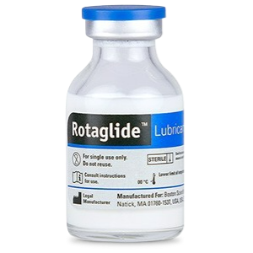
BRITISH CARDIOVASCULAR INTERVENTION SOCIETY
Lubricious solution
Rotaglide
Viperglide
Join the conversation using #BCISAHP
Notes:
Required by the meeting. Keep ONE of the two statements and delete the other.

Slide 26
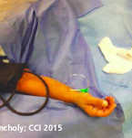
BRITISH CARDIOVASCULAR INTERVENTION SOCIETY
BP CUFF
BP above SBP cuff for 5 minutes
Ischemia-induced vasodilation once the cuff released
Join the conversation using #BCISAHP
Notes:
Required by the meeting. Keep ONE of the two statements and delete the other.

Slide 27
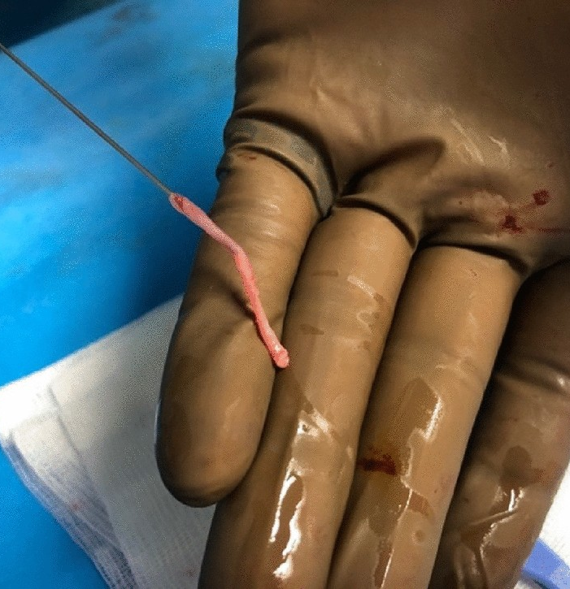
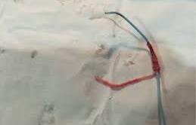
BRITISH CARDIOVASCULAR INTERVENTION SOCIETY
Surgery
Surgical exploration, removal, ligation
Brachial plexus block is sometimes used
Join the conversation using #BCISAHP
Notes:
Required by the meeting. Keep ONE of the two statements and delete the other.

Slide 28
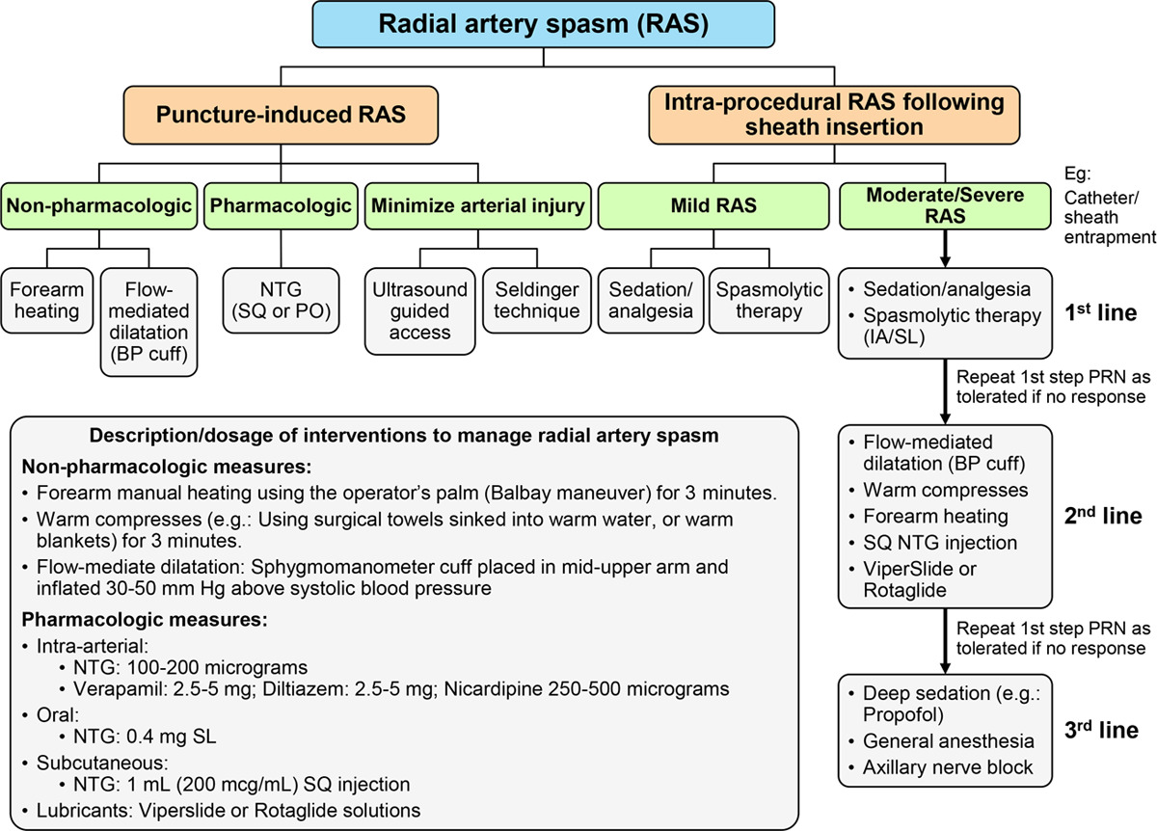
BRITISH CARDIOVASCULAR INTERVENTION SOCIETY
Join the conversation using #BCISAHP
Notes:
Required by the meeting. Keep ONE of the two statements and delete the other.

Slide 29
BRITISH CARDIOVASCULAR INTERVENTION SOCIETY
Remember DO NOT PULL!!!
Discussion
Join the conversation using #BCISAHP
Notes:
Required by the meeting. Keep ONE of the two statements and delete the other.

Slide 30
Thank you
Join the conversation using #BCISAHP
Notes:
Closing slide. Add your contact / handle for follow-up questions.

