Slide 1

BRITISH CARDIOVASCULAR INTERVENTION SOCIETY
AHP ANNUAL CONFERENCE 2026
Beyond the cath lab: The role of the ICC Nurse Specialist
Dr Jason Dungu. Lead ICC Consultant
Amy Hardy-Wallace/Gemma Long · ICC Nurses · The Essex Cardiothoracic Centre
13–14 July 2026
Birmingham Conference & Events Centre
Notes:
Speaker title slide. Replace the title and your name/role/organisation. Event branding is fixed.

Slide 2

BRITISH CARDIOVASCULAR INTERVENTION SOCIETY
Declaration of Interests
No conflicts of interest to declare.
Join the conversation using #BCISAHP
Notes:
Required by the meeting. Keep ONE of the two statements and delete the other.

Slide 3
BRITISH CARDIOVASCULAR INTERVENTION SOCIETY
A Case Study
Join the conversation using #BCISAHP
Notes:
Required by the meeting. Keep ONE of the two statements and delete the other.

Slide 4
BRITISH CARDIOVASCULAR INTERVENTION SOCIETY
51 year old lady
No previous medical history
Collapsed at the gym in 2014
Sustained ventricular tachycardia
Echo normal
Join the conversation using #BCISAHP
Notes:
Required by the meeting. Keep ONE of the two statements and delete the other.

Slide 5
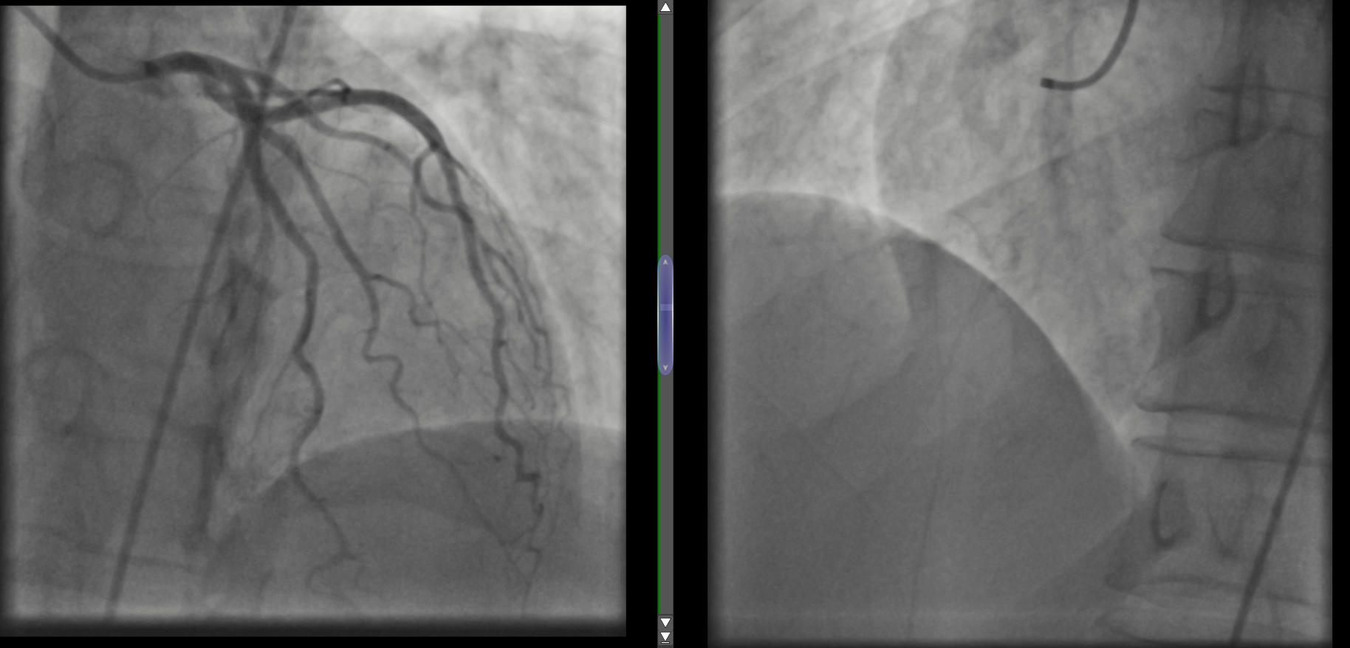
BRITISH CARDIOVASCULAR INTERVENTION SOCIETY
Join the conversation using #BCISAHP
Notes:
Required by the meeting. Keep ONE of the two statements and delete the other.

Slide 6
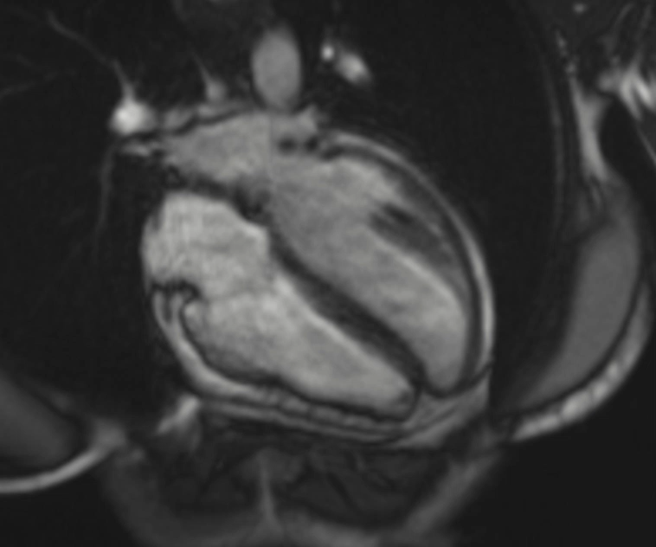
BRITISH CARDIOVASCULAR INTERVENTION SOCIETY
Cardiac MRI
Normal LV/RV function
Mild subepicardial scar
Join the conversation using #BCISAHP
Notes:
Required by the meeting. Keep ONE of the two statements and delete the other.

Slide 7
BRITISH CARDIOVASCULAR INTERVENTION SOCIETY
What is the appropriate management?
  Anti-inflammatory medication for myocarditis
  Secondary prevention single chamber ICD
  CTCA for possible spontaneous coronary dissection
  Beta-blocker for Takotsubo cardiomyopathy
Join the conversation using #BCISAHP
Notes:
Required by the meeting. Keep ONE of the two statements and delete the other.

Slide 8
BRITISH CARDIOVASCULAR INTERVENTION SOCIETY
What is the appropriate management?
  Anti-inflammatory medication for myocarditis
  Secondary prevention single chamber ICD
  CTCA for possible spontaneous coronary dissection
  Beta-blocker for Takotsubo cardiomyopathy
Discharged back to local hospital follow up after ICD
Diagnosis of possible early cardiomyopathy
Join the conversation using #BCISAHP
Notes:
Required by the meeting. Keep ONE of the two statements and delete the other.

Slide 9
BRITISH CARDIOVASCULAR INTERVENTION SOCIETY
Case Study 2
Join the conversation using #BCISAHP
Notes:
Required by the meeting. Keep ONE of the two statements and delete the other.

Slide 10
BRITISH CARDIOVASCULAR INTERVENTION SOCIETY
20-year-old Female
Presented to A and E (February 2026)
5/7 history of Diarrhoea and Vomiting
Unable to keep food and fluids down
General body aches
Central chest pain which radiated to back and left side
Join the conversation using #BCISAHP
Notes:
Required by the meeting. Keep ONE of the two statements and delete the other.

Slide 11
BRITISH CARDIOVASCULAR INTERVENTION SOCIETY
PMH:
None
Blood results:
Troponin 182 ng/L
Repeat Troponin 165ng/L (9 hours later)
All other bloods unremarkable
Join the conversation using #BCISAHP
Notes:
Required by the meeting. Keep ONE of the two statements and delete the other.

Slide 12
BRITISH CARDIOVASCULAR INTERVENTION SOCIETY
Echocardiogram Results:
Good Biventricular function, LVEF 55-60%,
No significant valvular abnormalities detected
Cardiac MRI Results:
Normal sized LV with normal systolic function, myocardial oedema with subepicardial scarring, normal sized RV and function, LVEF 67%, RVEF 65%
Join the conversation using #BCISAHP
Notes:
Required by the meeting. Keep ONE of the two statements and delete the other.

Slide 13
BRITISH CARDIOVASCULAR INTERVENTION SOCIETY
What is your working diagnosis?
A viral illness
Myocardial infarction
Myocarditis/Pericarditis
Panic attack
Let's review the ECG…
Join the conversation using #BCISAHP
Notes:
Required by the meeting. Keep ONE of the two statements and delete the other.

Slide 14
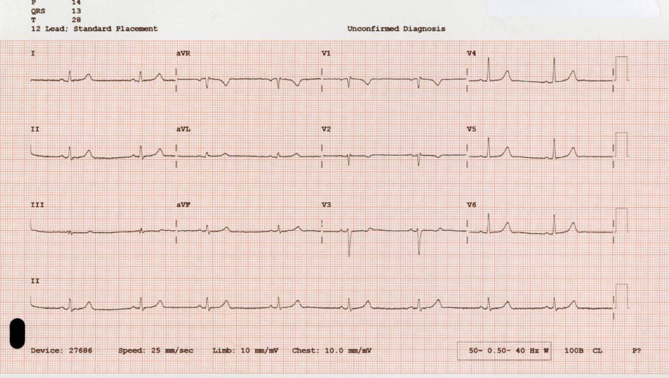
BRITISH CARDIOVASCULAR INTERVENTION SOCIETY
Join the conversation using #BCISAHP
Notes:
Required by the meeting. Keep ONE of the two statements and delete the other.

Slide 15
BRITISH CARDIOVASCULAR INTERVENTION SOCIETY
The family history:
77
Well
56
Breast Cancer
51
Secondary prevention ICD
CASE STUDY 1
Join the conversation using #BCISAHP
CASE STUDY 2
Notes:
Required by the meeting. Keep ONE of the two statements and delete the other.

Slide 16
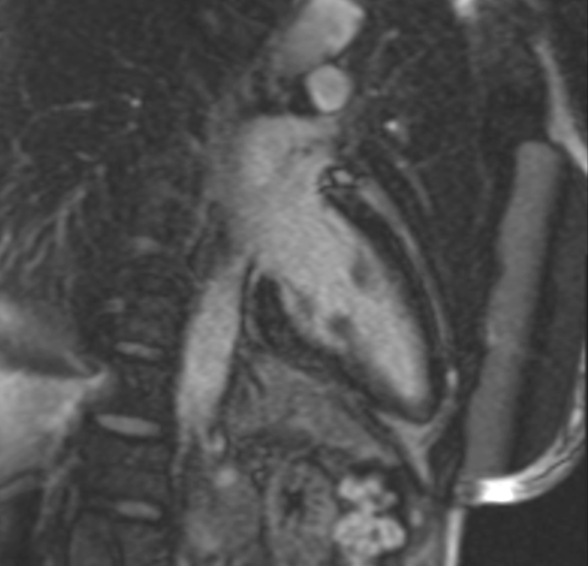
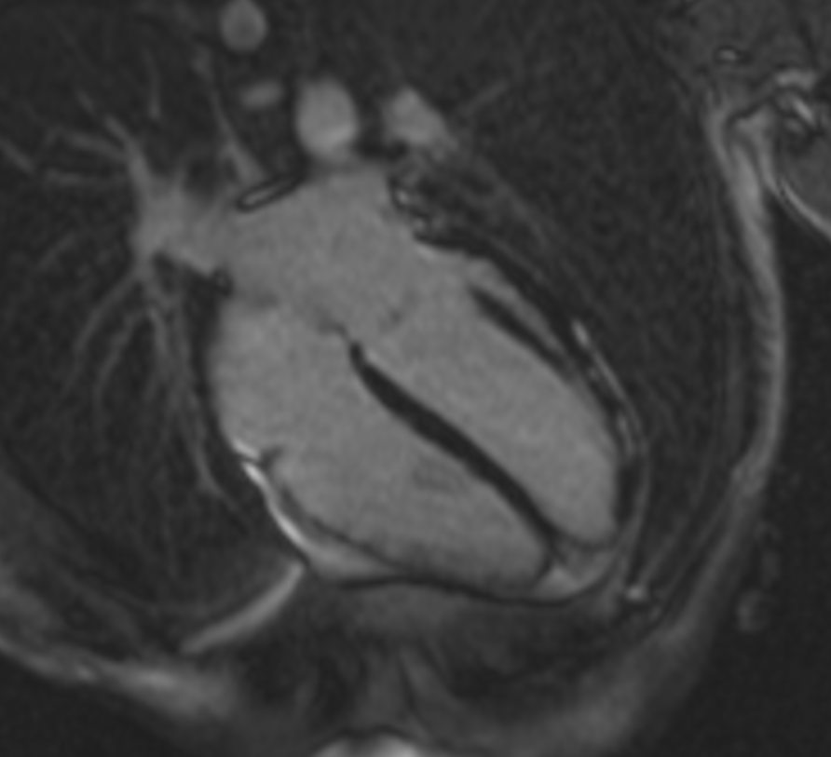
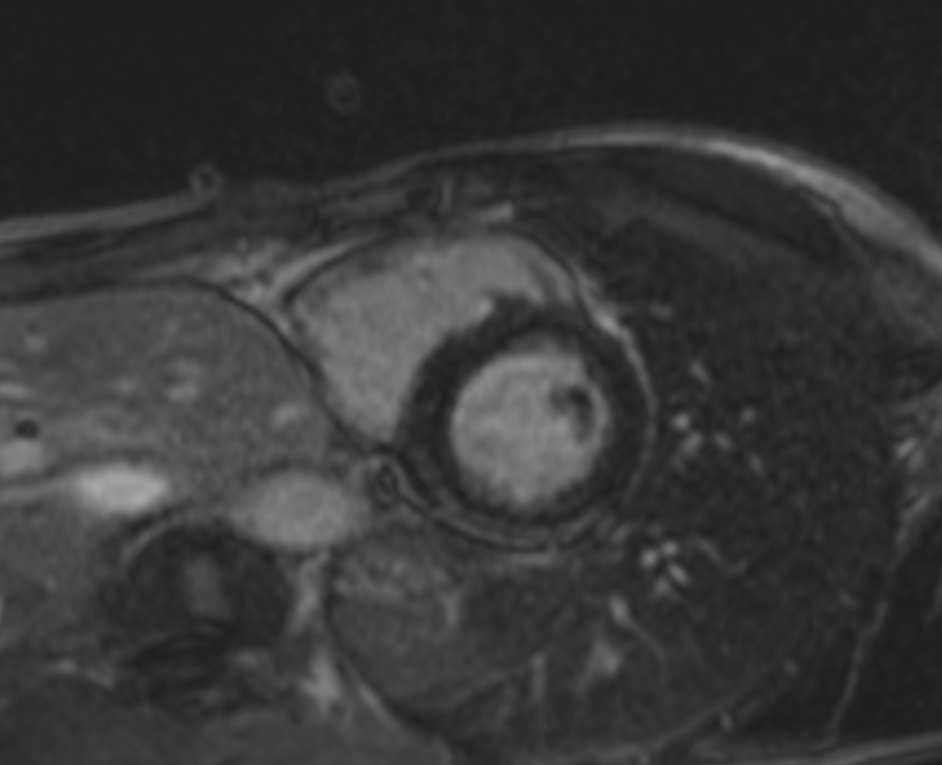
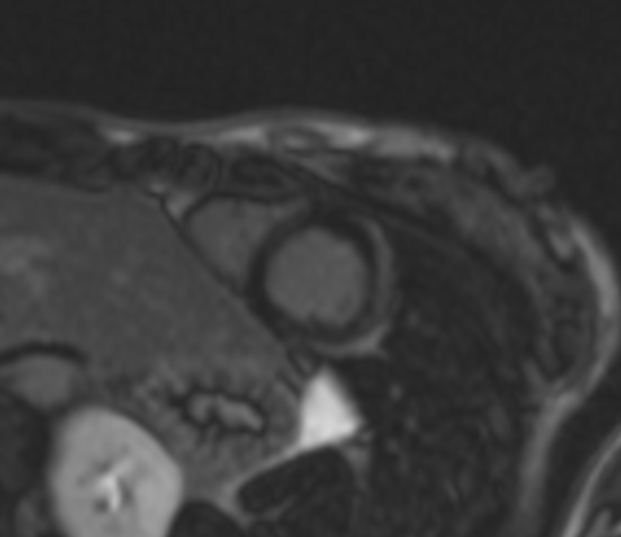
BRITISH CARDIOVASCULAR INTERVENTION SOCIETY
Cardiac MRI scans
Mum
Daughter
Join the conversation using #BCISAHP
Notes:
Required by the meeting. Keep ONE of the two statements and delete the other.

Slide 17

BRITISH CARDIOVASCULAR INTERVENTION SOCIETY
What next….
The role of the ICC Service
Join the conversation using #BCISAHP
Notes:
Required by the meeting. Keep ONE of the two statements and delete the other.

Slide 18
BRITISH CARDIOVASCULAR INTERVENTION SOCIETY
The ICC Service: What is an Inherited Cardiac Condition?
1.Primary heart muscle disease (Cardiomyopathies)
2. Heart rhythm abnormalities (Inherited Arrythmias)
3. Aortopathies
“Overall in the UK the capacity of services is inadequate to meet either current or future estimated needs. Service provision is highly unequal in quality as well as quantity across the country”
(NHS England, 2013)
Join the conversation using #BCISAHP
Notes:
Required by the meeting. Keep ONE of the two statements and delete the other.

Slide 19
BRITISH CARDIOVASCULAR INTERVENTION SOCIETY
The role of genetic testing:
Confirming diagnosis
Navigating patient management
Predictive genetic testing
Should anyone with an Inherited Cardiac Condition be offered genetic testing?
The reality….
Join the conversation using #BCISAHP
Notes:
Required by the meeting. Keep ONE of the two statements and delete the other.

Slide 20
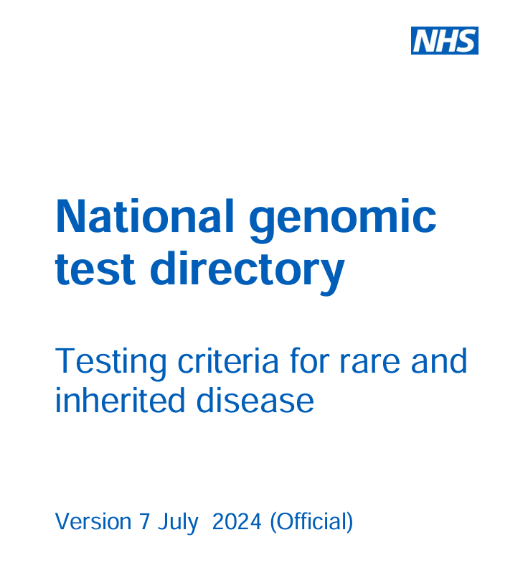
BRITISH CARDIOVASCULAR INTERVENTION SOCIETY
Join the conversation using #BCISAHP
Notes:
Required by the meeting. Keep ONE of the two statements and delete the other.

Slide 21
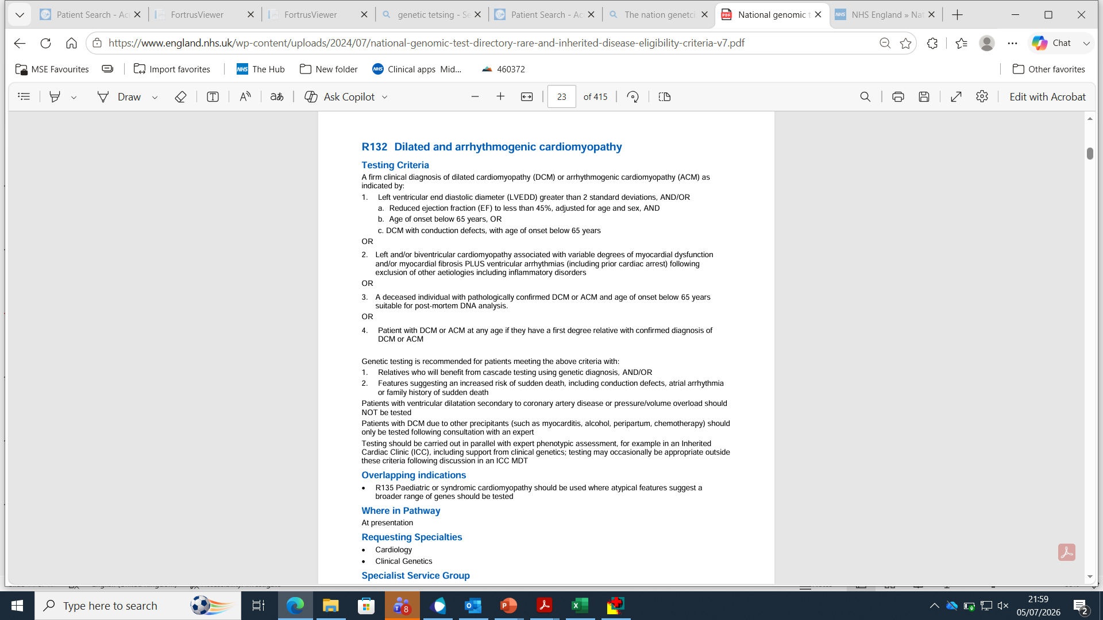
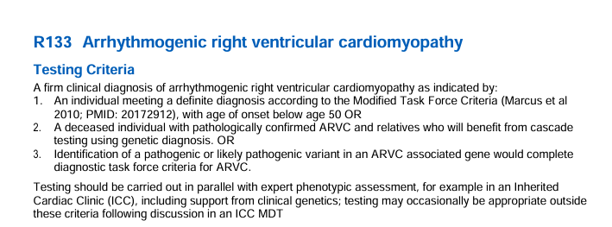
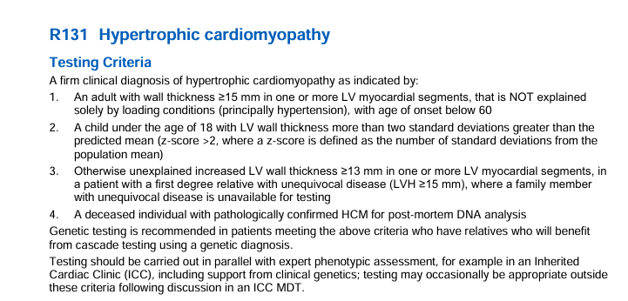
3..
BRITISH CARDIOVASCULAR INTERVENTION SOCIETY
1.
2.
Join the conversation using #BCISAHP
Notes:
Required by the meeting. Keep ONE of the two statements and delete the other.

Slide 22

BRITISH CARDIOVASCULAR INTERVENTION SOCIETY
Based on the clinical presentation and findings, which genetic panel would you consider sending?
Join the conversation using #BCISAHP
Notes:
Required by the meeting. Keep ONE of the two statements and delete the other.

Slide 23
BRITISH CARDIOVASCULAR INTERVENTION SOCIETY
What happened next?
Strictly neither Mum or daughter meets full genetic testing criteria for any of the 3 panels explored
Therefore, the case was discussed with the genomics laboratory
19-year-old admitted with myocarditis and MRI suggesting arrhythmogenic cardiomyopathy
No arrythmias to date demonstrated
Mother who is visiting daily has a secondary prevention ICD, presenting with malignant ventricular arrythmias
Mum’s MRI similar to her daughters upon review
Findings are highly suspicious of a familial arrhythmogenic cardiomyopathy
Join the conversation using #BCISAHP
Notes:
Required by the meeting. Keep ONE of the two statements and delete the other.

Slide 24
BRITISH CARDIOVASCULAR INTERVENTION SOCIETY
The proposed plan:
Request to send DCM/ACM (R132) for Mum (proband) despite not meeting criteria as clear left-dominant arrhythmogenic phenotype
Plan to store daughters DNA
Join the conversation using #BCISAHP
Notes:
Required by the meeting. Keep ONE of the two statements and delete the other.

Slide 25
BRITISH CARDIOVASCULAR INTERVENTION SOCIETY
The Laboratory respond:
Strictly they should not process this sample
However, the family are deemed worthy of genetic testing
The ICC Nurses therefore approach for consenting
Join the conversation using #BCISAHP
Notes:
Required by the meeting. Keep ONE of the two statements and delete the other.

Slide 26
BRITISH CARDIOVASCULAR INTERVENTION SOCIETY
The consent process for genetic testing
Comprehensive genetic counselling is essential
Diagnostic genetic testing of the proband should be performed first
Followed by discussion of the three possible outcomes:
1. Positive result
2. Negative result
3. Variant of unknown significance (VUS)
The consent form is then jointly signed
Join the conversation using #BCISAHP
Notes:
Required by the meeting. Keep ONE of the two statements and delete the other.

Slide 27
BRITISH CARDIOVASCULAR INTERVENTION SOCIETY
The results
Diagnostic results take 4-6 months to process
What did the genetic results for Mum reveal….
Join the conversation using #BCISAHP
Notes:
Required by the meeting. Keep ONE of the two statements and delete the other.

Slide 28
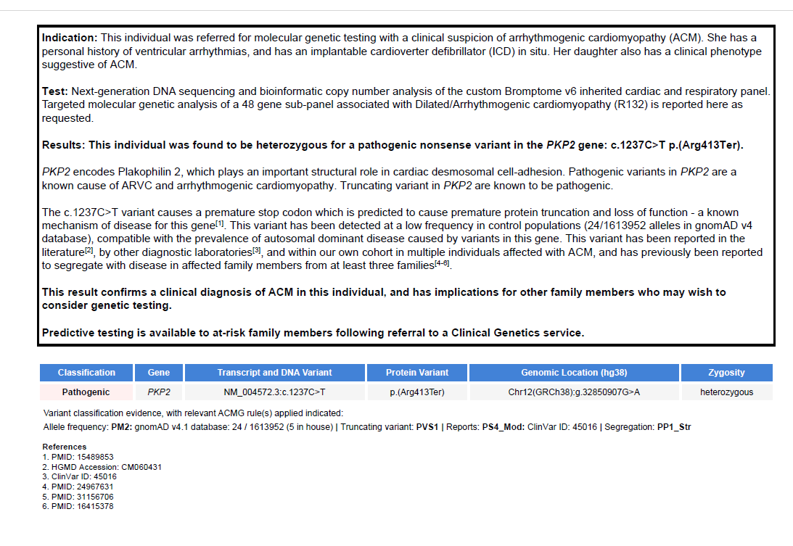
BRITISH CARDIOVASCULAR INTERVENTION SOCIETY
Join the conversation using #BCISAHP
Notes:
Required by the meeting. Keep ONE of the two statements and delete the other.

Slide 29
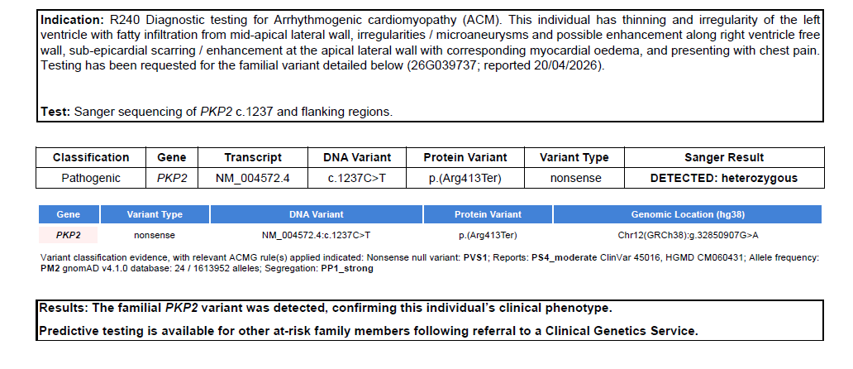
BRITISH CARDIOVASCULAR INTERVENTION SOCIETY
Daughter’s DNA sample was therefore activated:
Join the conversation using #BCISAHP
Notes:
Required by the meeting. Keep ONE of the two statements and delete the other.

Slide 30
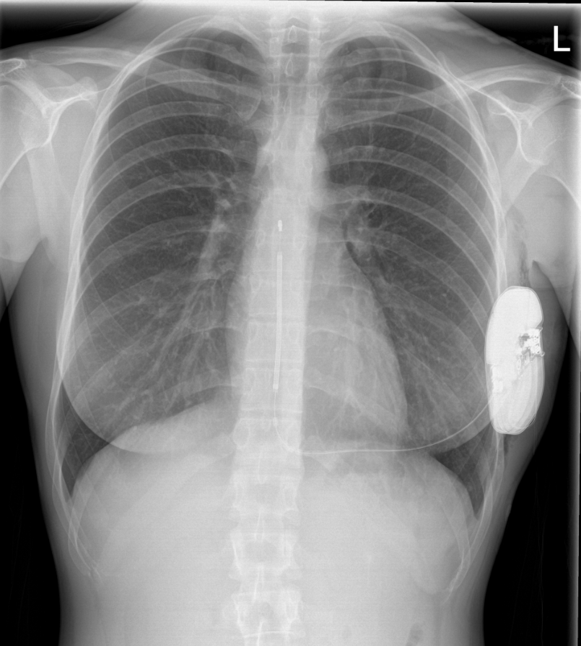
BRITISH CARDIOVASCULAR INTERVENTION SOCIETY
Genetic testing facilitates personalised care
Referral made for primary prevention ICD
Personalised exercise plan
Opportunity to consider preimplantation genetic testing when considering family planning (PGT)
In Summary
If the coronaries are unobstructed, consider ICC
Join the conversation using #BCISAHP
Notes:
Required by the meeting. Keep ONE of the two statements and delete the other.

Slide 31
BRITISH CARDIOVASCULAR INTERVENTION SOCIETY
Thank you for listening
Are there any Questions?
Join the conversation using #BCISAHP
Notes:
Required by the meeting. Keep ONE of the two statements and delete the other.

Slide 32
Thank you
Join the conversation using #BCISAHP
Notes:
Closing slide. Add your contact / handle for follow-up questions.

