Slide 1

BRITISH CARDIOVASCULAR INTERVENTION SOCIETY
AHP ANNUAL CONFERENCE 2026
Allergy & Anaphylaxis
Emily Wilson · Diagnostic Radiographer · University Hospital Hairmyres
13–14 July 2026
Birmingham Conference & Events Centre

Slide 2

BRITISH CARDIOVASCULAR INTERVENTION SOCIETY
Declaration of Interests
I have no conflicts of interest to declare.
Join the conversation using #BCISAHP

Slide 3
SECTION
Triple Threat
AHP ANNUAL CONFERENCE 2026
Notes:
Growing up I was a triple threat.
Despite being sporty, I mean in the atopic sense.
Eczema, Asthma and Allergy
Eczema from birth.
Asthma from age 2
Allergies I keep accumulating.

Slide 4

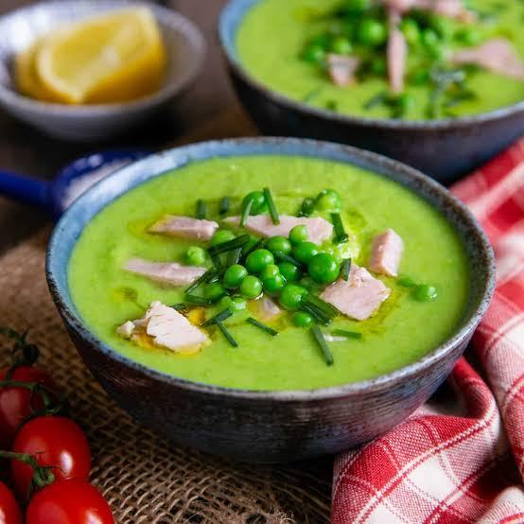
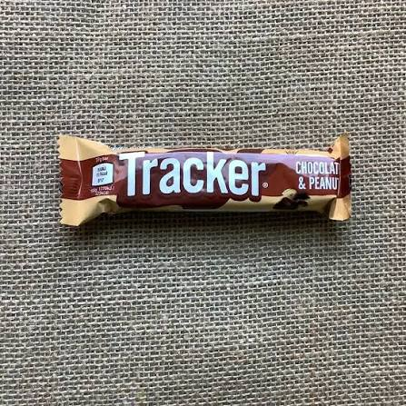
BRITISH CARDIOVASCULAR INTERVENTION SOCIETY
Join the conversation using #BCISAHP
Notes:
Started with egg white whilst licking the spoon when making cupcakes for the first time with my mum and sister. Piriton.
Pea and ham soup on our first hallowe'en in a new place, very spooky indeed. Pea sized lump appeared on my lip. Soup taken away from me. Piriton and ice brought down the swelling.
Penicillin – facial swelling, family history
Peanuts airborne on the train on the way to the dentist. Tree nuts with exposure. Time and air. Blood test confirmed it. Epi-pens given.
Kiwi fruit in a fruit juice.
Latex – from gloves in a job scooping ice cream
Erythromycin – facial swelling
Chickpeas, lentils, pulses. - airway tightening, antihistamines
Hayfever – didn't know until allergy testing confirmed it. On daily anti-histamines anyway for my skin.
Blood test, patch test. Blood test.

Slide 5
SECTION
Actual Threat
AHP ANNUAL CONFERENCE 2026
Notes:
Fast forward to March 2025, my husband and I set off for a month long trip to NZ.
We did everything right.
Informed the airlines of my allergies
asked to board the plane early and decontaminate seats
Booked self-catering everywhere
Fly drive holiday with minimal contact with others
Packed lunches everywhere.

Slide 6
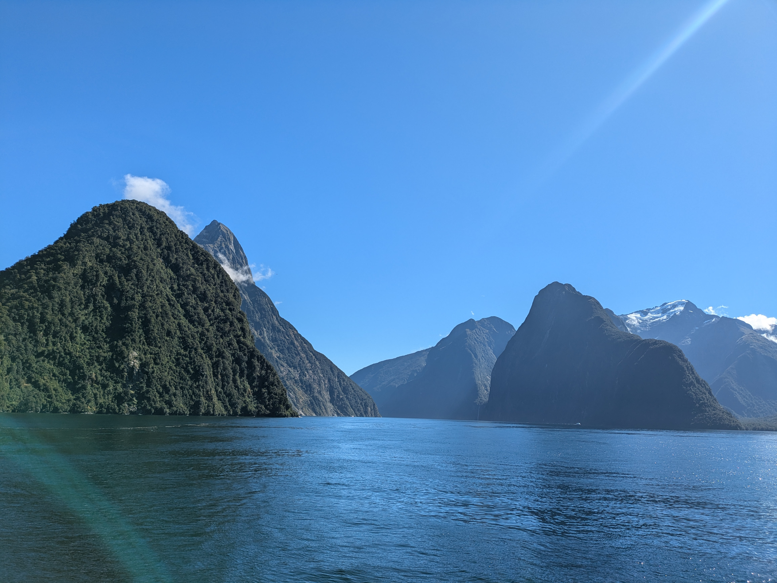

BRITISH CARDIOVASCULAR INTERVENTION SOCIETY
Join the conversation using #BCISAHP
Notes:
Here I am living my best life in Milford Sound, taking the standard tourist images of the incredible views.

Slide 7
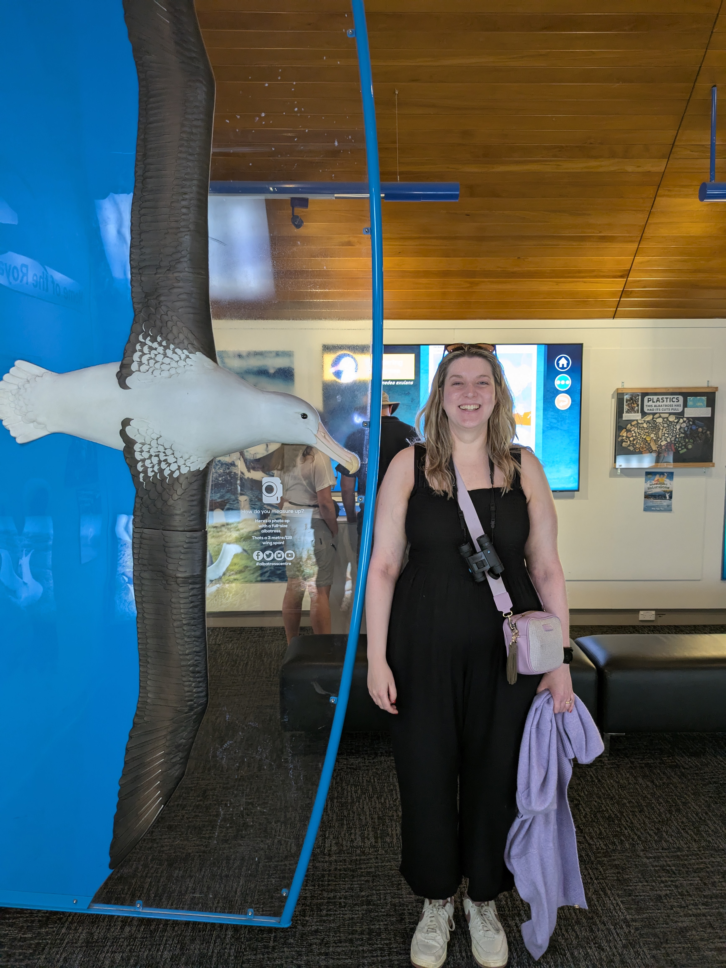
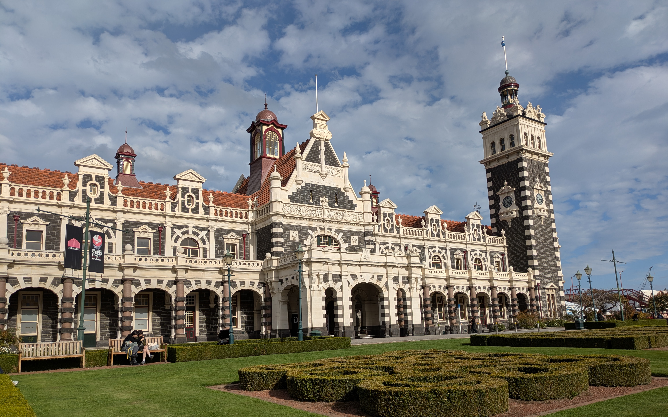
BRITISH CARDIOVASCULAR INTERVENTION SOCIETY
Join the conversation using #BCISAHP
Notes:
Here's me seeing how I measure up to an albatross... I think I did it wrong but I was having the best day in Dunedin.
So good that we went for a wee drink that night across the road from our apartment.
I had an alcohol-free ginger beer.
But it was a local one and not the same as the ones I had had every day of the trip so far.
A quick squint at the label, should be fine.
It was not fine.
I was not fine.

Slide 8
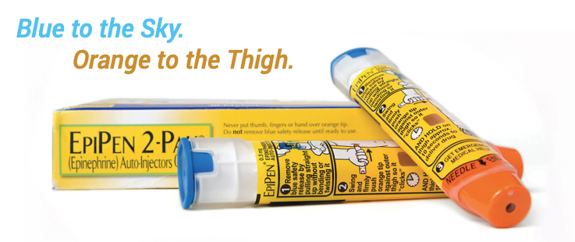
BRITISH CARDIOVASCULAR INTERVENTION SOCIETY
Join the conversation using #BCISAHP
Notes:
This was not like the reactions I had had before.
This was instant
My throat felt tight, it was getting harder to breathe and I felt faint.
Drank water and took another antihistamine
I remembered my ABCs and knew it was anaphylaxis
Took my first pen, blue to sky orange to thigh
Called for help – James and barmaid
Got myself to the floor, struggling to breathe and propped myself up
Rather alarmingly I started to struggle to talk too
5 mins after first pen took the second.
It helped a bit but I still felt awful.
Told my husband if I lost consciousness to start CPR.
Paramedics came and scooped me up
Couldn't find access
Put me on a shoogly trolley and strapped me up.
ECG, O2 sats couldn't find any as I had gel done for the trip, O2 mask
Had a jumpsuit on... made access interesting
Wheeled straight to resus where a consultant and 2 nurses were waiting
IV fluids, heated blankets, steroids
Time, observations, o2
Intubation tray ready beside me
Throat/airways kept getting tighter, adrenaline neb given (husband later said I looked like Darth Vader, the wheezing also didn't help with that)
Watching, waiting, more obs more monitoring
Threat subsided and put to cubicle after 4 hours
Chest pain, another ECG.
Not cardiac but oeosophageal spasm... gross.
Eventual discharge with prescription for steriods, more epipens and a letter for my healthcare team at home.

Slide 9
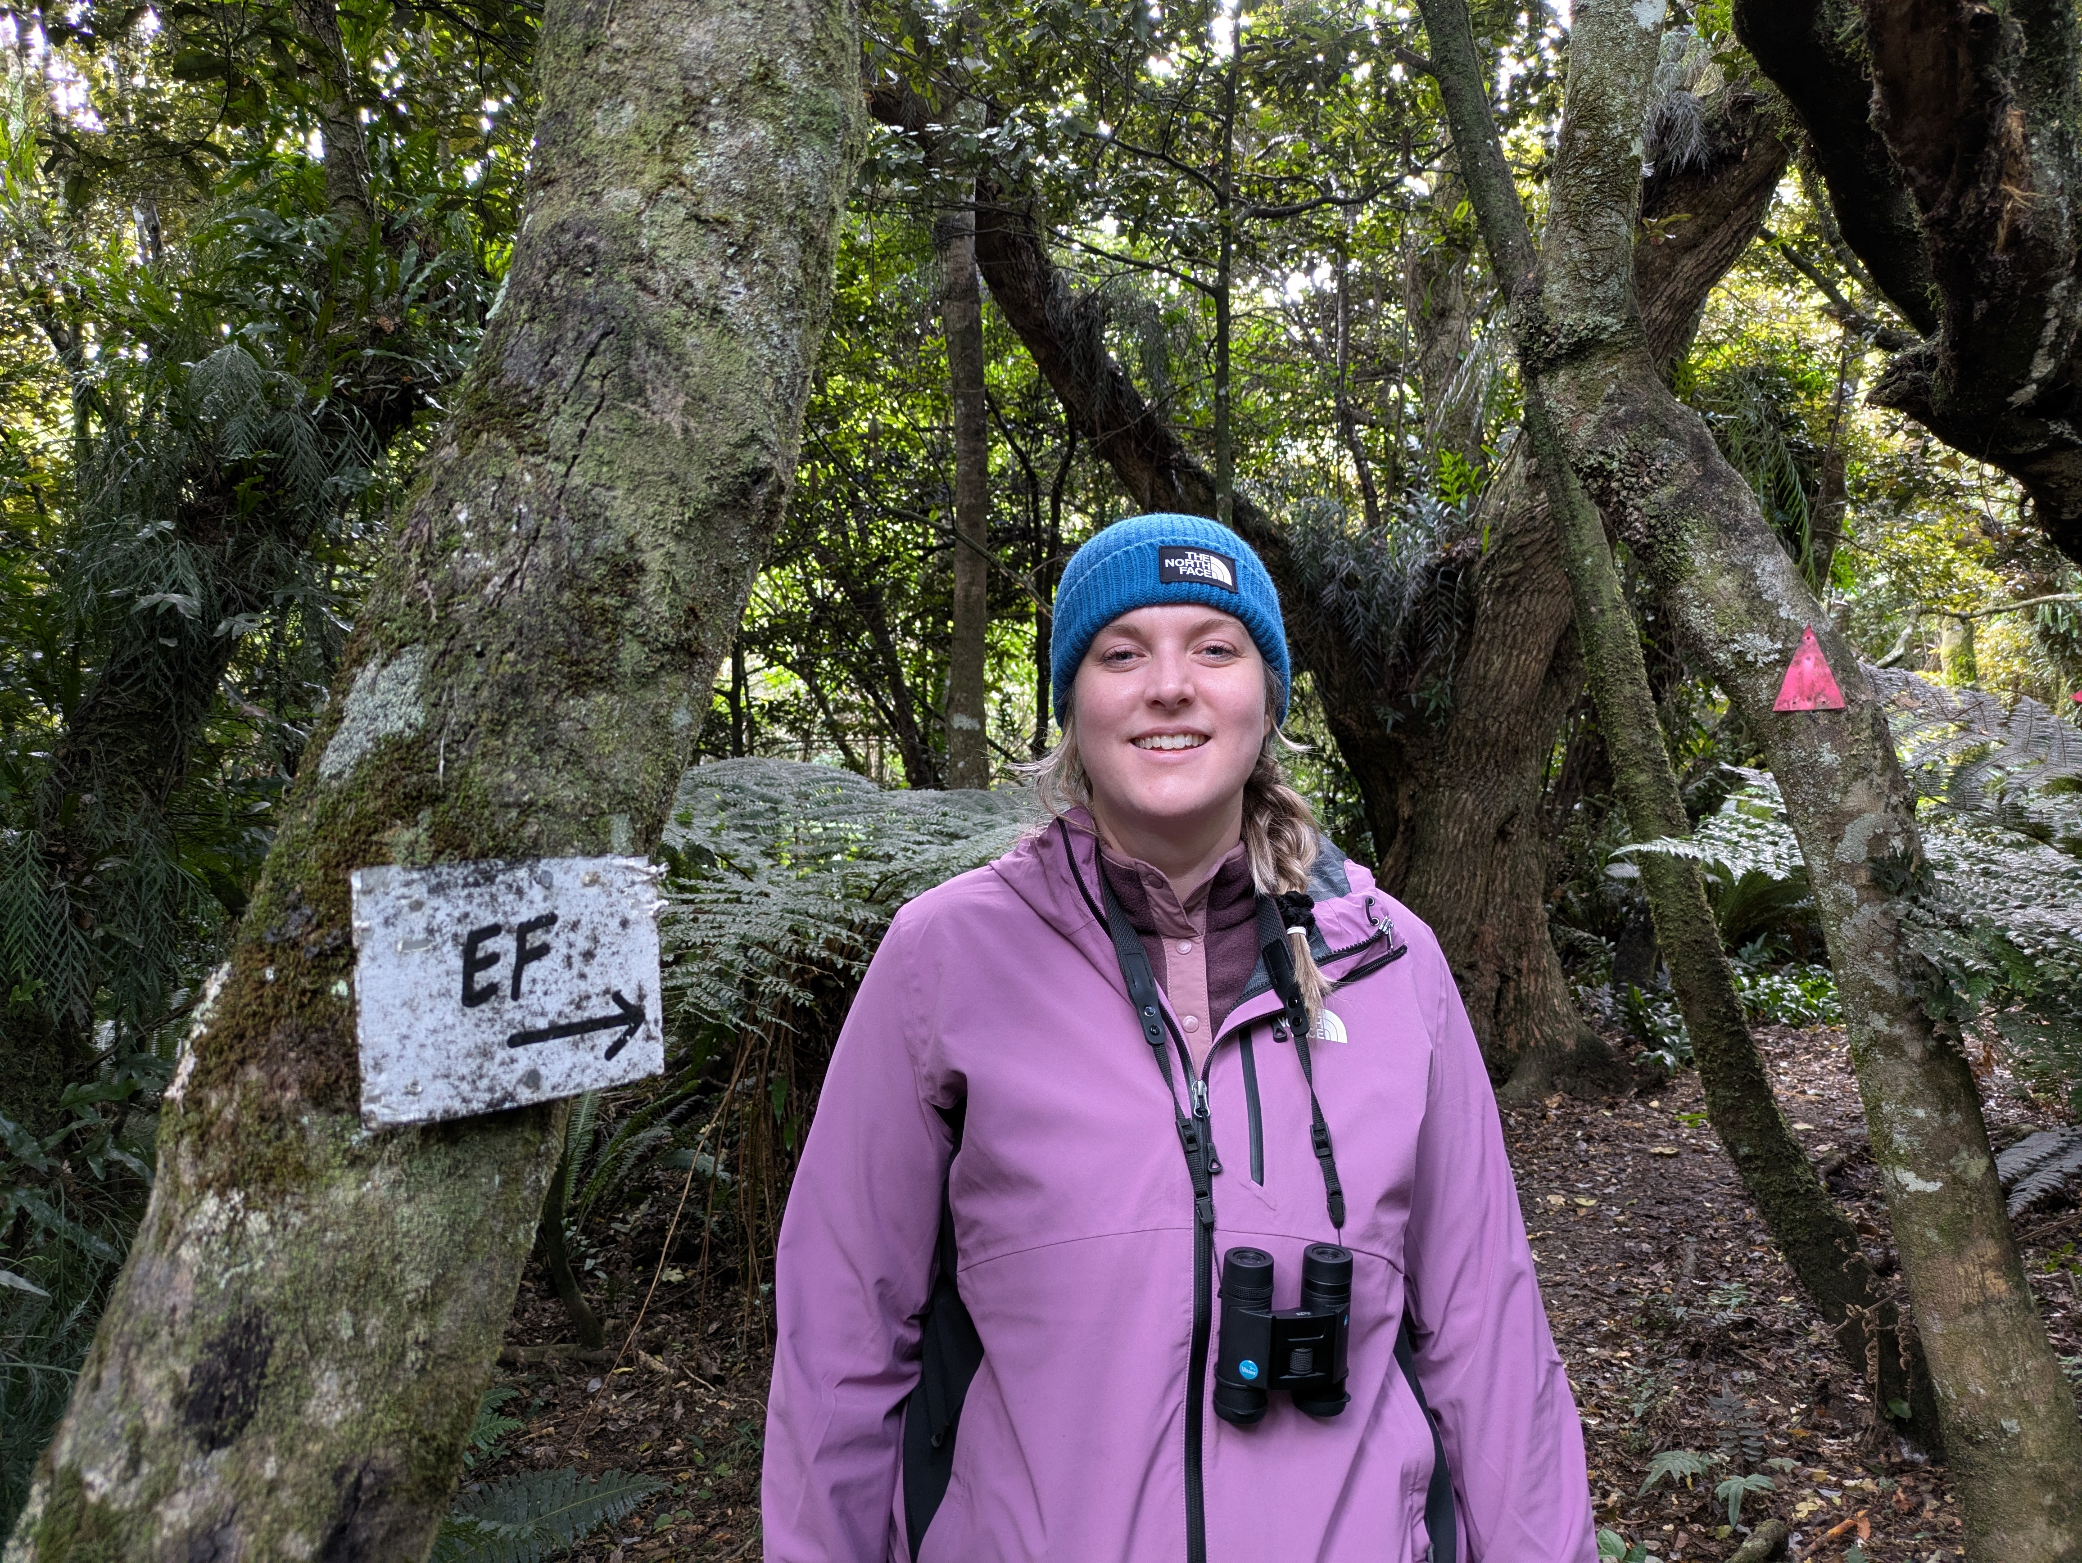
BRITISH CARDIOVASCULAR INTERVENTION SOCIETY
Join the conversation using #BCISAHP
Notes:
This is me the afternoon after, in an eco-sanctuary. Back to living my best life, determined to make the most of the rest of my trip.
My married name is Friel, so this was the picture my husband sent to my family as proof of life.
You can see how spaced out I look and puffy I am.

Slide 10
SECTION
Anaphylaxis Algorithm
AHP ANNUAL CONFERENCE 2026
Notes:
A question I was asked by concerned colleagues when I returned to work was how did I know to use my epi-pens?
Thanks to training from an anaesthetist at Ninewells.
If ABCs are off, use the pen. My CCL training saved my life.
Other's curiosity made me think that my colleagues would benefit from training in allergy and anaphylaxis.
I came back from NZ and for a variety of reasons looked to move to Glasgow, secured a job at Hairmyres Hospital.
I then had to navigate a new place and felt empowered to deliver allergy and anaphylaxis training.
HR made my new bosses do many risk assessments, OH referrals and put together a training plan for my new colleagues.
They had to do pre-reading to work with me.
Poor souls.

Slide 11
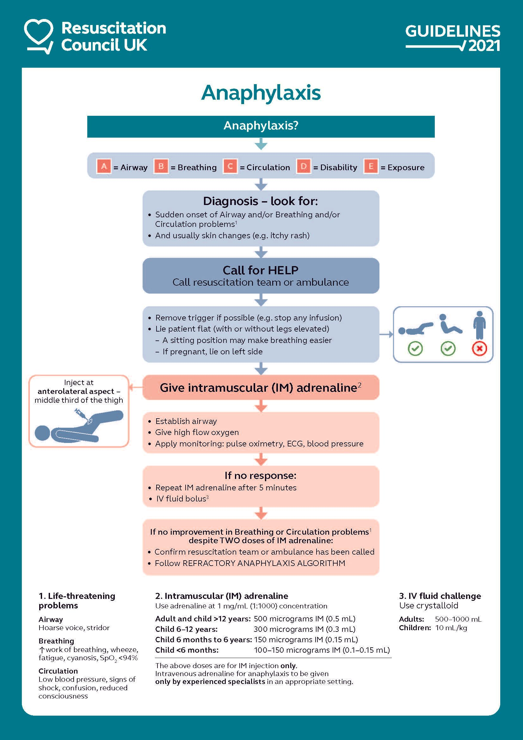
BRITISH CARDIOVASCULAR INTERVENTION SOCIETY
Remember your ABCs...
https://www.resus.org.uk/library/additional-guidance/guidance-anaphylaxis
Notes:
This diagram is everywhere in our departments for me and others
Allergy – body's immune system overreacting.
Recognising that an allergic reaction is happening vs anaphylaxis
Redness, itchiness (eyes, ears, lips, mouth, throat)
Sneezing
Wheezing
Rash/hives
Swelling locally
Sickness, D&V
Anaphylaxis – think ABC
Airway – hoarse voice, stridor
Breathing, - inc WOB, wheeze, fatigue, cyanosis, desaturations
Circulation – low BP (feeling faint), signs of shock, confusion, reduced consciousness.

Slide 12
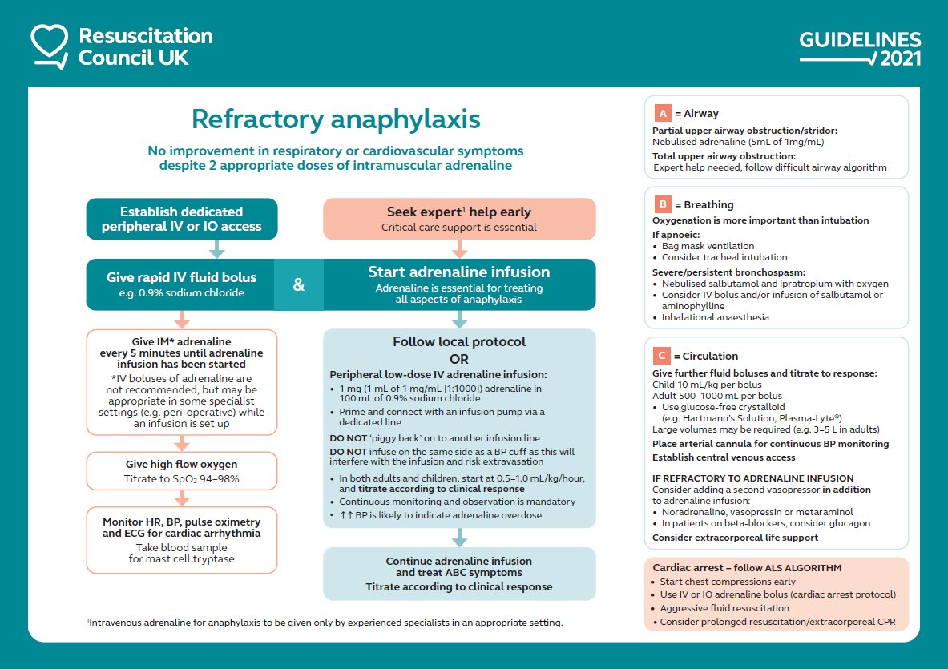
https://www.resus.org.uk/library/additional-guidance/guidance-anaphylaxis
Join the conversation using #BCISAHP
Notes:
This is the UK version of what the kiwi Drs did for me.
It is very clear and we need not know every step.
As part of my new role I now perform CT and give IV injections of contrast agents.
This took me a wee while to get my head around as I did not like the thought that others could have reactions at my hand.
But, I am trained to prevent, react and seek help in cases of contrast reaction.

Slide 13
SECTION
Handling Allergies in the CCL
AHP ANNUAL CONFERENCE 2026
Notes:
There are many opportunities to spot potential safety issues prior to the procedure – contrast is our most common reaction, but it could be anything, latex allergy, drug allergies, food reactions can predispose (shellfish, iodine), chloroprep etc etc
And, this might be the first time the patient comnes into contact with something/has a reaction

Slide 14
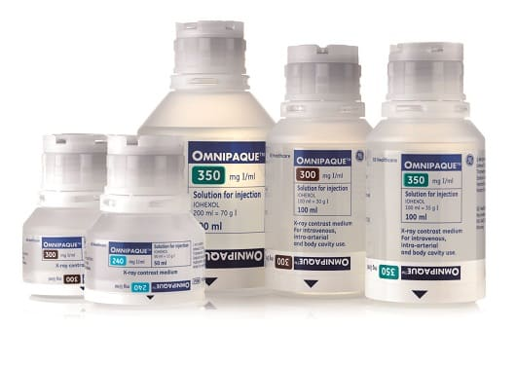
BRITISH CARDIOVASCULAR INTERVENTION SOCIETY
Imaging Referral
Patient Wristband
Safety Checklist
Nursing & Medical Notes
Safety Pause
Join the conversation using #BCISAHP
Notes:
Referral – clinical history, previous reactions flagged in red, have they had contrast before? Looking at the global PACs for evidence of other scans/contrast given
Wristband – red for allergies or drug sensitivities
Safety checklist – questions to ask which might heighten the risk of reactions – asthma, eczema, allergies (
We have a similar checklist in CT to screen for potential contrast contra-indications.)
Nursing & medical notes – we don't have access to much, but the nurses often have more information about the patient
Safety pause – is everyone happy including the patient?

Slide 15
SECTION
Case Discussion
AHP ANNUAL CONFERENCE 2026

Slide 16
BRITISH CARDIOVASCULAR INTERVENTION SOCIETY
Case discussion – August 2025
58 y/o Male
Indication – stable angina
Access – right brachial artery access obtained
Join the conversation using #BCISAHP
Notes:
Case started as normal – diagnostic catheters used

Slide 17
BRITISH CARDIOVASCULAR INTERVENTION SOCIETY
Case discussion – August 2025
58 y/o Male
Diagnostic Findings:
    Left Anterior Descending artery - mild stenosis
    Circumflex artery - moderate stenosis
    Right Coronary artery - severe stenosis
Join the conversation using #BCISAHP

Slide 18
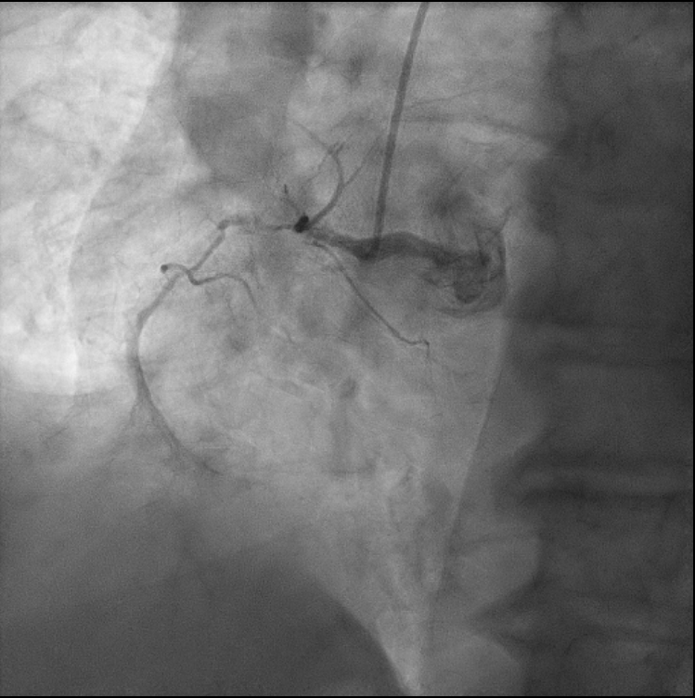
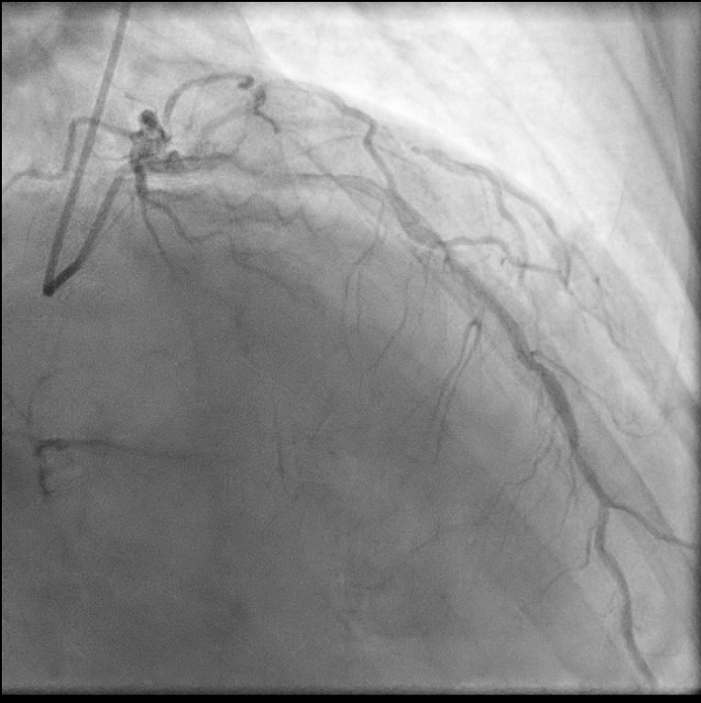
BRITISH CARDIOVASCULAR INTERVENTION SOCIETY
Case discussion – August 2025
Join the conversation using #BCISAHP
Notes:
Case started as normal – diagnostic catheters used

Slide 19
BRITISH CARDIOVASCULAR INTERVENTION SOCIETY
PROCEDURE ABANDONED
Join the conversation using #BCISAHP
Notes:
"previous history of facial swelling" mentioned in request
Note on RIS:
patient had contrast allergy so procedure had to be stopped. Patients got extremely hot and face started to swell. came out in rash over shoulders/chest/face. given piritin, steroids and hydrocortisone. Patient had previous contrast allergy at Stobhill however was very mild.
Recorded as: Feeling of Heat - patient felt hot, face swelling, rash over face/shoulders/chest, breathing difficulties (although sats were fine)
Lab report by operator:
- planned to wire RCA but developed severe facial flushing and dyspnoea
Given piriton and hydrocortisone but symptoms persisted
Opted to stop – moved to ward for nebulise and monitoring
Consider bring back for PCI

Slide 20
BRITISH CARDIOVASCULAR INTERVENTION SOCIETY
October 2025
Planned PCI to RCa
Patient pre-treated with IV Hydrocortisone & Piriton
Visipaque contrast media used
Outcome:
    Multiple wire/balloon attempts but unable to cross lesion
    Procedure abandoned
Join the conversation using #BCISAHP
Notes:
Radiographer note on RIS:
Previous contrast reaction.
Patient was loaded with hydrocortisone and visipaque used - patient well after procedure.
Multiple wire / balloon attempts but unable to pass. Abandoned procedure.

Slide 21
SECTION
Reducing Risks
AHP ANNUAL CONFERENCE 2026

Slide 22
BRITISH CARDIOVASCULAR INTERVENTION SOCIETY
Checklists
Recognise Reactions
Respond Rapidly
Timely Treatment
Documentation
Join the conversation using #BCISAHP
Notes:
Checklists are our friends
We do not need to remember everything
Pre-procedure pause
Pick up if they are at risk of reactions – shellfish, iodine is important

Slide 23
BRITISH CARDIOVASCULAR INTERVENTION SOCIETY
Checklists
Recognise Reactions
Respond Rapidly
Timely Treatment
Documentation
Join the conversation using #BCISAHP
Notes:
Keep an eye on your patient
As radiographer we are in a unique position to watch patient for movement – breathing normally
Can we see their skin?
Are they talking/alert and responsive
Techs and other staff keeping eye on vital signs
First clue something is wrong can be patient distress
However, it's not always a reaction – could be major haemorrhage, could be shock, could be loads of things

Slide 24
BRITISH CARDIOVASCULAR INTERVENTION SOCIETY
Checklists
Recognise Reactions
Respond Rapidly
Timely Treatment
Documentation
Join the conversation using #BCISAHP
Notes:
Say out loud what it is – this is anaphylaxis/ allergic reaction
Get help, more hands are always helpful
Do we need a call out?
Do we need anaesthetics?
Do we need to stop the procedure until we are in a safe position to continue?
ALS/BLS roles assigned

Slide 25
BRITISH CARDIOVASCULAR INTERVENTION SOCIETY
Checklists
Recognise Reactions
Respond Rapidly
Timely Treatment
Documentation
Join the conversation using #BCISAHP
Notes:
Follow your flow charts for anaphylaxis

Slide 26
BRITISH CARDIOVASCULAR INTERVENTION SOCIETY
Checklists
Recognise Reactions
Respond Rapidly
Timely Treatment
Documentation
Join the conversation using #BCISAHP
Notes:
My mum a nurse of over 30 years... if you don't document it didn’t happen
Document it.
Record it in the RIS record, then an alert is present for any further imaging.
They should get a red wristband too.

Slide 27
Thank you
emily.wilson@lanarkshire.scot.nhs.uk
Join the conversation using #BCISAHP
Notes:
Closing slide. Add your contact / handle for follow-up questions.

